Slide 1

Creative Commons Licensing
You are free:
to Share — to copy, distribute and transmit the work
to Remix — to adapt the work
Under the following conditions:
Attribution — You must attribute the work in the following manner:
  This work is based on an original work of the Core Knowledge® Foundation made available through licensing under a Creative Commons Attribution-NonCommercial-ShareAlike 3.0 Unported License. This does not in any way imply that the Core Knowledge Foundation endorses this work.
Noncommercial — You may not use this work for commercial purposes.
Share Alike — If you alter, transform, or build upon this work, you may distribute the resulting work only under the same or similar license to this one.
With the understanding that:
For any reuse or distribution, you must make clear to others the license terms of this work. The best way to do this is with a link to this web page: http://creativecommons.org/licenses/by-nc-sa/3.0/

Slide 2
Overview &
Design Principles
Core Knowledge Language Arts
© 2014 Core Knowledge Foundation. This work is licensed under a Creative Commons Attribution-NonCommercial-ShareAlike 3.0 Unported License. www.creativecommons.org/licenses/by-nc-sa/3.0

Slide 3
Objectives
We will be able to:
explain the significance of starting instruction with the most frequent or least ambiguous sounds;
describe how the Skills strand provides students with intensive practice that enables them to build reliability and automaticity;
describe how the domain structure of the Listening and Learning strand supports children’s comprehension and background knowledge;
identify at least two ways the Listening and Learning materials support vocabulary learning.

Slide 4
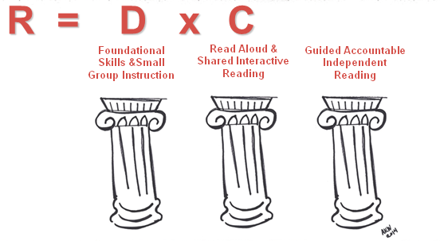
The Three Pillar Model of
Language Arts Instruction

Slide 5
R = D x C
Skills Strand
  Decoding and Encoding:
  Systematic Synthetic Phonics
  Handwriting
  Grammar
  Spelling
  Expressive Writing /The Writing Process
Listening & Learning
  Language Comprehension:
  Oral Read-aloud
  Text-based Discussion
  Word Work
  Extension Activities that Provide Students with the Opportunity to use New Language and Concepts

Slide 6
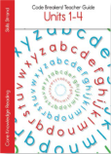
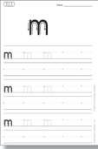
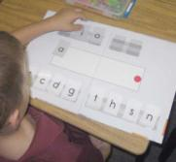
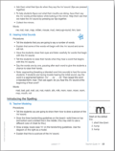
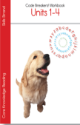
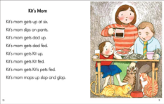

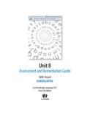
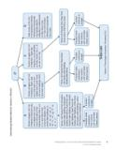
Overview of Skills Materials
Teacher Guides
Student Workbooks
Ancillary Materials
Student Decodable
Readers
Assessment & Remediation Guides
Big Books

Slide 7
Skills Strand Instruction
10 – 12 Lesson Types Per Grade
  Phonics & Reading
  Grammar
  Spelling
  Writing
Gradual Release Modeled Through Lessons
  Warm-up
  Explicit Instruction
  Model
  Group Practice
  Independent Practice
  Independent Application

Slide 8

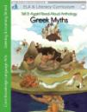





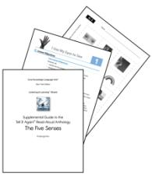

CKLA Materials
Teacher Anthology
Image Cards
Supplemental
Guide
Flip Book

Slide 9
Listening & Learning Instruction
Stays on topic for 2 – 3 weeks
Single Lesson Type Across Grades
Each Lesson Includes:
  Read-aloud
    Introduction to the Read Aloud
    Presenting the Read Aloud
  Discussion
    Comprehension Questions
    Word Work
  Extension Activity

Slide 10
Key Design Principles of the
Skills Strand
A Systematic Approach

Slide 11
What is the Significance of 270?
26 Letters
  A B C D E F G H I J K L M N O P Q R S T U V W X Y Z
52 Total with Upper- and Lowercase
  a b c d e f g h i j k l m n o p q r s t u v w x y z
16 Distinctly Different Uppercase
  A B D E F G H I J K L M N Q R T
44 sounds
  26 consonant, 18 vowel
150 spellings
  /ie/ = ie | i_e | igh | y | ye | y_e
Directionality ➔ ⬇

Slide 12
What We Know
Early Systematic Instruction in phonics seems to lead to better achievement in reading than later, less systematic instruction.
Unless decoding is automatic, there is little cognitive capacity to think about meaning.
Reliable decoding is more efficient than context cues.
Specific objectives, rather than broad goals, should inform both practice and assessment.
Practice leads to automaticity.

Slide 13
CKLA Teaches Children the Distinction Between Sounds and Spellings Using the Most Frequent or Least Ambiguous Sounds First.
DESIGN PRINCIPLE

Slide 14
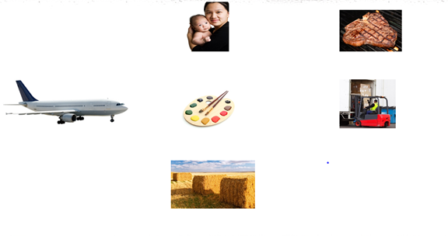
Sound:
/ae/
Spellings:
baby
steak
plane
paint
freight
hay
greyhound
14

Slide 15
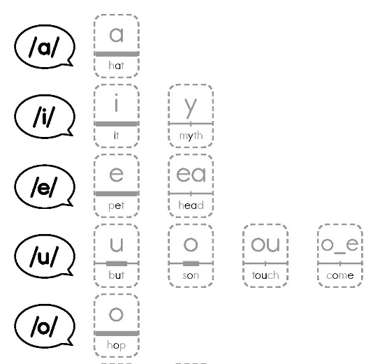
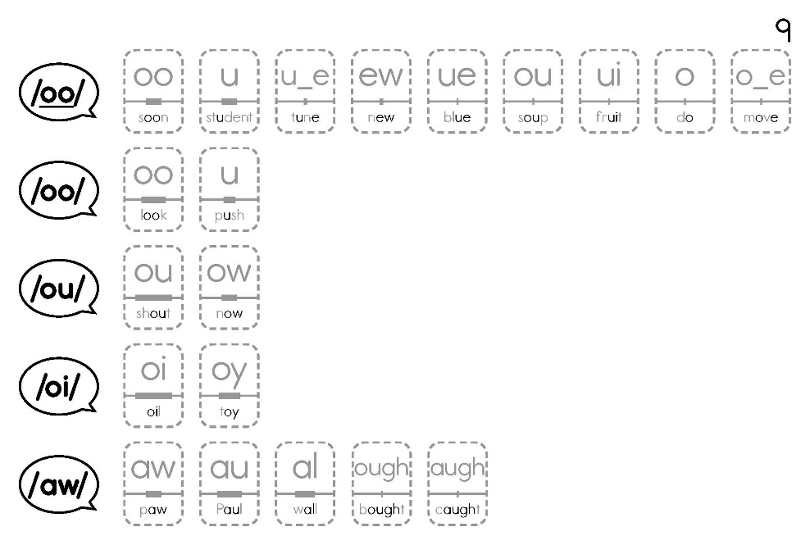
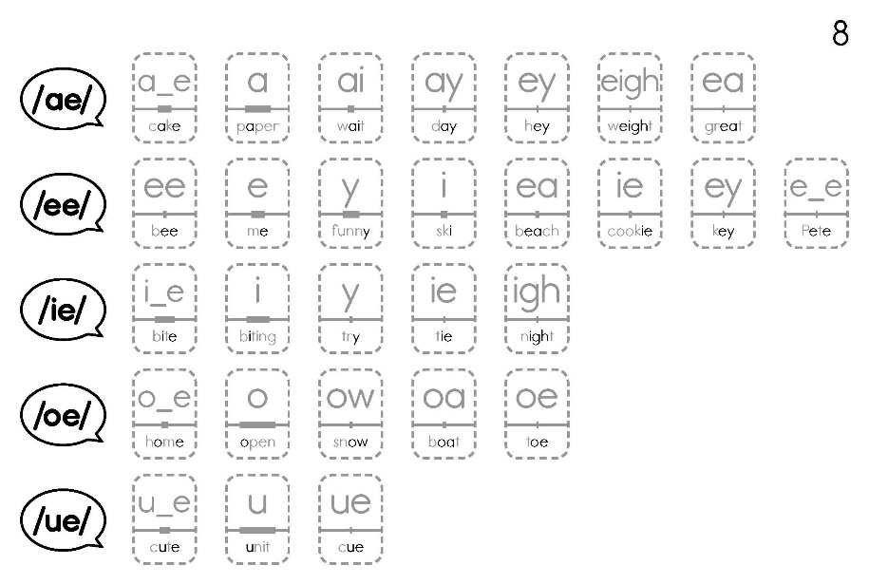
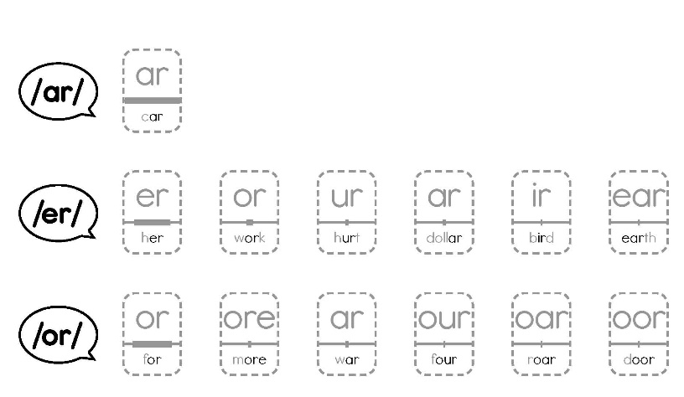
Basic Code: Vowels

Slide 16
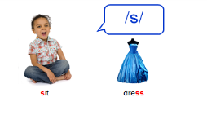
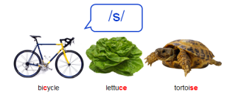
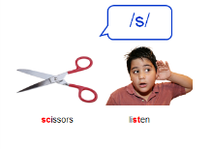
Most Frequent, Least Ambiguous
Consonant Spellings
K
1
2

Slide 17

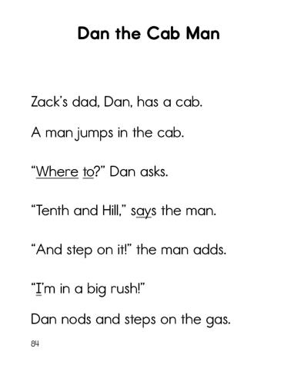
The Value of Most Frequent, Least Ambiguous Sound

Slide 18
CKLA Gives Intensive Practice to Build Reliability and Automaticity.
DESIGN PRINCIPLE

Slide 19
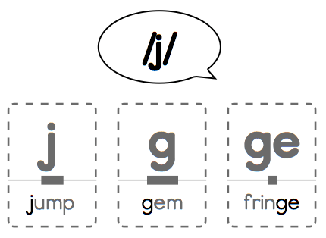
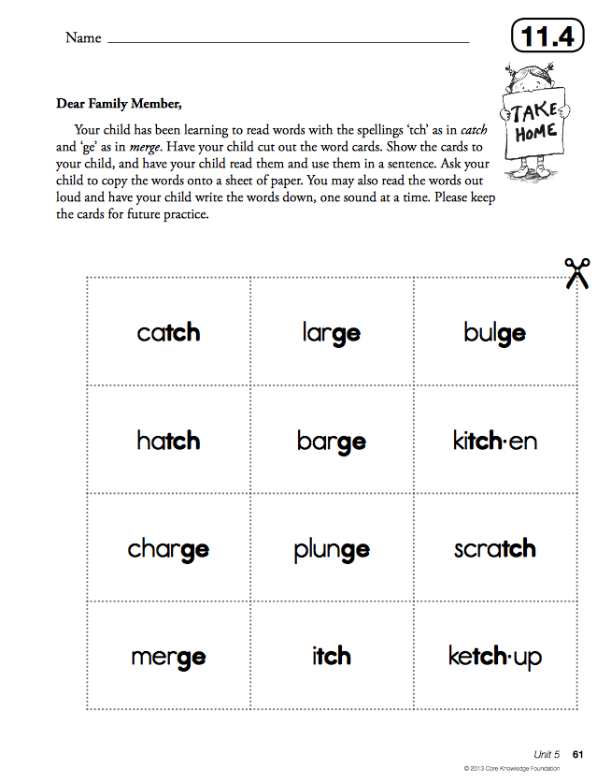
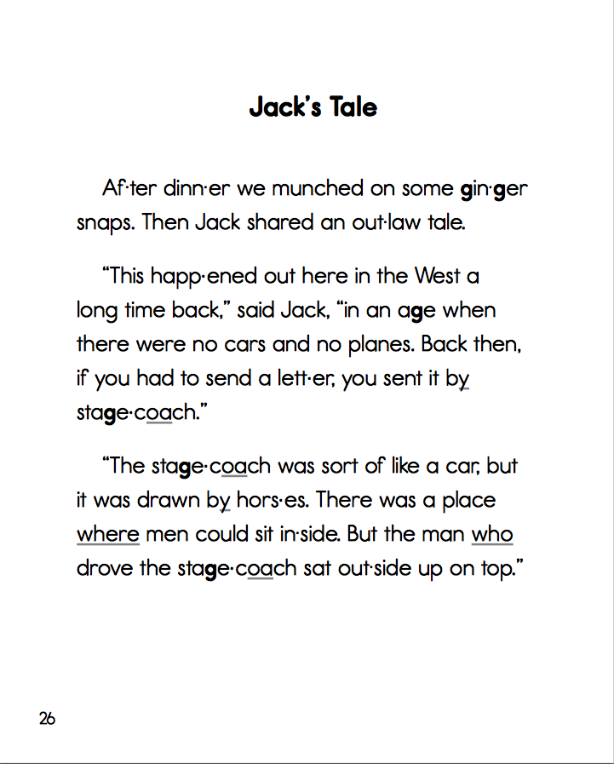
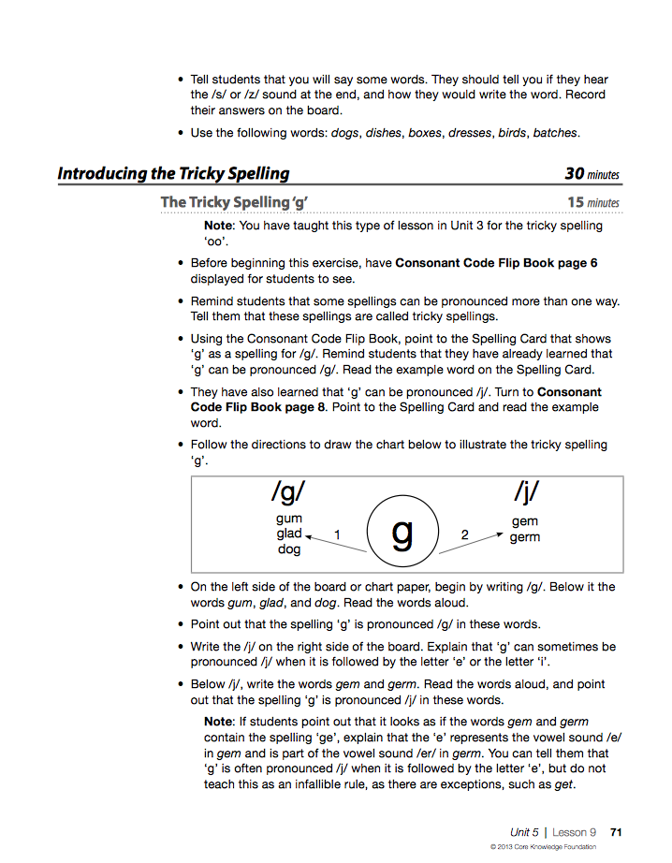
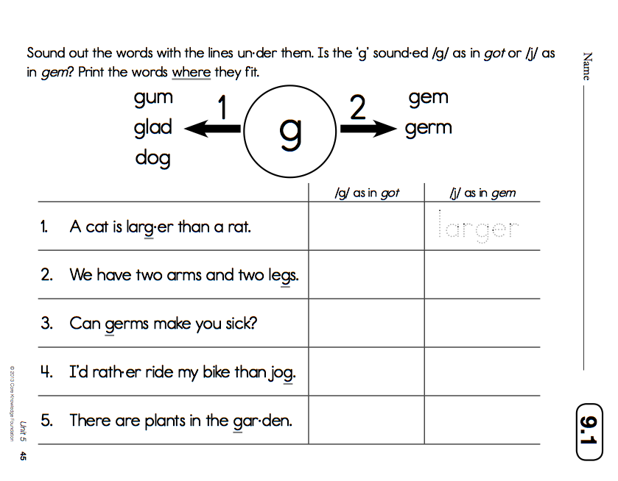
Intensive Practice through the Day’s Lesson

Slide 20
Areas of Confusion
Every sound can differ by:
Place: Where your lips, tongue and teeth are
Manner: How the air flows (burst or flow)
Voicing: Whether your voice box is on (voiced) or off (voiceless).
Minimal pairs differ in only one dimension:
  /c/, /g/ place
  /p/, /b/ manner
  /s/, /z/ voicing
  /m/, /n/ place
  /sh/, /ch/ manner
  /t/, /d/ voicing

Slide 21
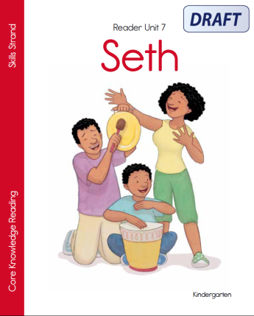
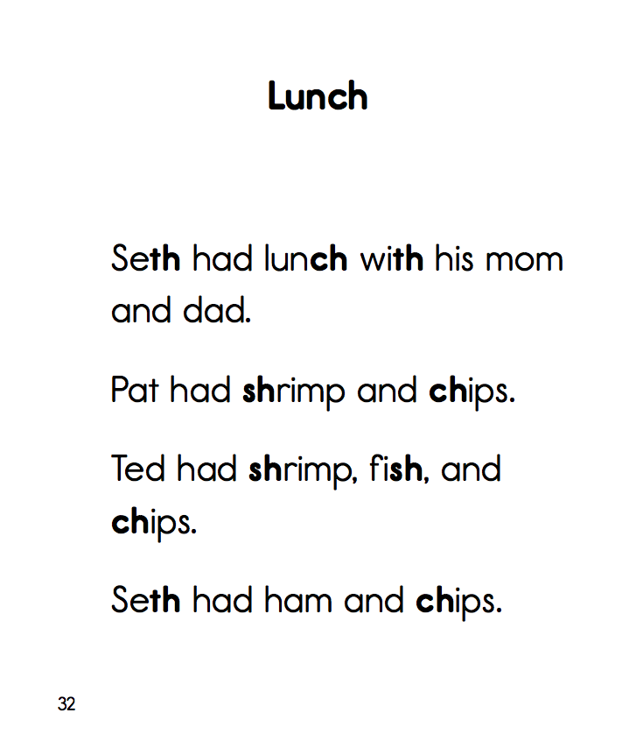
Practice in Making Distinctions

Slide 22
CKLA Directly Instructs in those Oral Language Skills (Blending & Segmenting) that Underlie And Parallel Reading And Writing Skills.
DESIGN PRINCIPLE

Slide 23
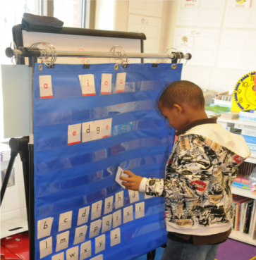
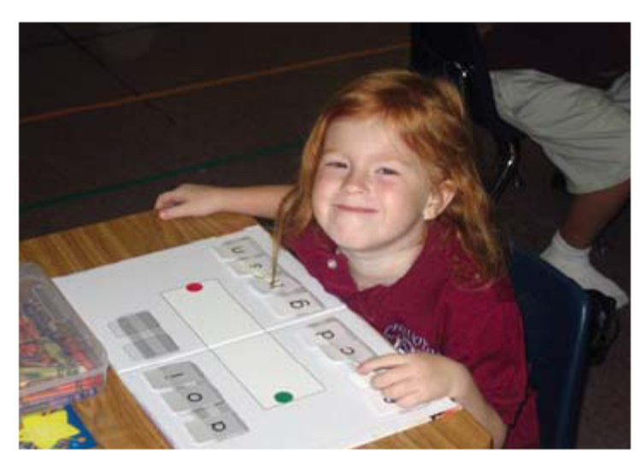
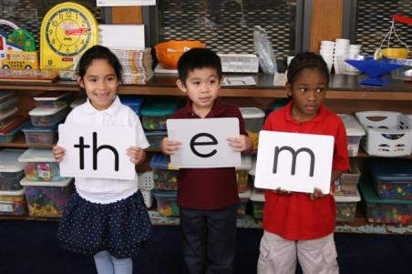
Blending and Segmenting
mat > met > pet > pit > it > hit > him > hem > them

Slide 24

A Strong Foundation
Road Signs & Rules
Directions
Guided Practice
Care and Use
24

Slide 25

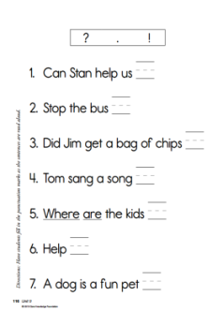
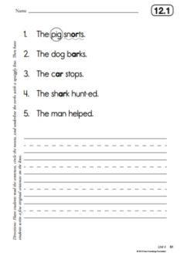
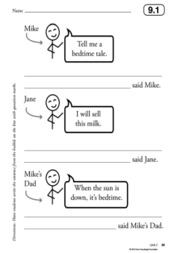

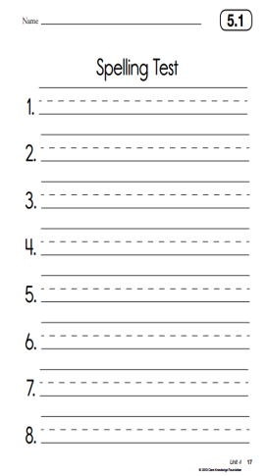
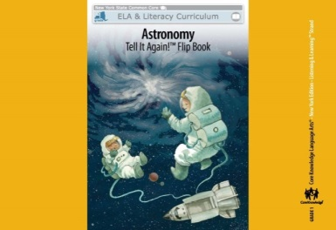
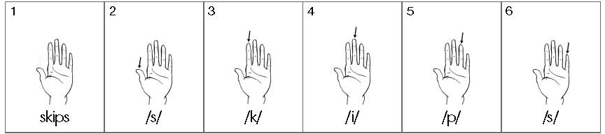
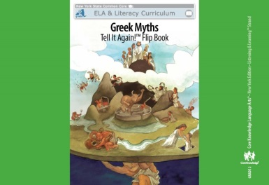
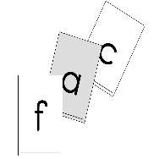
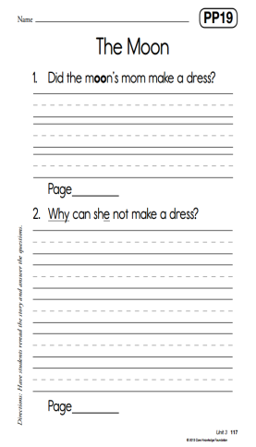
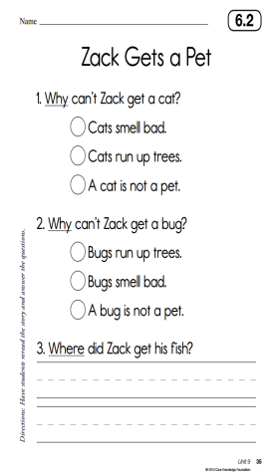
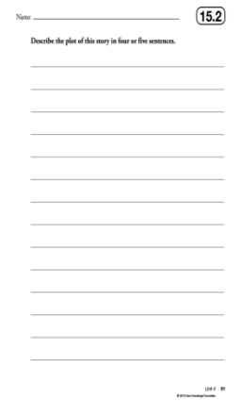
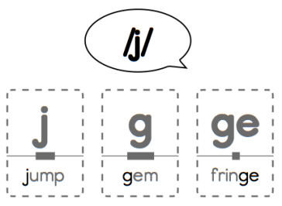

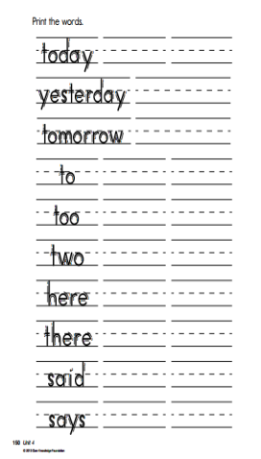
A Strong Foundation
Spelling & Grammar
Listening & Speaking
Phonics, Handwriting, & Reading
Genre Writing & Response to Text
25

Slide 26
Key Design Principles of Listening and Learning
Building Knowledge and Language Systematically
© 2014 Core Knowledge Foundation. This work is licensed under a Creative Commons Attribution-NonCommercial-ShareAlike 3.0 Unported License. www.creativecommons.org/licenses/by-nc-sa/3.0

Slide 27
CKLA uses Read-alouds to Support Oral Language Skills that Underlie and Parallel Reading and Writing Skills.
DESIGN PRINCIPLE

Slide 28
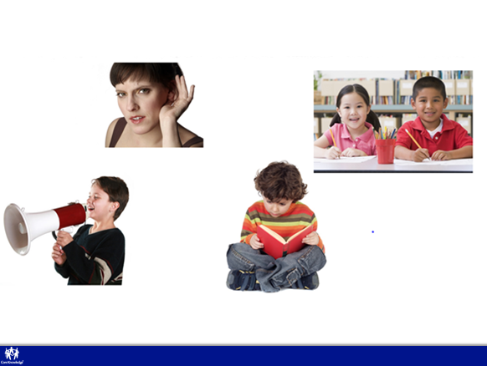
Language Development
Oral
Written
28

Slide 29
Written Language Uses Richer Vocabulary
Hey, stop by my house later!
You are
cordially
invited…

Slide 30
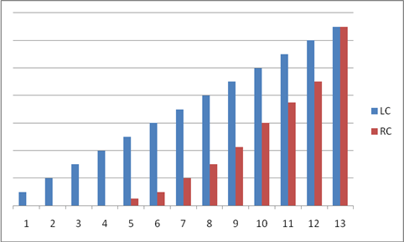
Listening Comprehension (LC) versus Reading Comprehension (RC)
T. G. Sticht, 1974, 1984

Slide 31
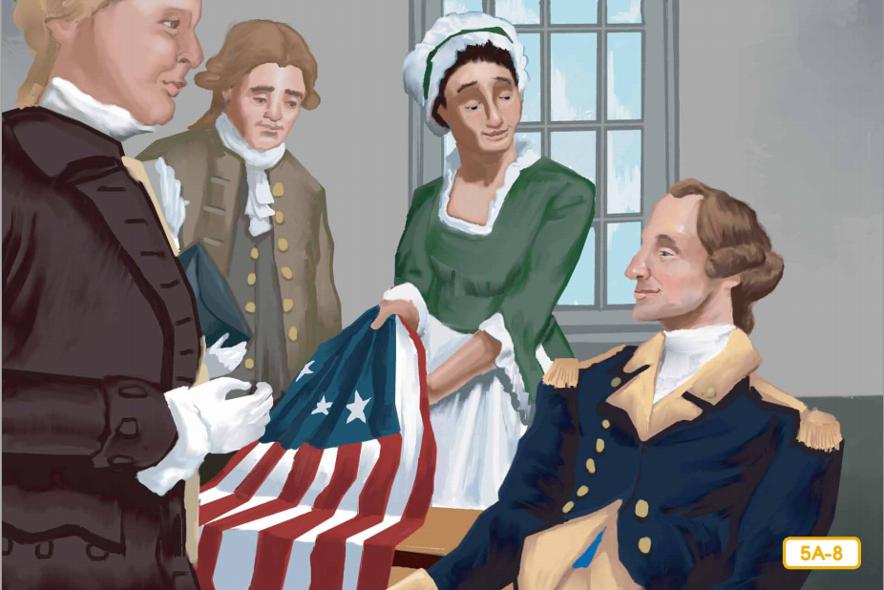
Knowledge Helps Fill in Gaps
Simple texts, like those on reading tests, are filled with gaps –presumed domain knowledge– that the writer assumes the reader knows.

Slide 32
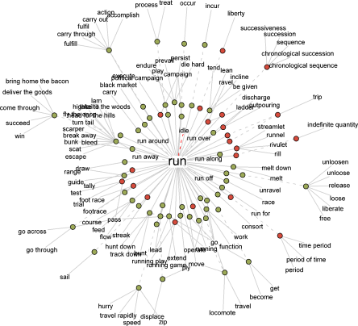
Knowledge Helps
Resolve Ambiguity
run
http://www.visualthesaurus.com/

Slide 33
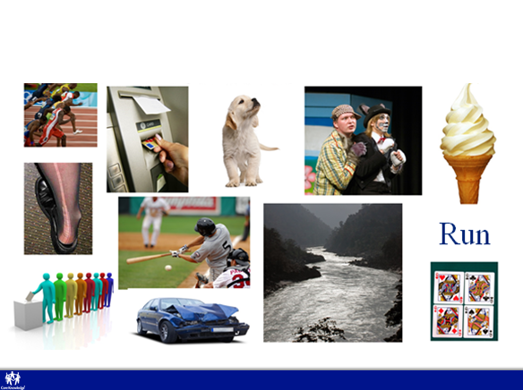
Knowledge Helps
Resolve Ambiguity

Slide 34

The CKLA Listening & Learning Strand Uses Knowledge-Building Complex Texts

Slide 35
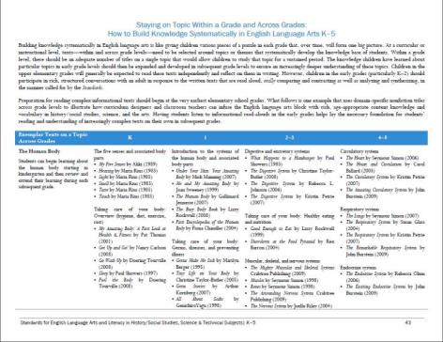
What Does It Mean to Build Knowledge Systematically?
“Building knowledge systematically in English language arts is like giving children various pieces of a puzzle in each grade that, over time, will form one big picture. At a curricular or instructional level, texts—within and across grade levels—need to be selected around topics or themes that systematically develop the knowledge base of students.”

Slide 36
CKLA Systematically Builds Knowledge
DESIGN PRINCIPLE

Slide 37
What We Know
Knowledge builds on knowledge
All of our most desirable goals for education are all knowledge dependent:
  Creativity
  Problem solving
  Reading comprehension
  General achievement
Knowing things allows us to expend the smallest amount of cognitive capacity on processing lower-order aspects of a problem so that more cognitive capacity is available for higher levels

Slide 38
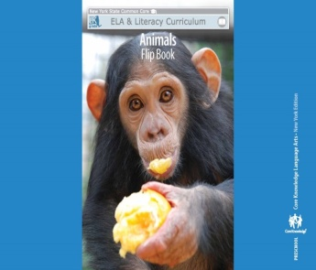









Coherence

Slide 39

Systematic Knowledge Building

Slide 40
CKLA Stays On Topic To Foster The Most Efficient Word Learning
DESIGN PRINCIPLE

Slide 41

ex
cres
cence


© 2014 Core Knowledge Foundation. This work is licensed under a Creative Commons Attribution-NonCommercial-ShareAlike 3.0 Unported License. www.creativecommons.org/licenses/by-nc-sa/3.0

Slide 42
What We Know
Most vocabulary is learned implicitly.
Word learning is most efficient when the reader (listener) already understands the context well.
Making tiny gains on a dozen words is more efficient than large gains on just one word at a time.
What makes vocabulary valuable and important is not the words themselves so much as the understandings they afford.

Slide 43



What are Kings and Queens?

Slide 44

Building Webs of Words in Domains

Slide 45


Sections 3 & 4

Slide 46
Systematic Knowledge Building

Slide 47

Leveling the Playing Field
Jumping from topic to topic and landing briefly on each privileges children who know something about those topics from elsewhere.
      Liben & Liben, 2012

