Slide 1
Power Challenge:
Standing Broad Jump
Share with me in the chat what your longest jump was!

Slide 2
Unified PE
Day 15: Speed

Slide 3
Agenda
What are we doing??
Learning Goal
Vocabulary
Warm up: Speed challenges
Activity: Halloween choice workout
Cool down: Unwind Yoga Stretches
What’s Due??
Exit ticket – available in announcement and under “lesson materials” module

Slide 4
Learning Goal
I can develop my personal fitness to stay healthy and active at home

Slide 5
Vocabulary
Speed: the rate at which something or someone can move
Brain Bites: Speed

Slide 6

Warm-up Challenge #1: Speed Bounce Challenge
Directions:
Lay out a sock or use a tape line as a marker
Jump and land two-footed on the other side of the marker
Count how many you can do in 20 seconds
Speed Bounce Challenge

Slide 7
Warm-up Challenge #2: Sock Ladder Challenge
Directions:
Lay out 4 socks like rungs of a ladder
Step between the rungs working your way along the ladder then back again
Both feet must touch the floor in each space between rungs
Up & back = 1
Count how many you can do in 20 seconds
Sock Ladder Challenge

Slide 8
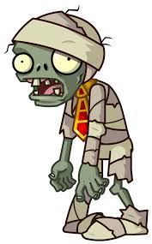
Activity: Halloween Workout
Directions:
Class vote for which workout we will complete (Halloween vs. Zombie)
Follow along with the video – 30 seconds of exercise, 10 seconds of rest
Complete the other workout for “asynchronous” day on Thursday (will link to announcements)
Halloween Workout or Zombie Workout

Slide 9
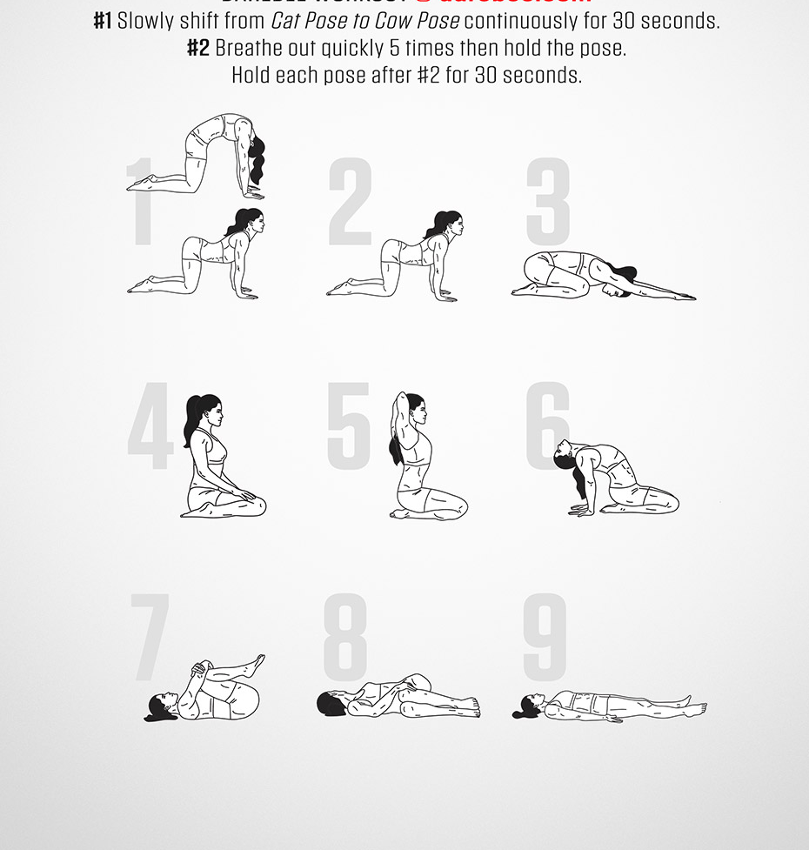
Cool Down: Unwind Yoga Stretches
Directions:
#1 – Slowly shift from Cat Pose to Cow Pose continuously for 30 seconds
#2 – Breathe out quickly 5 times then hold the pose
#3 – Hold poses 3-9 for 30 seconds each

