Slide 1
Unified PE
Day 14: Power

Slide 2
Agenda
What are we doing?
Learning Goal
Vocabulary
Warm-up: Teacher-Led
Activity: Rock, Paper, Scissors Fitness
Cool-Down: 6-minute yoga chill
What’s due?
Exit ticket – available in announcement and under “Live Lesson Materials” Module
Power Challenge: Broad jump

Slide 3

Learning Goal
I can develop my personal fitness to stay healthy and active at home

Slide 4
Vocabulary
Power: The ability to produce a maximum amount of work in the shortest amount of time
Brain Bites - Power

Slide 5
Warm-up
Repeat the following exercises 2x
30 seconds jog in place
10 High Kicks
15 Squats
15 Curl ups
20 second Plank
20 second Arm circles
10 Alternating windmill toe-touches

Slide 6
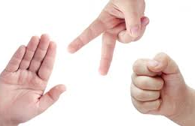
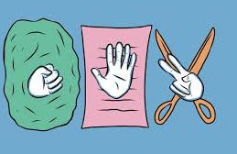
Activity: Rock, Paper, Scissors Fitness
Directions: You will have 10 seconds to rest and decide if you will play a “rock”, “paper”, or “scissors”. Based on the results of the battle, you will look at the exercise connected to the “win”, “lose”, or “tie” arrows and perform that exercise 5 times
Rock, Paper, Scissors Fitness

Slide 7
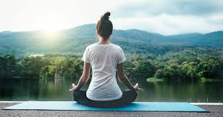
Cool Down:
6-minute Yoga Chill
Directions: Listen and follow along with the video
6-minute Yoga Chill

Slide 8
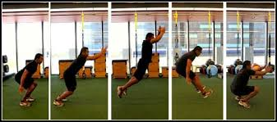
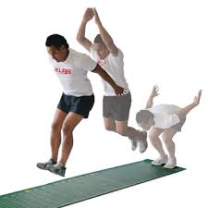
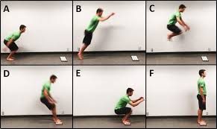
Post-Class Power Challenge: Standing Broad Jump
Make sure you have an area with enough space to complete this challenge.
Directions:
In your space, lay a measuring tape on the ground
Start with your toes just behind the start of the measuring tape
Bend your knees, swing your arms back, and jump as far as you can off both feet
Record your distance
Repeat 3x and report to class on Tuesday with your highest score

