Slide 1
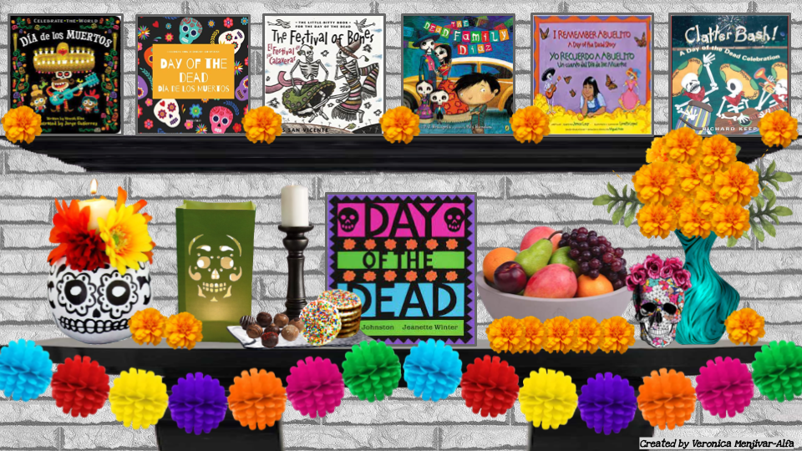
Notes:
💀Dia de los Muertos
Click on the book you’d like to hear for a read aloud.

Slide 2
