Slide 1
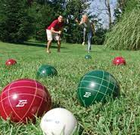
Unified PE
Bocce: How to Play

Slide 2
Agenda
What are we doing today?
Learning Goals
Bocce: Vocabulary, Types of Shots & How to Play
Activity for Home: Modified Bocce Game
Activity: Double Dare Fitness Challenge
Cool Down: Darebee Unbound
What’s Due?
Bocce Exit Ticket – Available in Announcements & under Live Lessons Module
Warm-Up: Darebee Setting Goals

Slide 3

Learning Goals
I can work hard at home and in school to improve my physical fitness
I can describe the rules of bocce
I can participate in a modified game of bocce

Slide 4
Bocce Vocabulary
Dead Ball – ball that has been ruled, by the official, as disqualified due to some infringement
Live Ball – “good” – ball rolled is legitimate & legal
Foul – relates to either a foot foul or a like foul
Foul Line – the lines on the court the player must stay behind before the ball is released
Initial Point – the first ball rolled in an end toward the pallina

Slide 5
Bocce: Types of Shots
Hitting
Shot played to displace other balls around the target ball, rather than playing a slow gentle roll to gain the advantage/point.
Played with such force to reach the far end of the court
May be played from anywhere up to the 10-foot hitting/pointing line
Pointing
Shot played to get the ball close to the target ball, rather than trying to scatter/displace other balls.
Played with a soft, smooth release, finesse, & gentle motion
Usually from standing position rather than running/moving
Must release the ball before crossing the hitting/pointing line

Slide 6
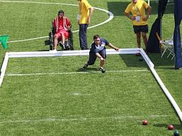
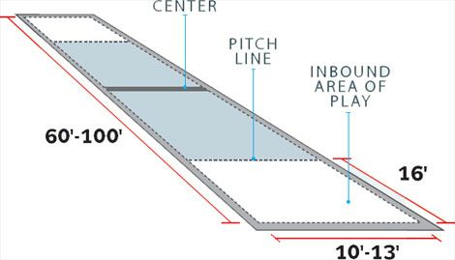
How to Play Bocce
How to Play Bocce

Slide 7
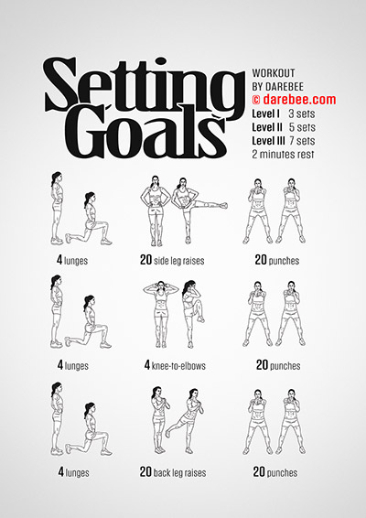
Warm-up: Darebee Setting Goals
Directions: Complete the following exercises 2x
  4 Lunges
  20 Side Leg Raises
  20 Punches
  4 Lunges
  4 Knee-to-Elbows
  20 Punches
  4 Lunges
  20 Back Leg Raises
  20 Punches

Slide 8

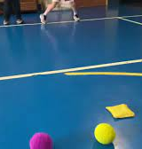
Activity for Home: Modified Bocce Play
For outdoor play: can substitute softballs/tennis balls/baseballs for the bocce balls & use golf balls as the pallina
For indoor play: can substitute sock balls for the bocce balls & use bean bags/shoe
Modified Play:
  Can play by yourself or with family
  Take turns either throwing or setting the “pallina”
  Take turns trying to see who can get their “bocce balls” closest to the pallina

Slide 9

Activity: Double Dare Fitness Challenge
Directions: You have 10 seconds to pick your answer. To lock in your answer, do the exercise that goes with it for 30 seconds.
  Stuck on a question? Take on the physical challenge – 60 seconds long
  Double Dare Fitness Chllenge

Slide 10
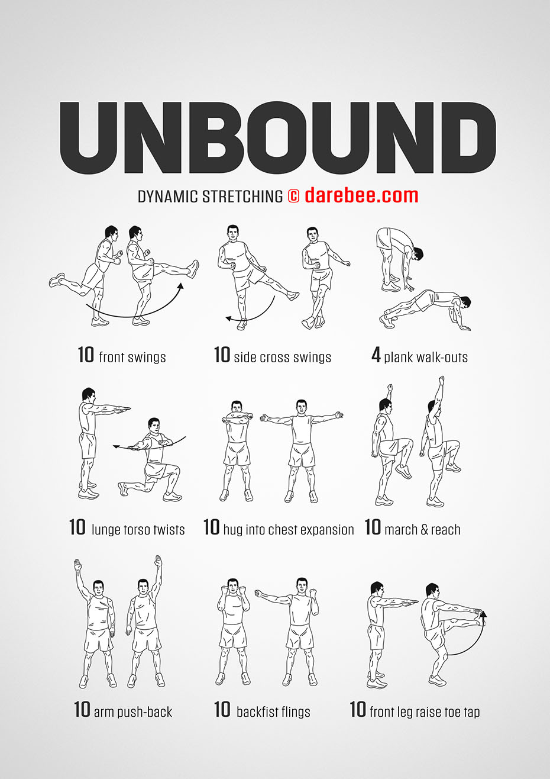
Cool Down: Darebee Unbound
Directions: Complete each exercise 2x

