Slide 1
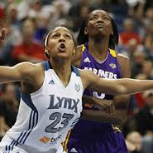
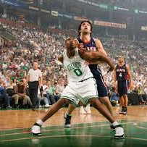
Unified PE
Basketball: Rebounding

Slide 2
Agenda
What are we doing today?
Learning Goal
Skill: Rebounding
Warm-up: Darebee So Far, So Good
Activity: Jeopardy – Basketball Edition
What’s Due?
Basketball Skills Exit Ticket – available in announcement & Lesson Materials Module
Cool Down: Darebee Sore Muscles Stretch

Slide 3

Learning Goals
I can work hard at home and in school to improve my physical fitness
I can name the cues for performing the box out
I can perform a box out correctly

Slide 4
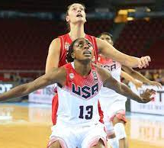
Skill: Rebounding
Steps for the Box Out:
  Step toward the player
  Armbar to locate opponent
  Pivot into player, raise arms
  Go get the ball
Cues for the Box Out:
  Locate
  Pivot
  Rebound
Tips, Skills, & Drills: Rebounding

Slide 5
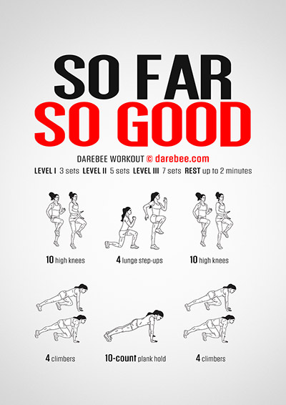
Warm-up: Darebee – So Far, So Good
Complete the following exercises 2x
  10 High Knees
  4 Lunge Step-Ups
  10 High Knees
  4 Climbers
  10-Second Plank Hold
  4 Climbers

Slide 6

Activity: Jeopardy- Basketball Edition
How to play:
  Answer 2 questions from each category
  You have 10 seconds to choose your answer
  You have 20 seconds to show your answer with exercise
Jeopardy - Basketball Edition

Slide 7
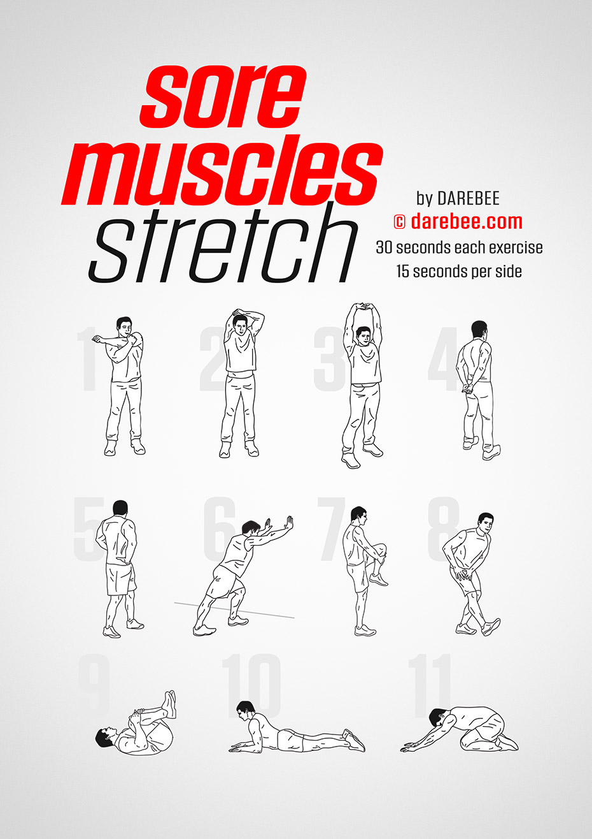
Cool Down: Sore Muscles Stretch
Hold each exercise for 20 seconds

