Slide 1
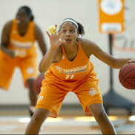
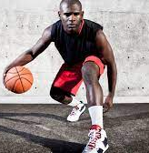
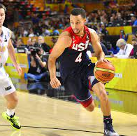

Unified PE
Day 1 (MP4): Dribbling

Slide 2
Agenda
What are we doing today?
Learning Goals
Skill: Dribbling
Warm-up: Darebee Counter
Activity: Dribbling Drills
Cool Down: Upper Body Stretching Routine
What’s due?
Exit Tickets – will be condensed into ONE exit ticket covering ALL basketball skills (once covered in class).

Slide 3
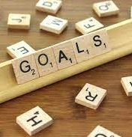
Learning Goals
I can work hard at home and in school to improve my physical fitness
I can name the cues for dribbling
I can dribble a ball using the proper cues

Slide 4
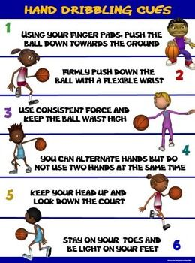
Skill: Dribbling
Main Cues:
  Finger Pads
  Waist Level
  Eyes Up
Fundamentals of Dribbling

Slide 5
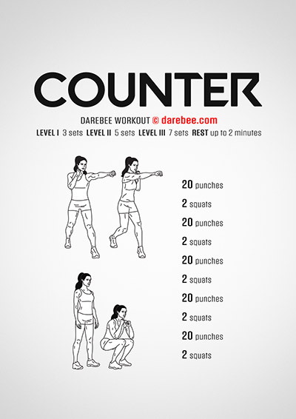
Warm-up: Darebee Counter
Complete the exercises 2x through

Slide 6
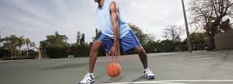
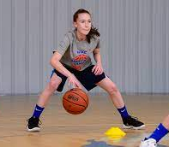
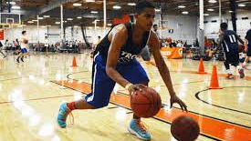
Activity: Dribbling Exercises
Dribbling Drills (Beginner)
10-min At-Home Dribbling Workout
At-Home Dribbling Drills (advanced)

Slide 7
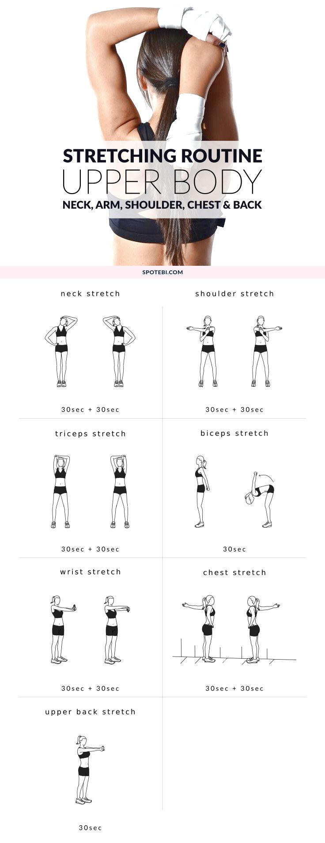
Cool Down: Upper Body Stretching Routine
Hold each stretch for 20 seconds

