Slide 1
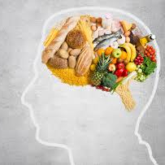
Unified PE
Day 15: How food affects your brain

Slide 2
Agenda
What are we doing today?
Learning Goal
Vocabulary
Warm-up: Ninja Speed
Activity: 4-minute beginner Tabata
Cool Down: Stretching
What’s Due?
Exit ticket – available in announcements and under “Live Lesson Materials”

Slide 3

Learning
I can work hard at home to improve my physical fitness
I can use what I’ve learned about nutrition to improve my diet
This Photo by Unknown Author is licensed under CC BY-NC-ND

Slide 4

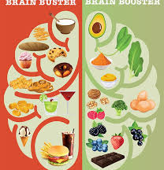
Vocabulary:
Nutrients: substance that provides nourishment essential for growth and maintenance of life – include proteins, fats, carbohydrates, vitamins, minerals, and water
Neurotransmitters – chemical messengers that carry signals between neurons affecting things like mood, sleep, attentiveness and weight
How the food you eat affects your brain

Slide 5
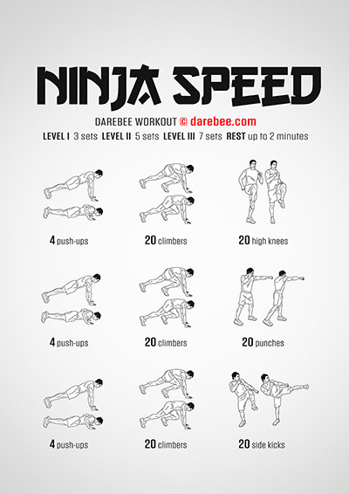
Warm-up: Ninja Speed
Directions: 2 rounds of the following exercises
  4 push-ups
  20 climbers
  20 high knees
  4 push-ups
  20 climbers
  20 punches
  4 push-ups
  20 climbers
  20 side kickcs

Slide 6
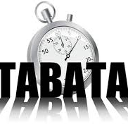
Activity: 4-minute Beginner Tabata
4-minute total workout
  20 seconds of work and 10 seconds of rest
8 rounds of the following exercises:
  Jumping jacks
  Glute bridge
  Mountain climbers
  Shuffle
  Walk out
  Reverse Lunges
  Ab crunches
  Plank Jack
4-minute beginner tabata

Slide 7
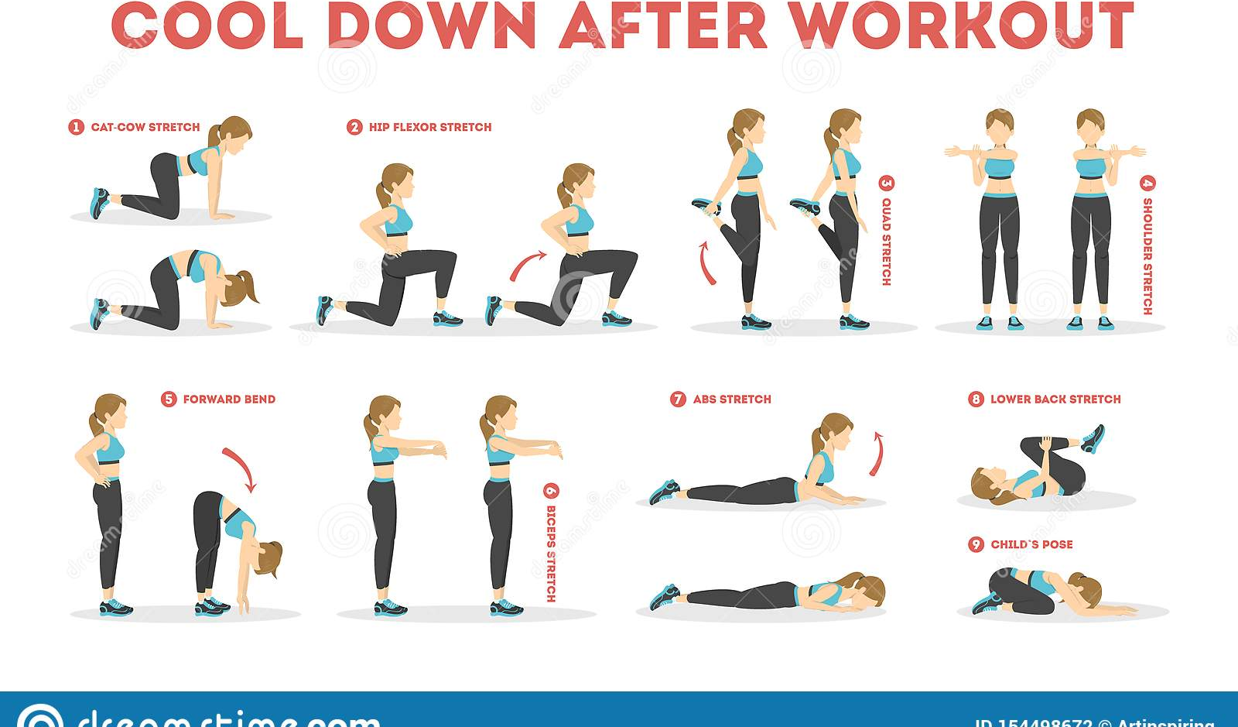
Cool Down: Stretching
Directions: Hold each stretch for 15-20 seconds

