Slide 1
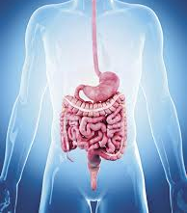
Unified PE
Day 6: Digestive System

Slide 2
Agenda
What are we doing today?
Learning Goal
Vocabulary
Warm-up: Burning Bright
Activity: Valentine’s Day Choice!
Cool Down: Flexible Today
What’s Due?
Exit ticket – available in announcements & under Live Lessons Materials Module

Slide 3

Learning Goals
I can work hard at home to improve my physical fitness
I can name the main task of the digestive system
I can name the 4 components of the digestive system
I can describe the digestive process

Slide 4
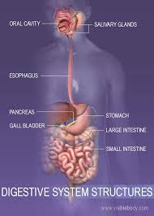
Vocabulary
Digestive System: Turns your food into the nutrients and energy you need to survive
How Your Digestive System Works

Slide 5
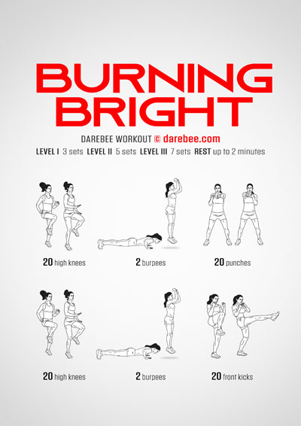
Warm-up: Burning Bright
Complete the following exercises 2x:
20 high knees
2 burpees
20 punches
20 high knees
2 burpees
20 front kicks

Slide 6
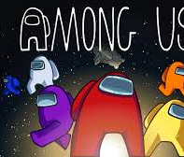

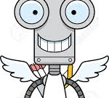
Activity: Valentine’s Day Choice
We will take a quick vote and complete the workout with the most votes!
  This or That – Find the Gnome!
  Cupid On The Run
  Valentines Among Us Fitness

Slide 7
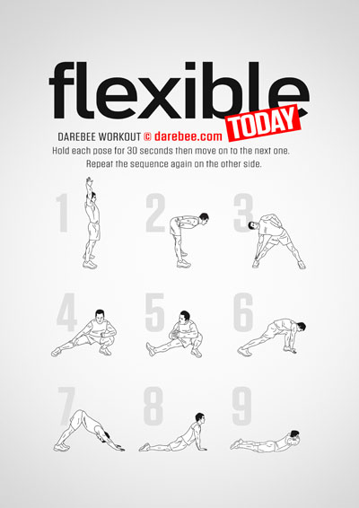
Cool Down
Hold each pose for 20-30 seconds. Repeat the sequence on the other side

