Slide 1
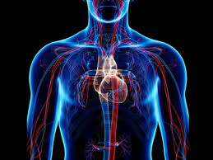
Unified PE
Day 7: Circulatory (Cardiovascular) System

Slide 2
Agenda
What are we doing today?
Learning Goal
Vocabulary
Warm-up: Precursor
Activity: Cardio Tabata
Cool Down: 5-minute stretching
What’s Due?
Exit ticket – available in announcements & in Live Lessons Module

Slide 3
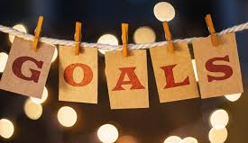
Learning
I can work hard at home to improve my physical fitness
I can name the parts of the circulatory system
I can describe the functions of the circulatory system

Slide 4
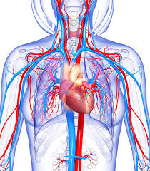

Vocabulary
Circulatory (Cardiovascular) System: organ system that permits blood to circulate and transport oxygen, nutrients, and hormones to cells; and removes waste products like carbon dioxide
  Components: Heart, Blood, Blood Vessels
Introduction to the Circulatory System

Slide 5
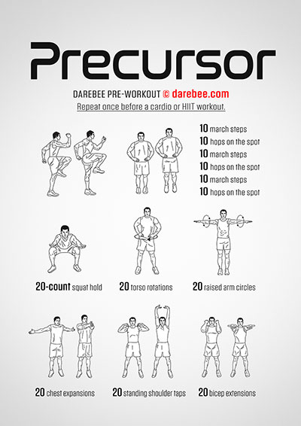
Warm-up
3x of each:
  10 march steps
  10 hops on the spot
20-sec squat hold
20 torso rotations
20 arm circles
20 chest expansions
20 standing shoulder taps
20 bicep extensions

Slide 6
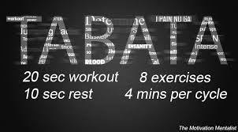
Activity: Cardio Tabata
8 rounds: 20 seconds of exercise, 10 seconds of rest
Exercises:
  Round 1: Jumping Jacks
  Round 2: Squats
  Round 3: Butt Kicks
  Round 4: Seal Jacks
  Round 5: High Knees
  Round 6: Reverse Lunges
  Round 7: Jump rope
  Round 8: Mountain Climbers

Slide 7
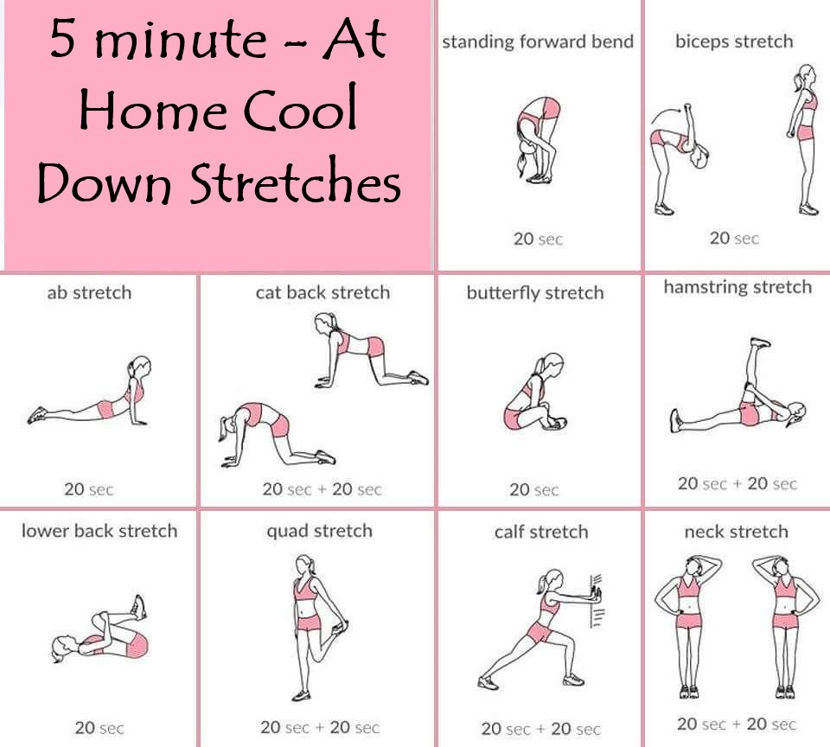
Cool Down: 5-minute stretching

