Slide 1

Unified PE
Day 14: Calories

Slide 2
Agenda
What are we doing today?
Learning Goal
Vocabulary
Warm-up: 1-minute Cardio
Activity: 15-minute Low-Impact Cardio
Cool Down: Quick Cool Down & Stretch
What’s Due?
Exit ticket – available in announcements and under “Live Lesson Materials”

Slide 3

Learning
I can work hard at home to improve my physical fitness
I can use what I’ve learned about nutrition to improve my diet
This Photo by Unknown Author is licensed under CC BY-NC-ND

Slide 4
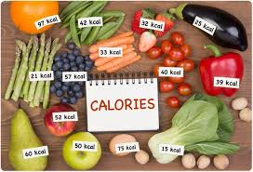
Vocabulary
Calorie – a unit of measurement for energy. Describes how much energy your body could get from eating or drinking it.
Body needs calories to operate – keep heart beating and lungs breathing, etc.
Too many calories and not burning enough of them through activity → weight gain
Burning more calories than you eat → weight loss
3,000 calories = 1 pound of fat
What is a calorie?

Slide 5
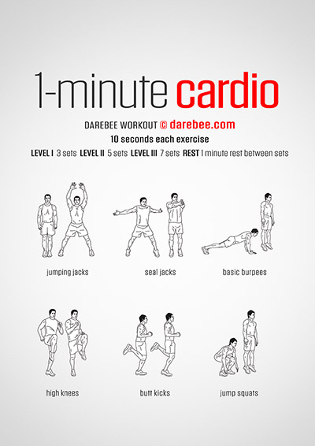
Warm-up: 1-minute Cardio
Directions: 2 rounds of each of the following exercises for 10 seconds”
Jumping Jacks
Seal Jacks
Basic Burpees
High Knees
Butt Kicks
Jump Squats

Slide 6
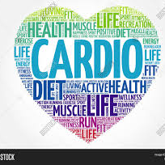
Activity: 15-minute Low-Impact Cardio
Directions: Follow along with the video to best of ability – modify and take breaks as needed
15-minute Low-Impact Cardio

Slide 7
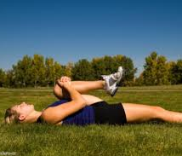
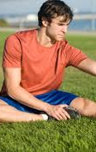
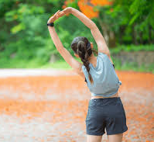
Cool Down: Quick Cool Down and Stretch
Directions: Follow along with the video – 1 round of 10 stretches. Holding each for 15 seconds.
Quick Cool Down and Stretch

