Slide 1
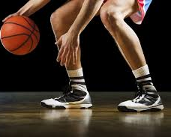
Unified PE
Day 16: Basketball Ball Handling

Slide 2
Agenda
What are we doing today?
Learning Goal
Vocabulary
Warm-up: Darebee Courage
Activity: Basketball Ball-Handling Skills
Cool Down: Darebee Care Package
What’s Due?
No Exit tickets this week ☺
Enjoy Spring Break! ☺

Slide 3

Learning Goals
I can work hard at home and in school to improve my physical fitness
1
I can explain the purpose of ball-handling in basketball
2
I can work hard to improve my basketball ball-handling skills
3

Slide 4
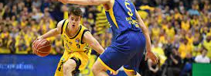
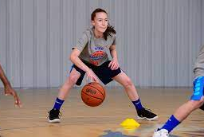
Vocabulary
Ball-handling – one of the most important parts of the game of basketball
  Includes dribbling and passing
  Most basic skill and often overlooked
  Without ball handling, the ball could not advance up the court or offenses could not run effectively

Slide 5
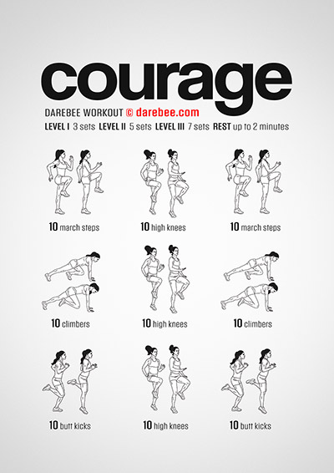
Warm-up: Darebee Courage
Directions: Complete the following exercises 2x:
  10 march steps
  10 high knees
  10 march steps
  10 climbers
  10 high knees
  10 climbers
  10 butt kicks
  10 high knees
  10 butt kicks

Slide 6
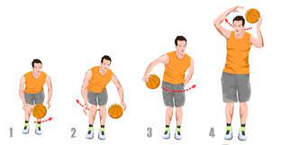
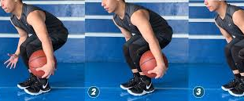
Activity: Basketball Ball-Handling Skills
Ball handling without dribbling

Slide 7


Slide 8
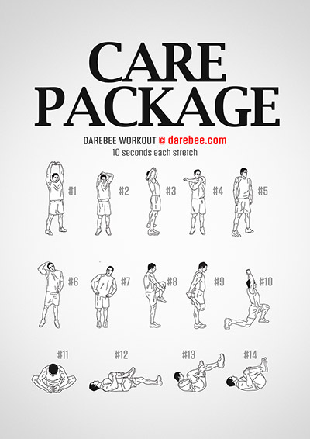
Cool Down: Darebee Care Package
Hold each stretch for 10-15 seconds

