Slide 1
Unified PE
Day 10: Agility

Slide 2

Agenda
What are we doing today?
Learning Goal
Vocabulary
Warm-up: Teacher-Led
Activity: Agility Challenge
Cool Down: Recovery Yoga
What’s due?
Exit Ticket – on Canvas in Announcements & under Lesson Materials Module

Slide 3
Learning Goal
I can develop my personal fitness to stay healthy and active at home

Slide 4
Vocabulary
Agility: The ability to change directions quickly
Brain Bites - Agility

Slide 5
Warm-up
30 seconds of each of the following exercises – repeat 2x:
Squat to side reaches
Chest openers & calf raises
Skier swings to overhead reach
Jumping jacks

Slide 6
Activity: Agility Challenge
What do I need? 5 sheets of paper
What do I do? Watch each challenge. After watching, pause the video. Complete the challenge 3 times. Move to next challenge
Agility Challenge

Slide 7
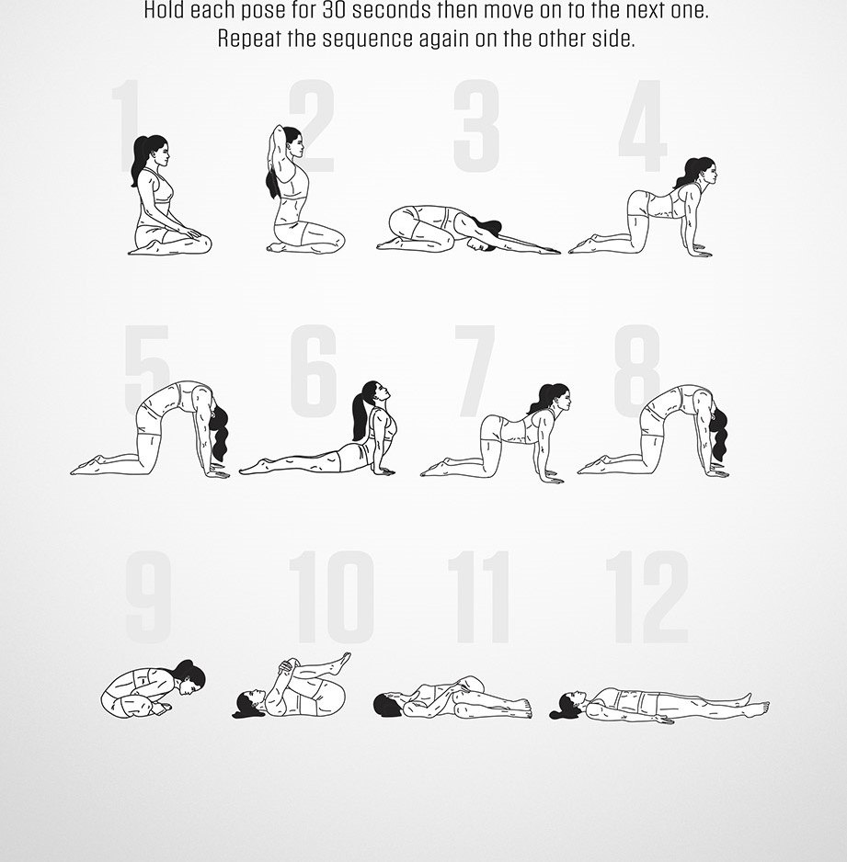
Cool Down: Recovery Yoga
Hold each pose for 30 seconds

