Slide 1
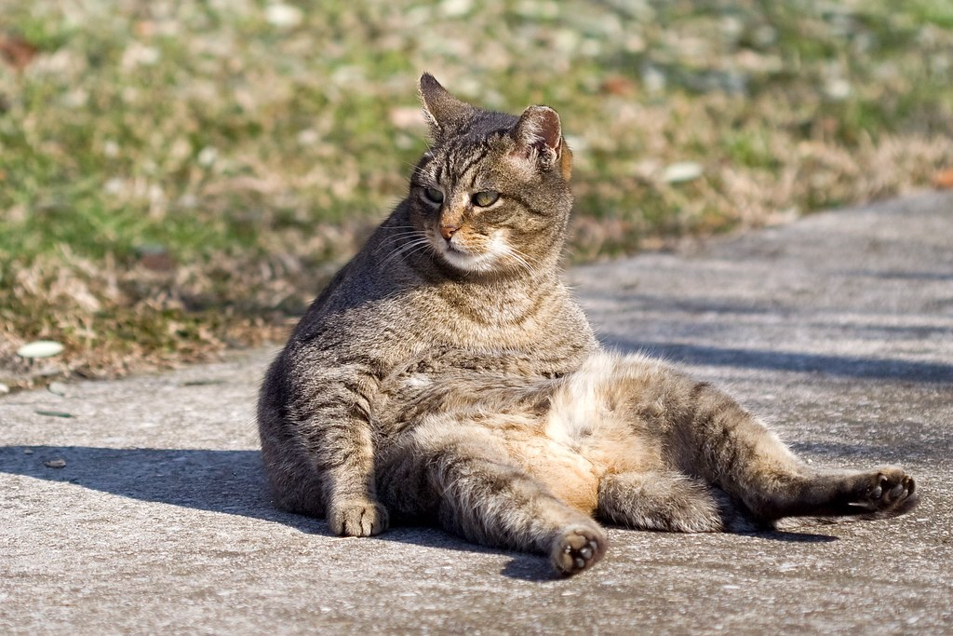
Unified PE
Day 2: What’s wrong with my posture??

Slide 2

Agenda:
What are we doing today?
Learning Goal
Vocabulary
Lesson: What’s Wrong with my Posture
Activity: 10 Minute Desk Stretches/Yoga
Exit Ticket: What are they? How will we use them?
Future Classes:
Come ready to move and hopefully have fun! (Dress appropriately)
At-home workouts/resources will be posted online
Exit Tickets

Slide 3
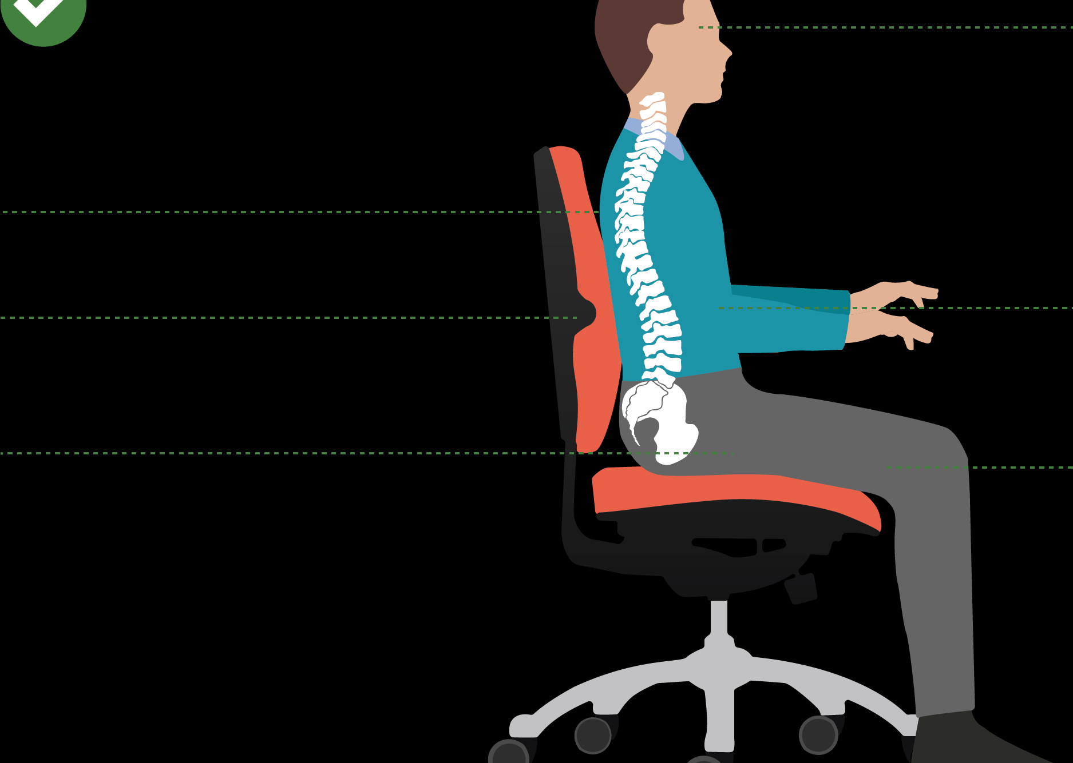
Learning Goal:
I can improve my posture and flexibility even while sitting

Slide 4

Vocabulary
Posture: The position in which we hold our bodies while standing, sitting, or lying down
  Good Posture: correct alignment of body parts supported by muscles and gravity
Flexibility: the range of motion in a joint or group of joints and the ability to move joints through a complete range of motion
TedTalk: The Benefits of Good Posture

Slide 5
Activity: What’s wrong with my posture??

Slide 6
All about Exit Tickets
What are they?
Formative Assessment to check what you learned
How will they be used?
Will be assigned at end and/or after class (on Canvas)
Will be graded

