Slide 1


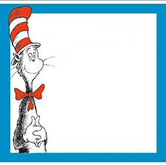
What’s The Sight word?
Can you find the Cat in the Hat hiding behind a sight word?
any
now
each
could
how
about
see
her
out
down
say
would
many
our
over
says

Slide 2
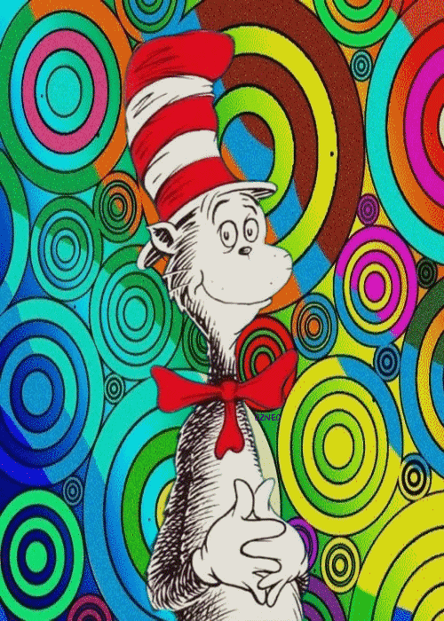

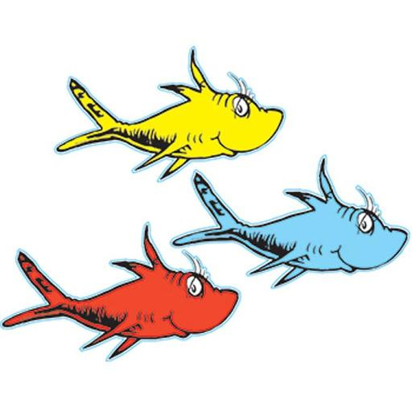
YOU FOUND THE CAT IN THE HAT!!!
Go Back

Slide 3
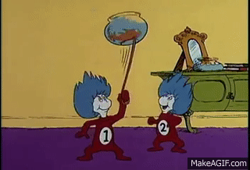
Keep looking!!!
Go Back

Slide 4
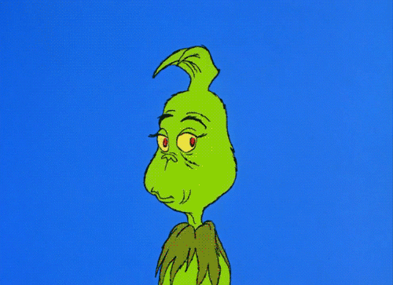
Keep looking!!!
Go Back

Slide 5
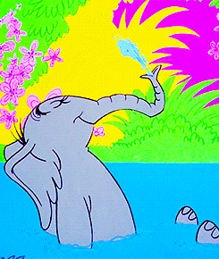
Keep looking!!!
Go Back

Slide 6
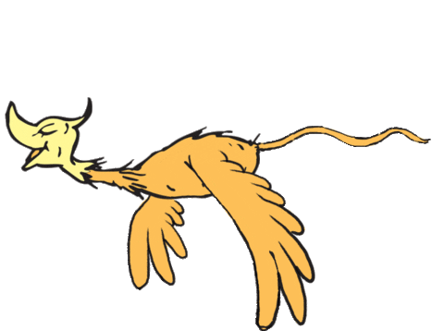
Keep looking!!!
Go Back

Slide 7
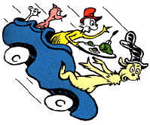
Keep looking!!!
Go Back

Slide 8
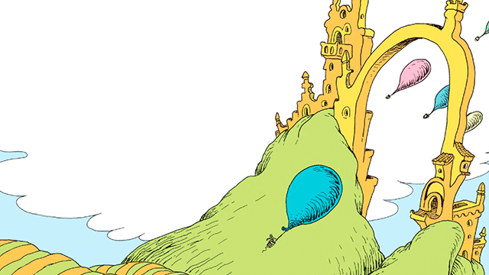
Keep looking!!!
Go Back

Slide 9
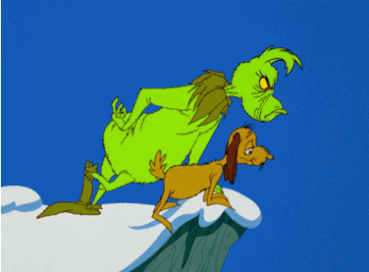
Keep looking!!!
Go Back

Slide 10
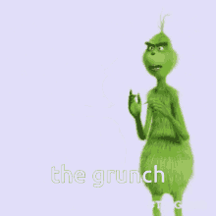
Keep looking!!!
Go Back

Slide 11
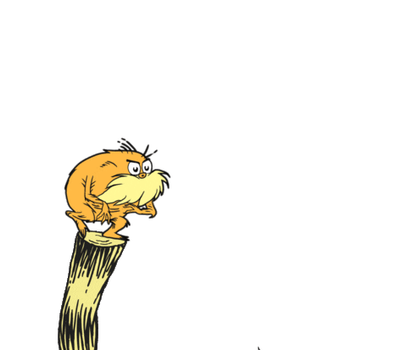
Keep looking!!!
Go Back

Slide 12
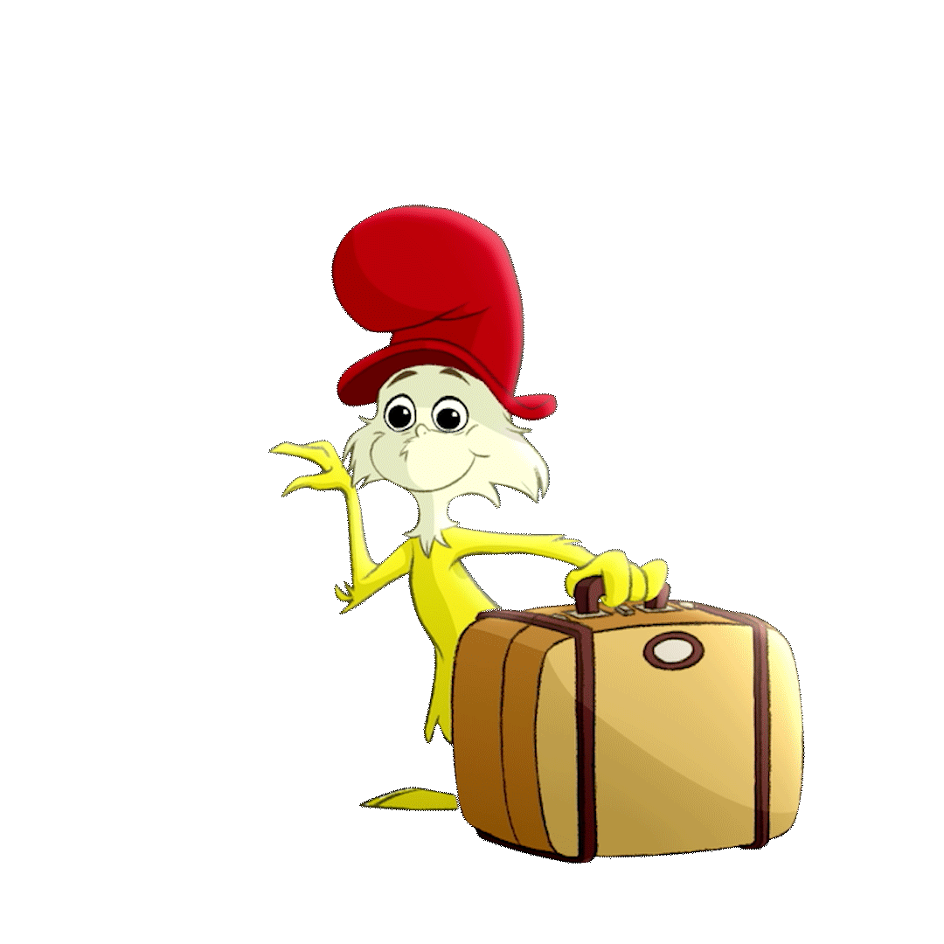
Keep looking!!!
Go Back

Slide 13

Keep looking!!!
Go Back

Slide 14
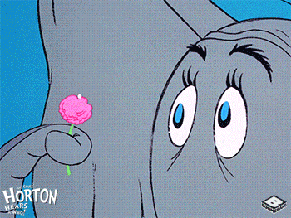
Keep looking!!!
Go Back

Slide 15
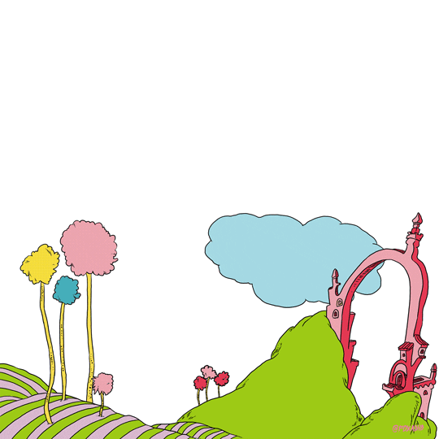
Keep looking!!!
Go Back

Slide 16
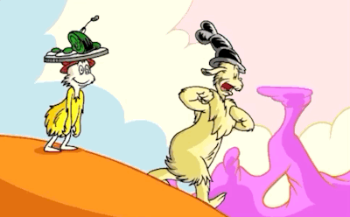
Keep looking!!!
Go Back

Slide 17
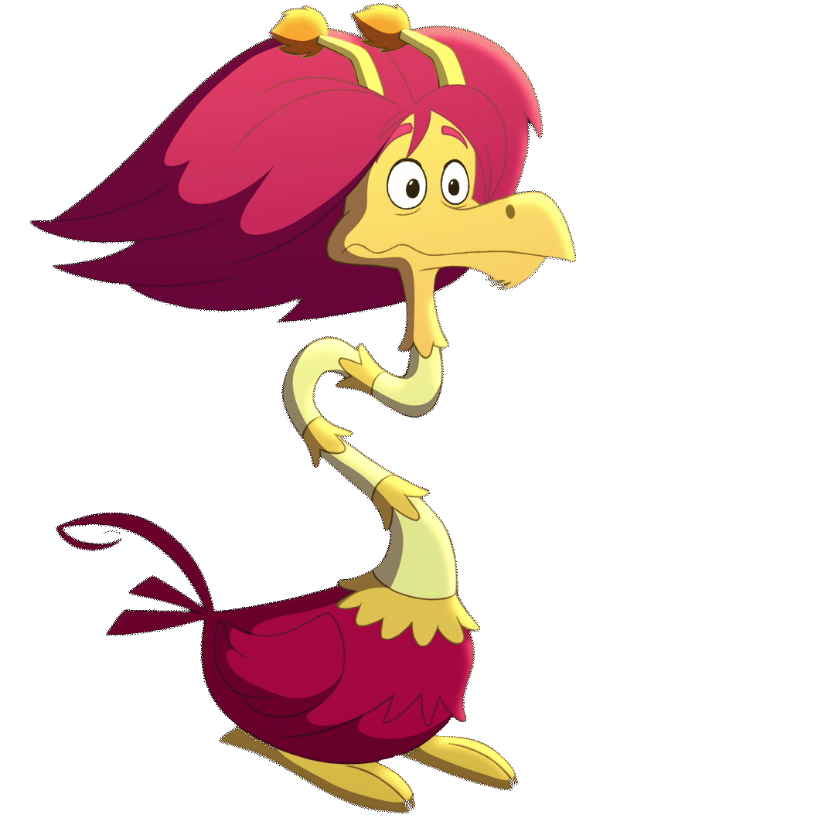
Keep looking!!!
Go Back

