Slide 1



Directions: Leave a compliment in each jar for your classmates by clicking and typing in a heart on each page.
March Compliment Clovers

Slide 2
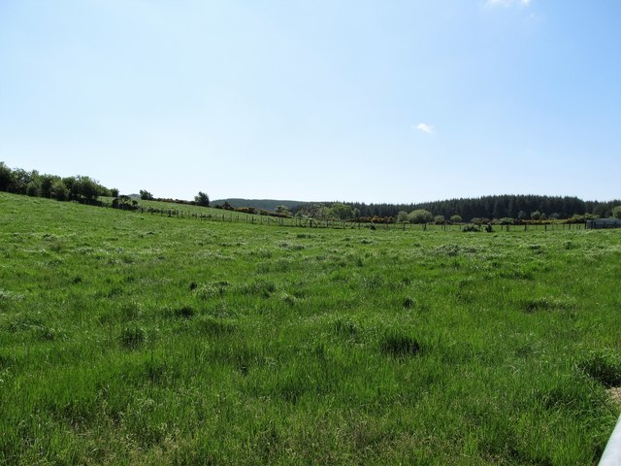
You’re a great classmate because...
Sentence starter examples:
Thanks for helping me when...
I like playing with you at recess because...
I’m glad you’re my friend because...
Something you’re great at is...

Slide 3

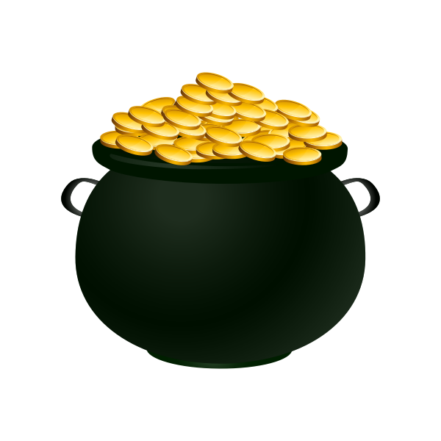
Name

Slide 4
Name

Slide 5
Name

Slide 6
Name

Slide 7
Name

Slide 8
Name

Slide 9
Name

Slide 10
Name

Slide 11
Name

Slide 12
Name

Slide 13
Name

Slide 14
Name

Slide 15
Name

Slide 16
Name

Slide 17
Name

Slide 18
Name

