Slide 1


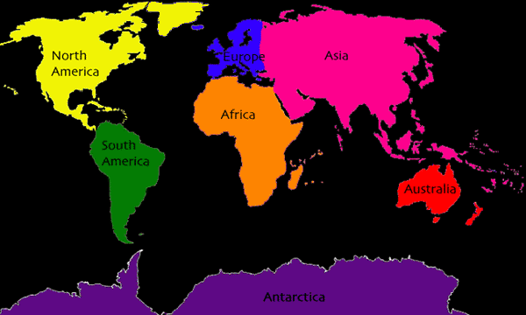
POTOWMACK ELEMENTARY PASSPORT
TO THE WORLD FIELD DAY
A. GERMANY __________
B. ICELAND ___________
C. MEXICO ___________
D. HOLLAND ____________
E. ITALY ____________
F. AUSTRALIA ___________
G. KENYA ___________
H. SWITZERLAND ___________
I. BAHAMAS ____________
J. ENGLAND ___________
K. IRELAND ___________
L. GREECE ____________
M. FRANCE ___________
N. USA ____________

