Slide 1


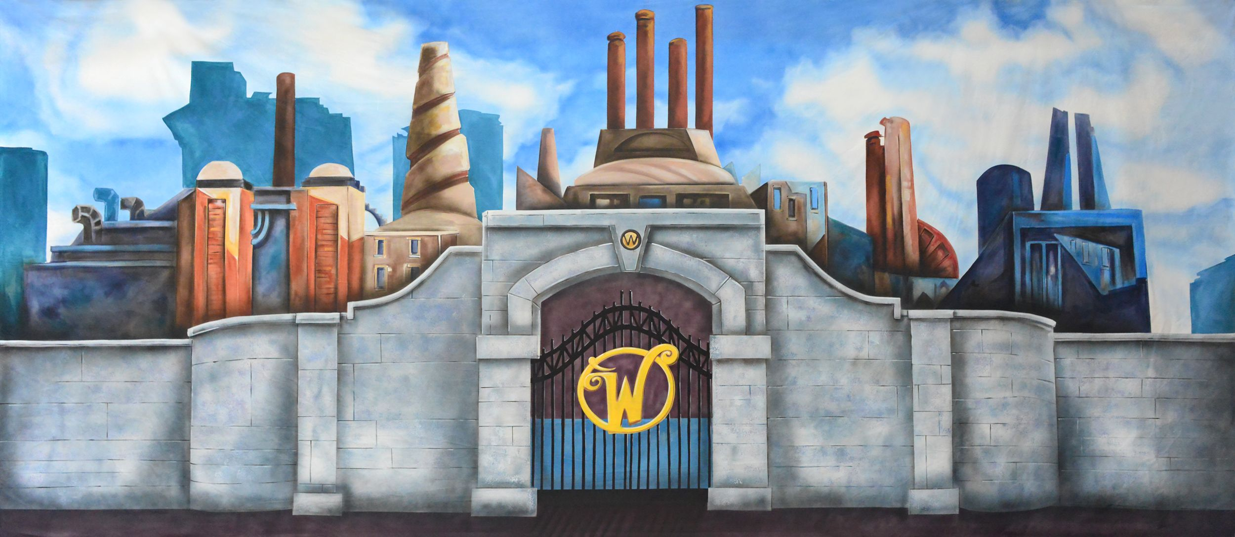
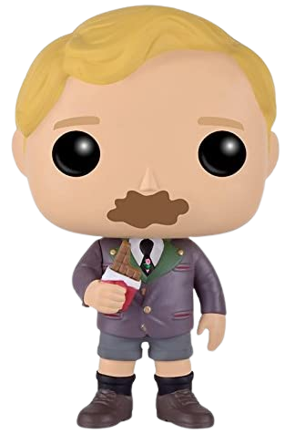
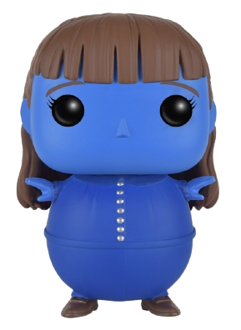
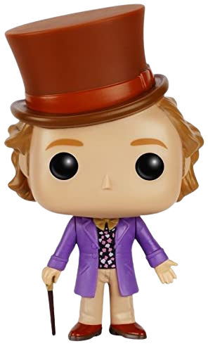
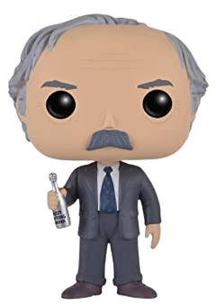


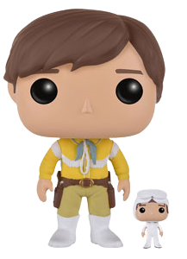
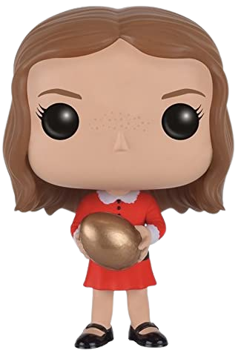
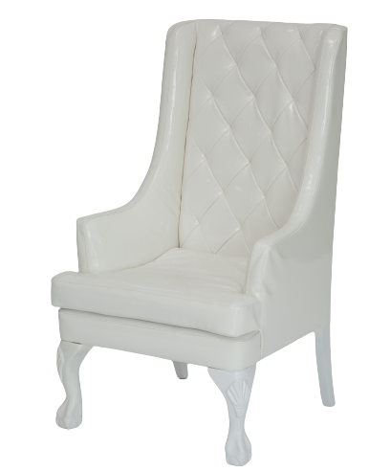

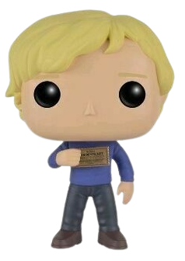

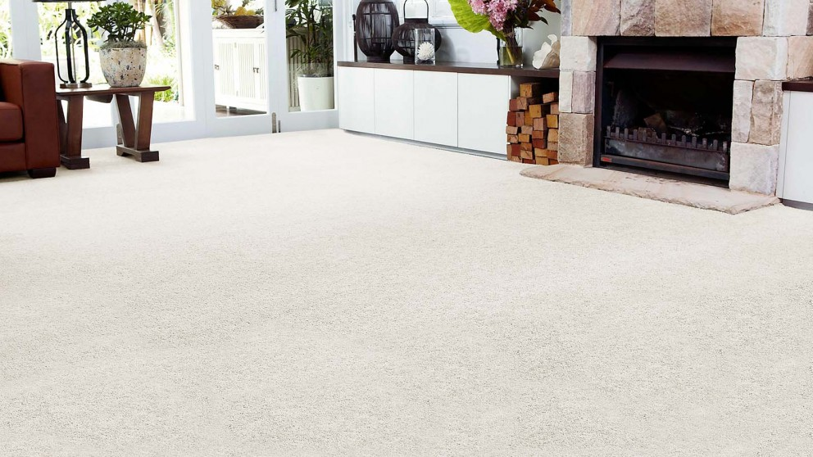
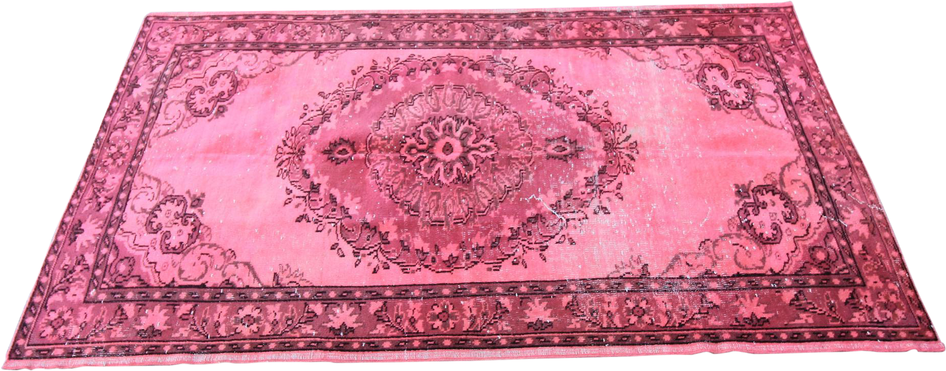

Chapters 1-2
Chapters 8-9
Chapters 3-5
Chapters 6-7
Chapters 10-11

Slide 2
Chapters 12-13
Chapters 18-19
Chapters 14-15
Chapters 16-17
Chapters 20-21

Slide 3
Chapter 22-23
Chapters 27
Chapters 24
Chapter 25-26
Chapters 28-29

Slide 4
Chapter 30
Willy Wonka The Wondrous Boat Ride Song
Willy Wonka Pure Imagination Song
Willy Wonka Oompa Loompa Song
Interview with Roald Dahl 1982

