Slide 1


Read Across America
Come to you!
Sit back and enjoy the gift of a good book!
Celebrity Readers

Slide 2




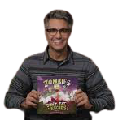
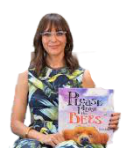
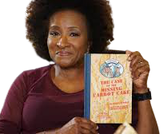
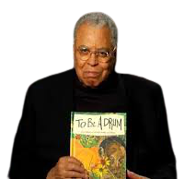
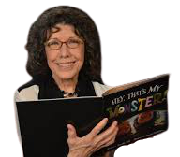
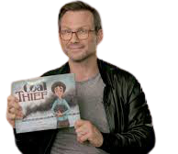
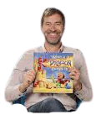
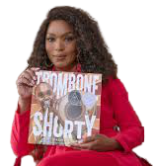
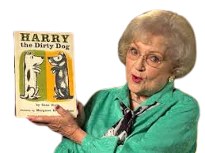
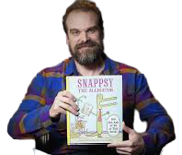

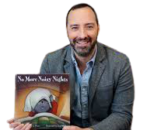
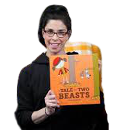
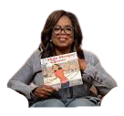
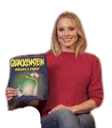
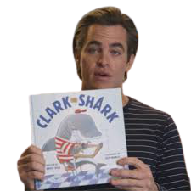
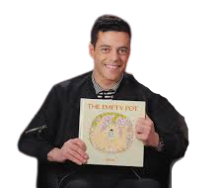

Slide 3

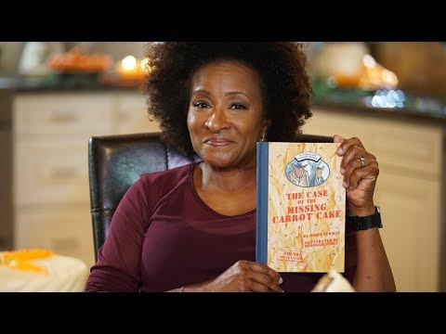
Wanda Sykes
Wanda Sykes was born on March 7, 1964. She is an American actress, comedian, and writer. She was first recognized for her work as a writer on The Chris Rock Show, for which she won a Primetime Emmy Award in 1999. In 2004, Entertainment Weekly named Sykes as one of the 25 funniest people in America.

Slide 4


Jaime Camil
Jaime Federico Said Camil Saldaña da Gama was born on July 22, 1973. Jaime is known professionally as Jaime Camil. He is a Mexican actor, singer and television personality. He was nominated for the Critic’s Choice Award for best actor in a comedy series.

Slide 5


Rashida Jones
Rashida Leah Jones was born February 25, 1976. She is an American actress, director, writer, and producer. Jones appeared in the drama series Boston Public, and in the comedy series The Office, and Parks and Recreation.

Slide 6

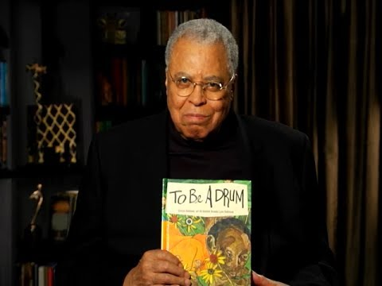
James Earl Jones
James Earl Jones was born January 17, 1931, and he was a profound stutter growing up. He is an American actor whose career spans more than seven decades. He has been described as "one of America's most distinguished and versatile" actors for his performances in film, theater and television, and "one of the greatest actors in American history".

Slide 7
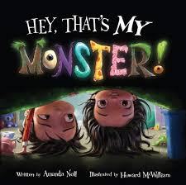
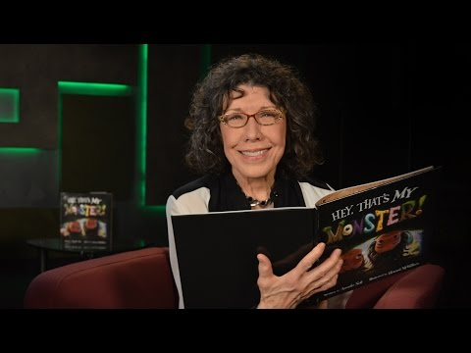
Lily Tomlin
Mary Jean "Lily" Tomlin was born on September 1, 1939. Lily is an American actress, comedian, writer, singer, and producer. Tomlin started her career as a stand-up comedian as well as performing Off-Broadway during the 1960s. Her breakout role was on the variety show Rowan & Martin's Laugh-In from 1969 until 1973.

Slide 8
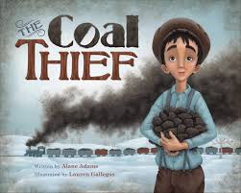
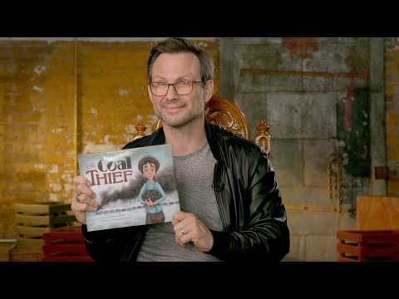
Christian Slater
Christian Michael Leonard Slater was born August 18, 1969. He is an American actor, voice actor, and producer. Slater has earned a Golden Globe Award for Best Supporting Actor – Series, Miniseries or Television Film in 2016, with additional nominations in 2017 and 2018.

Slide 9
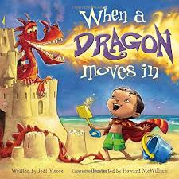
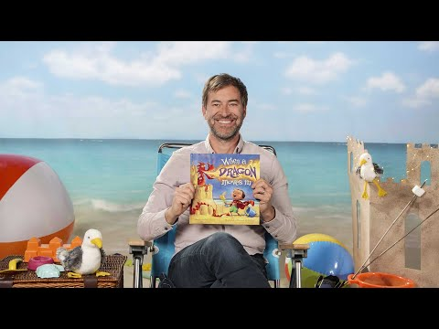
Mark Duplass
Mark David Duplass was born December 7, 1976. Mark is an American filmmaker, actor, writer, and musician of Cajun descent. He has starred in several movies and television shows. Mark and his brother Jay Duplass have their film production company called Duplass Brothers Productions.

Slide 10

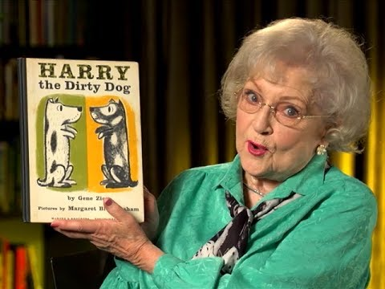
Betty White
Betty White was born January 17, 1922. White is an American actress best known for her comedic work on numerous television sitcoms, most notably The Mary Tyler Moore Show and The Golden Girls. Her career began in 1939, shortly after graduating from high school. She is also a devoted advocate for the welfare and health of animals.

Slide 11

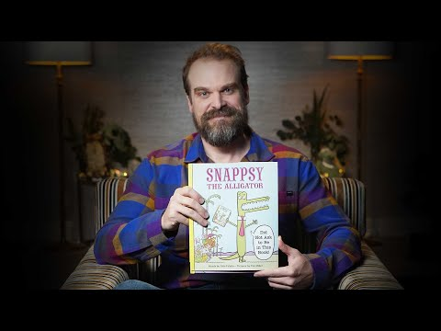
David Harbour
David Kenneth Harbour was born on April 10, 1975. David is an American actor. He gained recognition for his portrayal of Jim Hopper in the Netflix science fiction drama series Stranger Things, for which he earned a Critics' Choice Television Award in 2018.

Slide 12


Vanessa Marano & Katie LeClerc
Vanessa Nicole Marano was born on October 31, 1992. She is an American actress and singer. She has starred in television movies and has had recurring roles in several television series.
Katie Lynn Leclerc was born on November 6, 1986. She is an American actress and producer. She has appeared on several television series.

Slide 13

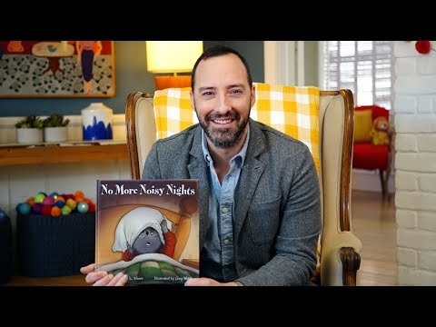
Tony Hale
Anthony Russell Hale was born on September 30, 1970. Tony is an American actor and comedian. He is known for his role in the Fox comedy series Arrested Development as the neurotic Buster Bluth. Hale also created and voiced Archibald in the Netflix series Archibald's Next Big Thing and Toy Story 4’s character Forky.

Slide 14
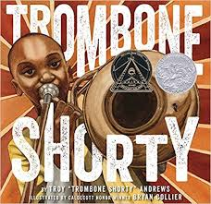
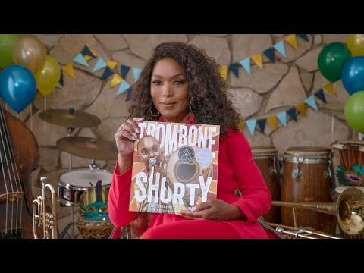
Angela Bassett
Angela Evelyn Bassett was born on August 16, 1958. Angela is an American actress, director, producer, and activist. She is most known for her biographical film roles. Her most notable performance was her depiction of Tina Turner in What’s Love Got to Do With it?

Slide 15


Sarah Silverman
Sarah Kate Silverman was born on December 1, 1970. Sarah is an American stand-up comedian, actress, singer, and writer. Her comedy addresses social taboos and controversial topics, such as racism, sexism, politics, and religion.

Slide 16
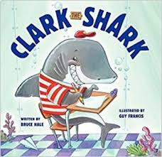
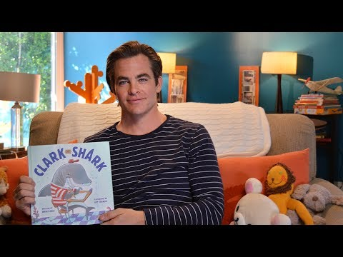
Chris Pine
Christopher Whitelaw Pine was born on August 26, 1980. Chris is an American actor. He made his feature film debut as Lord Devereaux in The Princess Diaries 2: Royal Engagement (2004), and later starred as James T. Kirk in the Star Trek reboot film series.

Slide 17
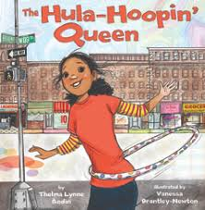

Oprah Winfrey
Oprah Winfrey was born on January 29, 1954. Oprah is a talk show host, media executive, actress and billionaire philanthropist. She's best known for being the host of her own, wildly popular program, The Oprah Winfrey Show, which aired for 25 seasons, from 1986 to 2011. In 2011, Winfrey launched her own TV network, the Oprah Winfrey Network (OWN).

Slide 18

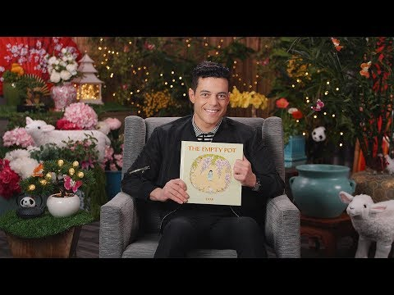
Rami Malek
Rami Malek is an American actor of Egyptian Arabic Descent, born May 12, 1981. He has received multiple other accolades, and is the first actor of Egyptian heritage to win the Academy Award for Best Actor. His acting career includes Bohemian Rhapsody and the Night at the Museum Trilogy.

Slide 19


Kristen Bell
Kristen Anne Bell was born on July 18, 1980. Kristen is an American actress, singer, and producer. She began her acting career by performing in various stage productions while she was a college student at New York University. Bell earned a Saturn Award for Best Actress on Television, for her starring role in the TV Series Veronica Mars.

