Slide 1





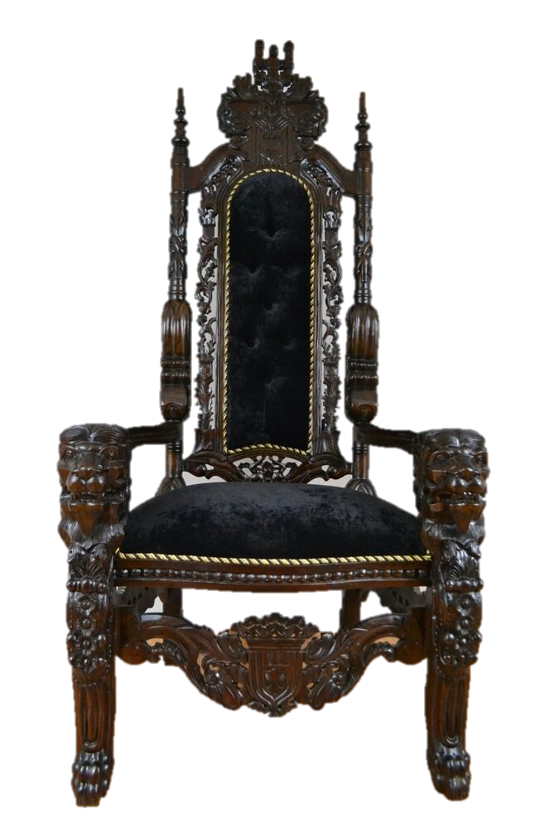





















Click on a book to hear the story.

