Slide 1


Slide 2
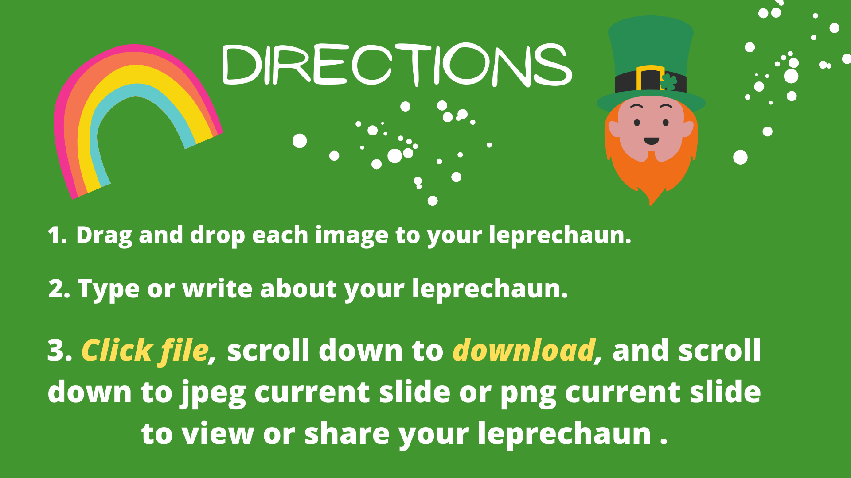

Slide 3
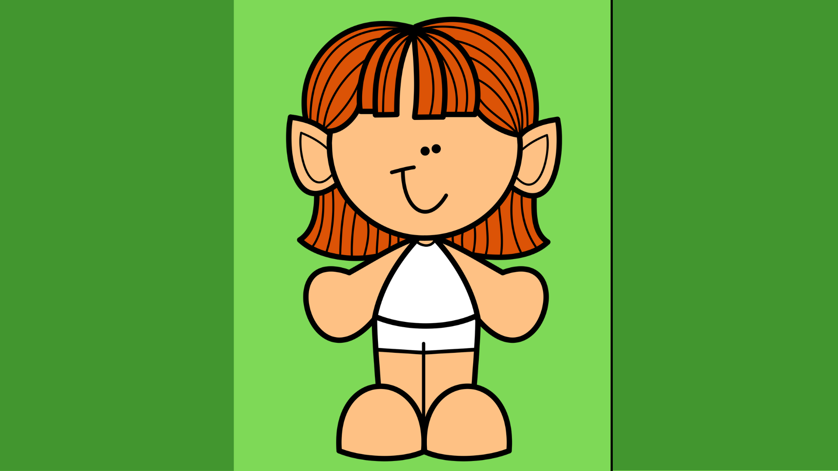

















Slide 4
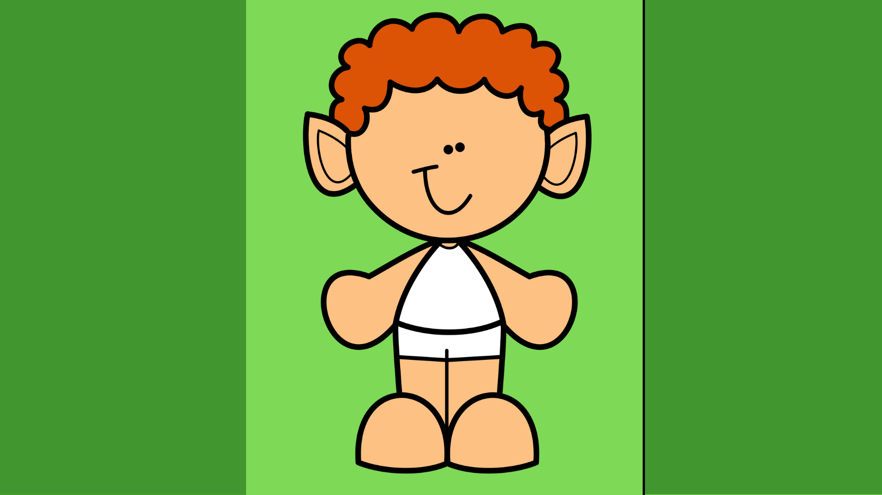














Slide 5
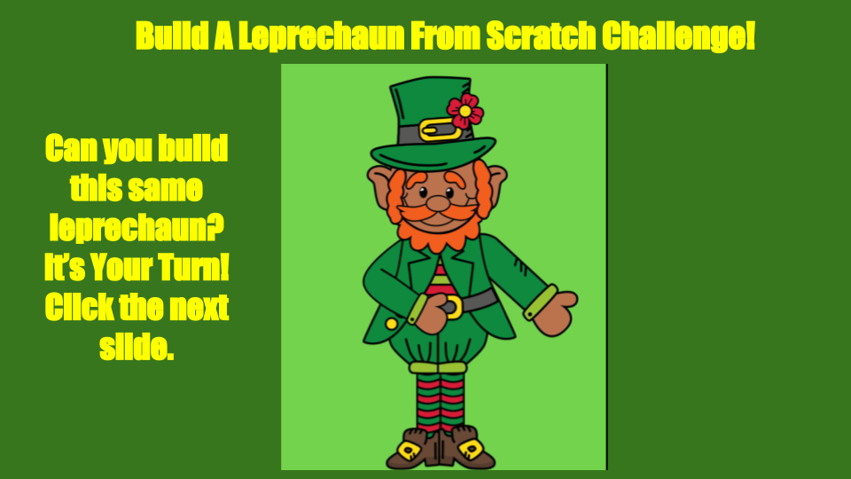
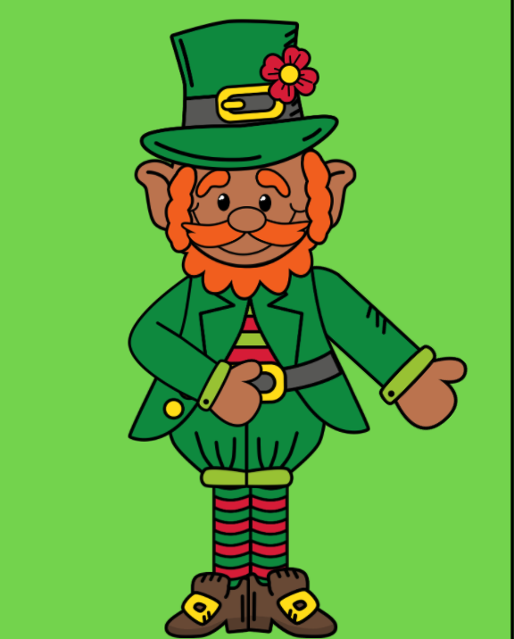

Slide 6























Slide 7
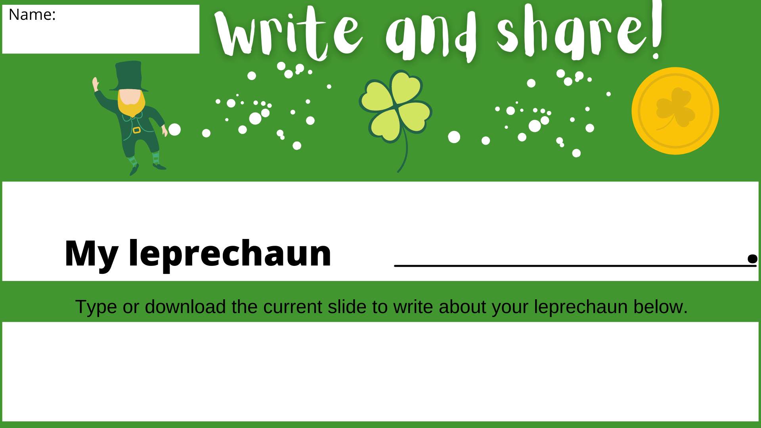

Slide 8


Slide 9
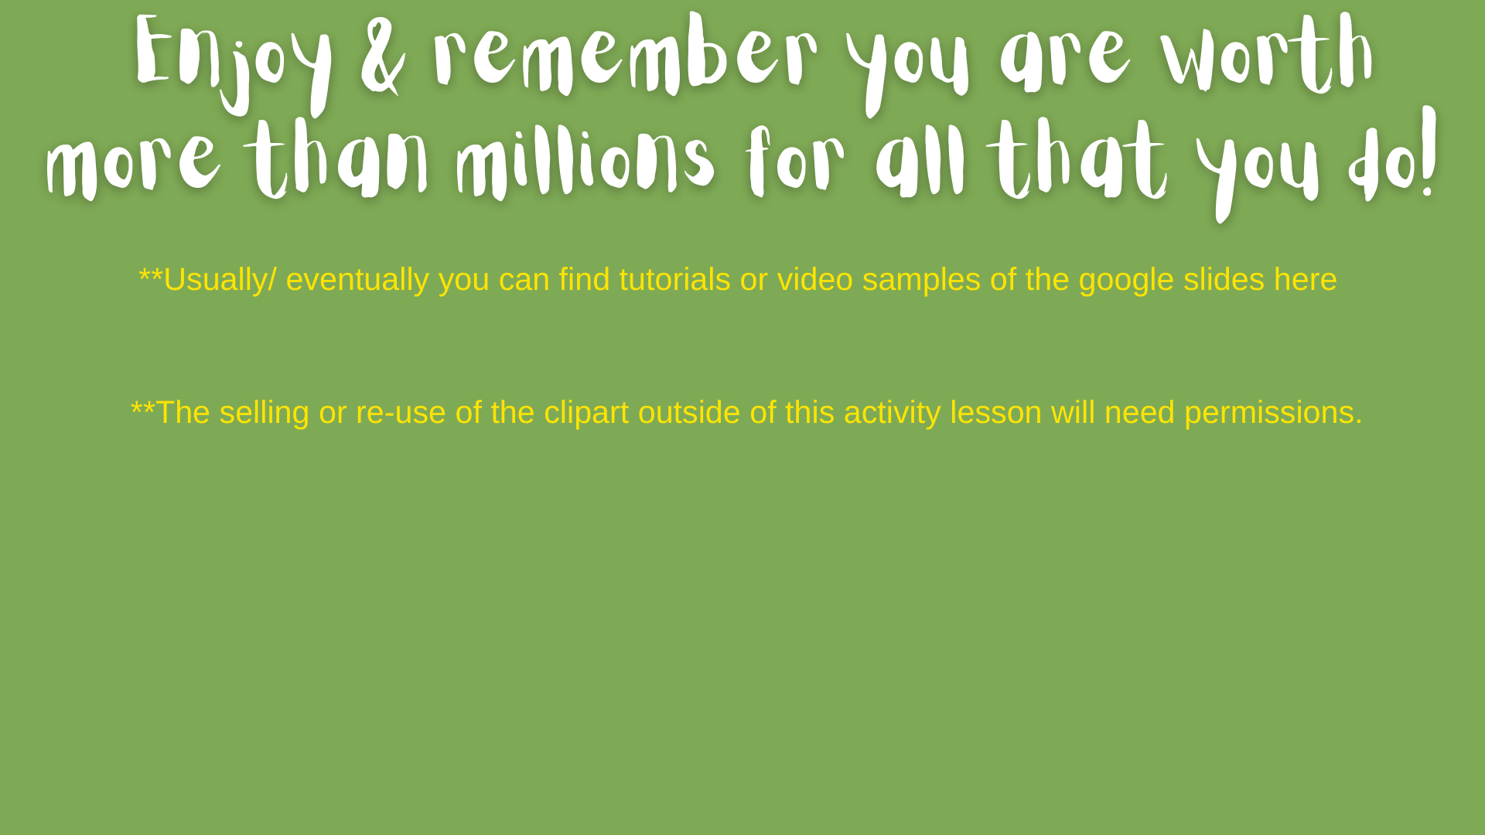
Click
** This is a free version for educators. If you see any editing that needs to be done in regards to grammar or spelling, just message me and I will quickly change it. I try, but I am not an editing expert and I welcome the extra eyes :)

