Slide 1
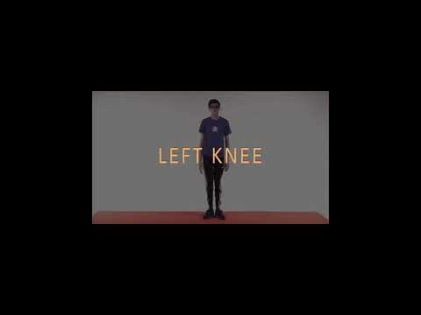
JHS DISTANCE LEARNING EXERCISE BUDDY BODY PARTS

Slide 2
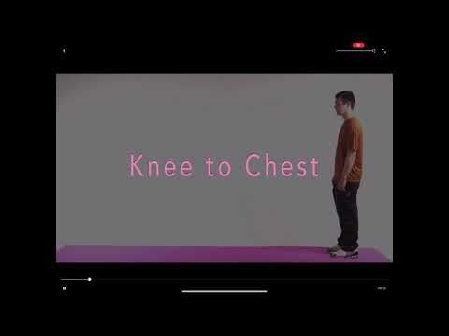
JHS 2020 DISTANCE LEARNING CIRCUIT STATION

Slide 3
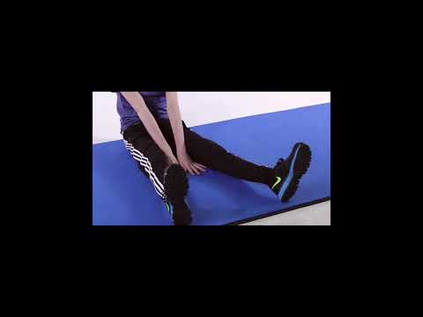
Jefferson High School Exercise Buddy Mini Workout

Slide 4
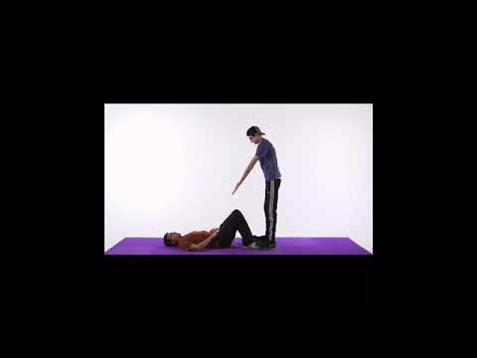
Jefferson Home Workout Exercise Buddy

Slide 5
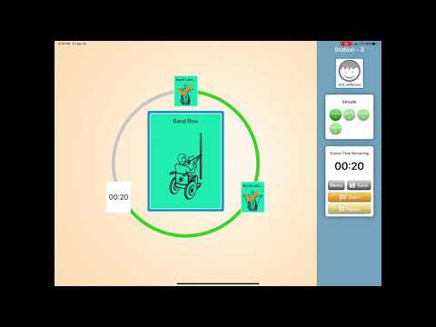
Jefferson WheelChair Circuit Station Exercise Buddy

Slide 6
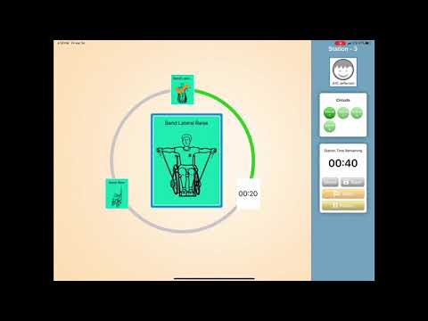
Jefferson WheelChair Circuit Station Exercise Buddy

Slide 7
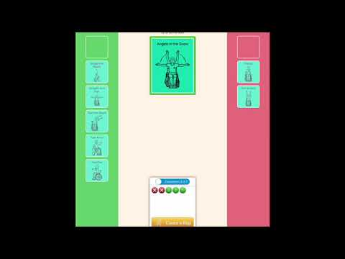
Jefferson WheelChair Stretches Exercise Buddy

Slide 8
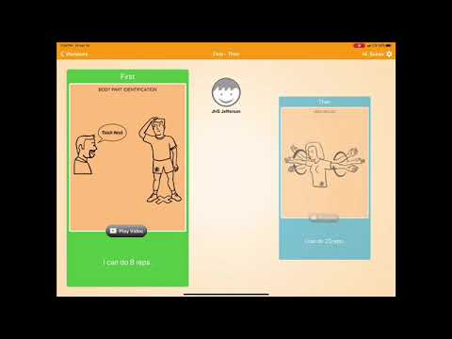
Jefferson High School Exercise Buddy Head Touches and Arm Circles

