Slide 1
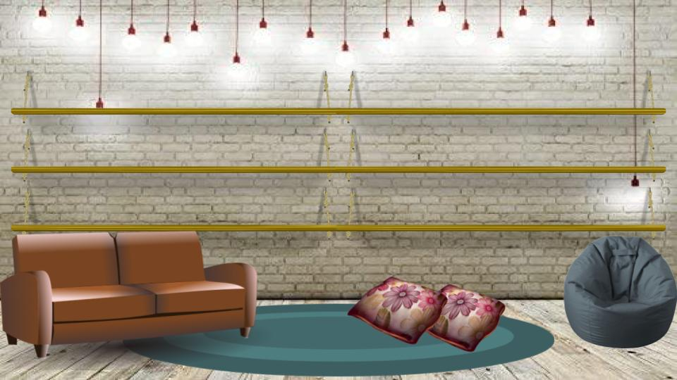

























AA
AA
AA
AA
A
A
A
B
B
B
C
C
C
D
D
D
D
E
E
E
E
F
F
F

Slide 2



























G
G
G
H
H
H
I
I
I
J
J
J
K
K
K
K
L
L
L
M
M
M
M
N
N
N

Slide 3




























O
O
O
P
P
P
Q
Q
Q
R
R
R
S
S
S
T
T
T
U
U
V
W
W
X
Y
Z
Z

