Slide 1
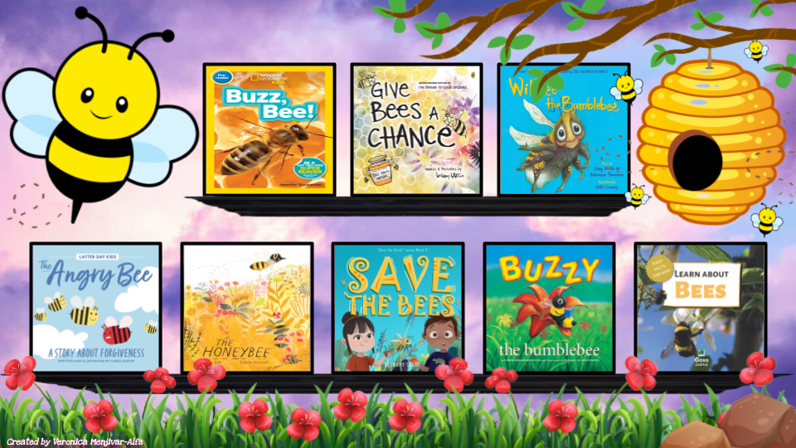
Notes:
🐝🍯Click on the book you’d like to hear for a read aloud.🍯🐝

