Slide 1
In this slideshow you will find some quick challenges you might be able to do around the house. Your goal is to try to create a fun trick similar to the one I am doing or you can try the exact trick as well. Be Creative!!
********************
With any of these challenges please get parent permission before attempting

Slide 2
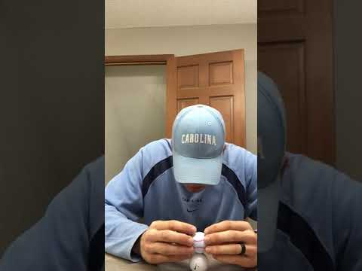
Challenge 1--Stack 3 Golf Balls

Slide 3
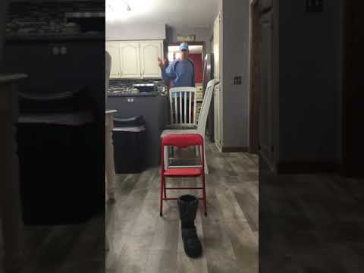
Challenge 2--The 3 Bounce Score

Slide 4
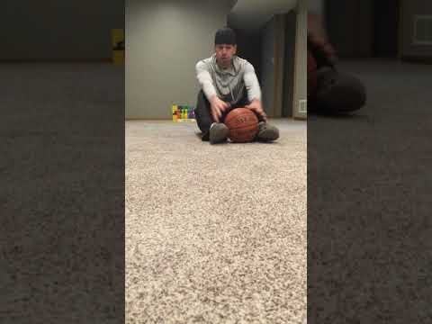
Challenge 3--Best Bowling Strike

Slide 5
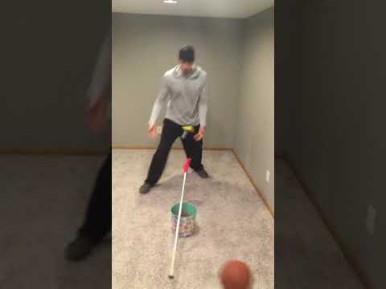
Challenge 4--Fulcrum Fever

Slide 6
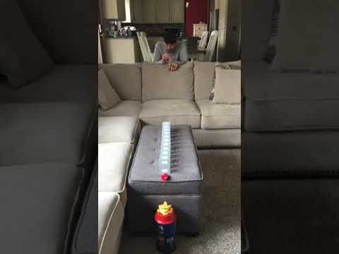
Challenge 5--Card Tricks

Slide 7
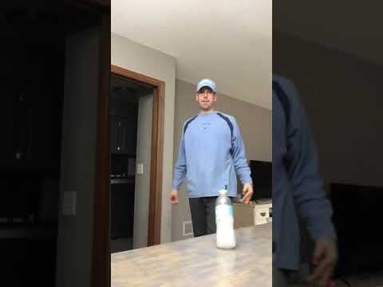
Challenge 6--Extreme Bottle Flip

Slide 8
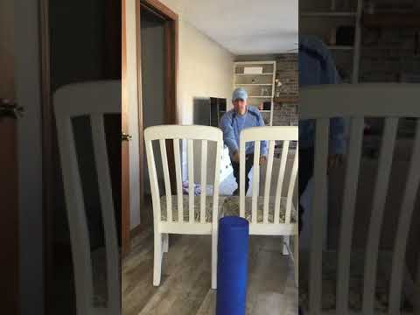
Challenge 7--Paper Airplane Party

Slide 9
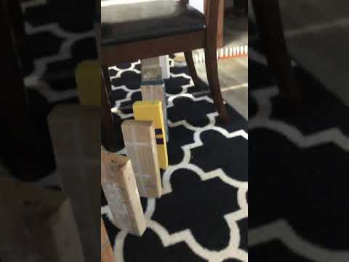
Challenge 8--The Domino Effect

Slide 10
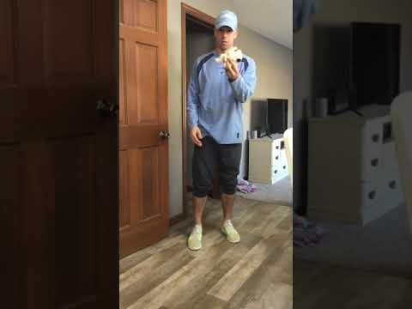
Challenge 10--Beanie Baby Bonanza

