Slide 1
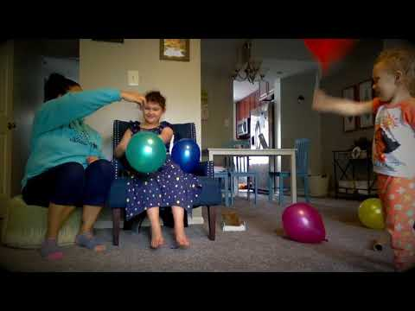
Balloon Volley Demonstration:

