Slide 1


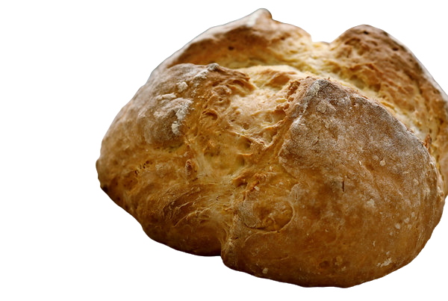
Baking Irish Soda Bread

Slide 2
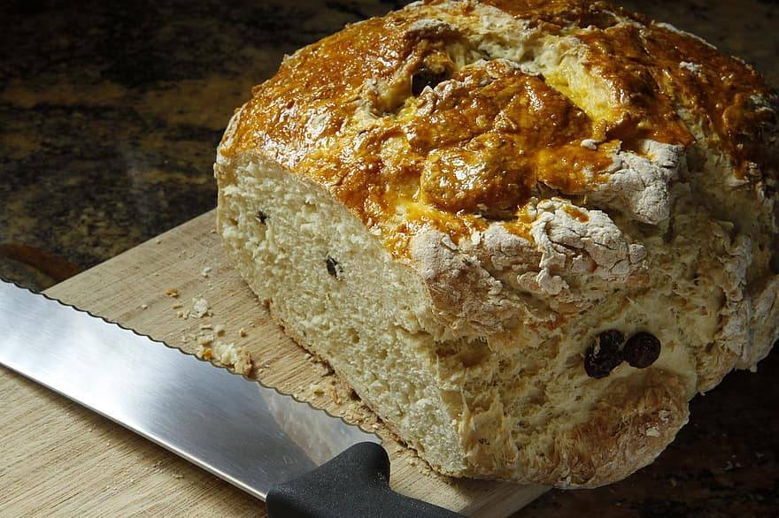
Irish Soda WATCH

Slide 3

Locate Ireland

Slide 4

Preheat the oven
to 375 F
Type here

Slide 5
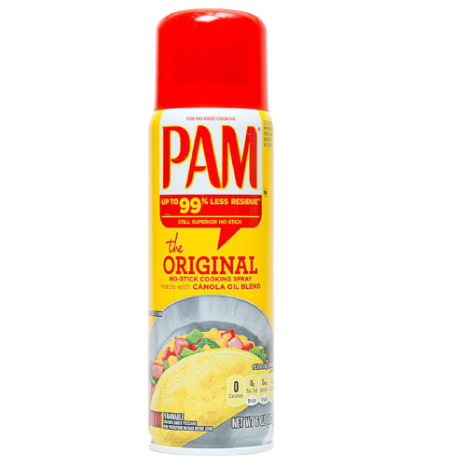
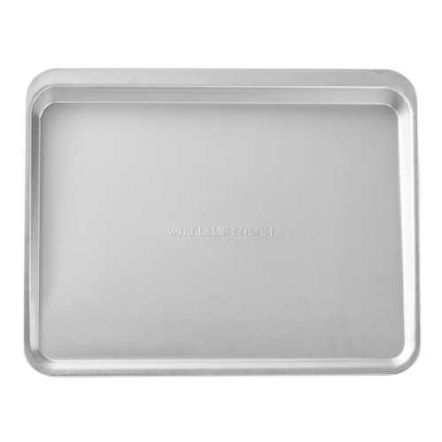
Lightly grease a large baking sheet.

Slide 6
Irish Soda Bread Recipe Ingredients
4 cups all-purpose flour 1 egg
4 tablespoons white sugar
1 cup buttermilk
1 teaspoon baking soda
1 tablespoon baking powder
½ teaspoon salt
½ cup margarine, softened

Slide 7
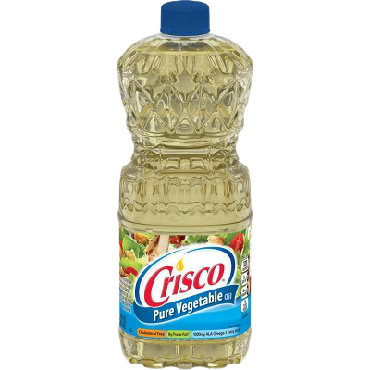
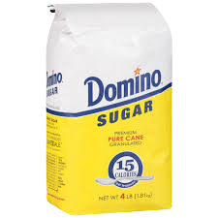
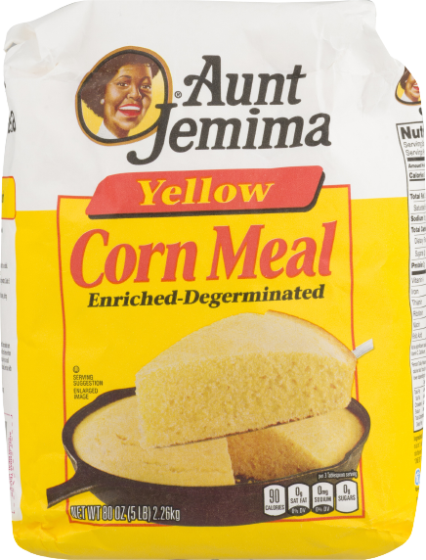
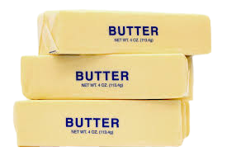
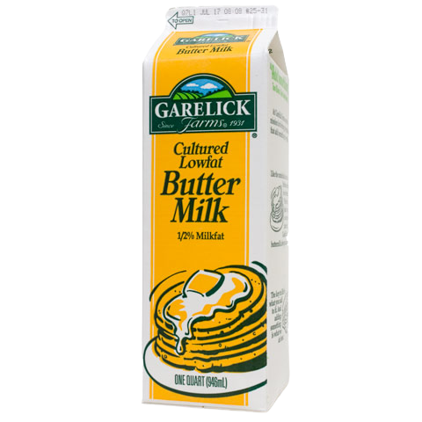
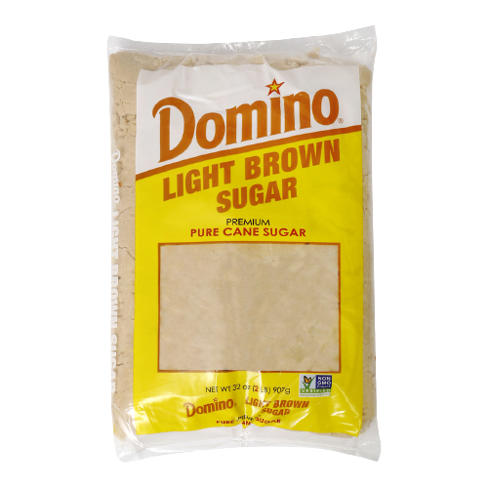
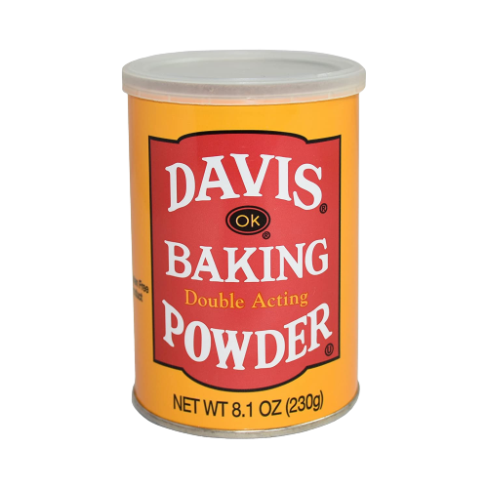
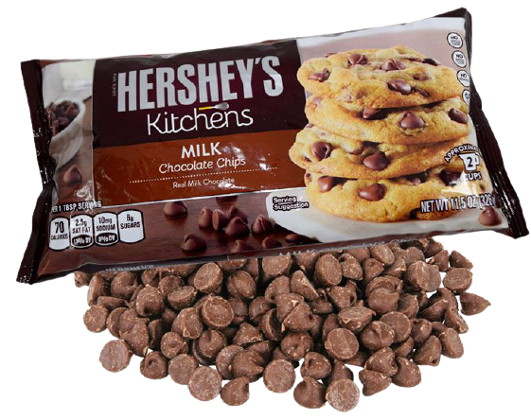

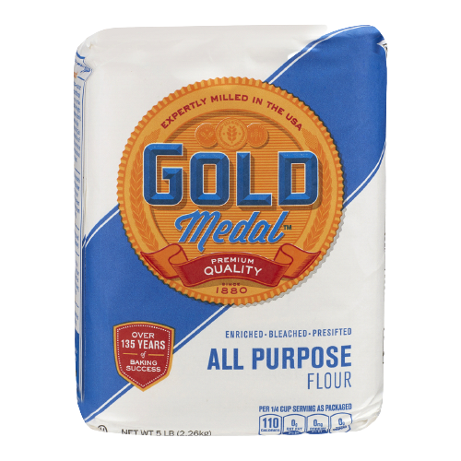
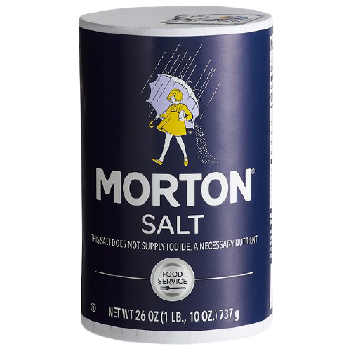

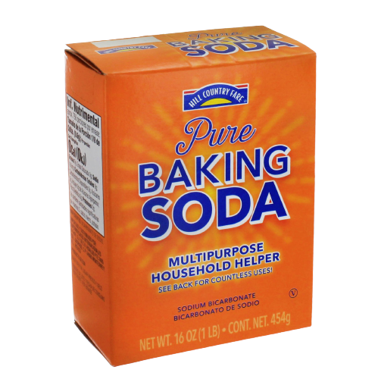
Take out the ingredients

Slide 8
How many eggs does the recipe call for?

Slide 9
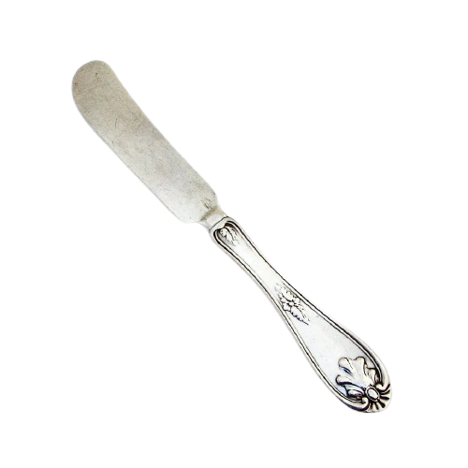
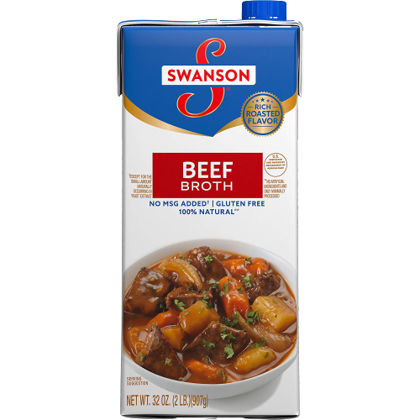


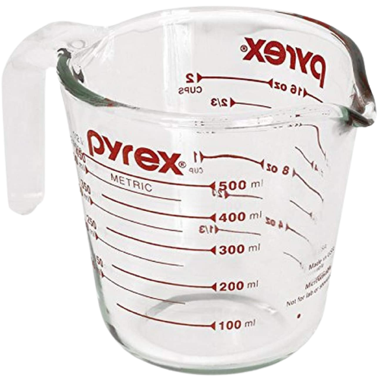
Measure 4 Cups flour
Place the correct measuring equipment in this box.
Place the correct ingredient in this box.

Slide 10


Measure 4 Tablespoons of sugar
Place the correct measuring equipment in this box.
Place the correct ingredient in this box.

Slide 11
Measure 1 cup buttermilk
Place the correct measuring equipment in this box.
Place the correct ingredient in this box.

Slide 12
Measure 1 teaspoon baking soda
Place the correct measuring equipment in this box.
Place the correct ingredient in this box.

Slide 13

Measure 1 tablespoon baking powder
Place the correct measuring equipment in this box.
Place the correct ingredient in this box.

Slide 14

Measure 1/2 teaspoon salt
Place the correct measuring equipment in this box.
Place the correct ingredient in this box.

Slide 15
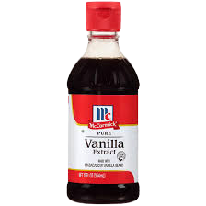
Measure ½ margarine
Place the correct measuring equipment in this box.
Place the correct ingredient in this box.

Slide 16
DIRECTIONS
In a large bowl, mix together flour, sugar, baking soda, baking powder, salt and margarine. Stir in 1 cup of buttermilk and egg.

Slide 17
What are the last 2 ingredients you mix in?

Slide 18
DIRECTIONS
Turn dough out onto a lightly floured surface and knead slightly. Form dough into a round and place on prepared baking sheet.

Slide 19
What does knead mean?

Slide 20
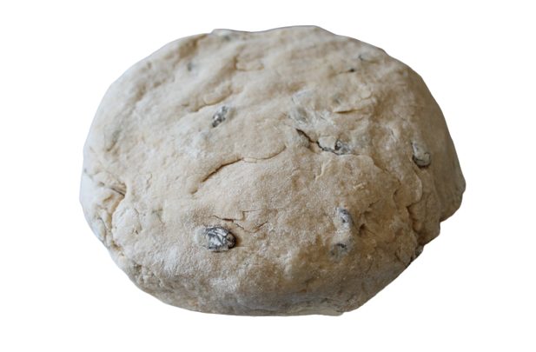
Put the dough on the greased cookie sheet

Slide 21
DIRECTIONS for topping
In a small bowl, combine melted butter with 1/4 cup buttermilk; brush loaf with this mixture.
Use a sharp knife to cut an 'X' into the top of the loaf.

Slide 22
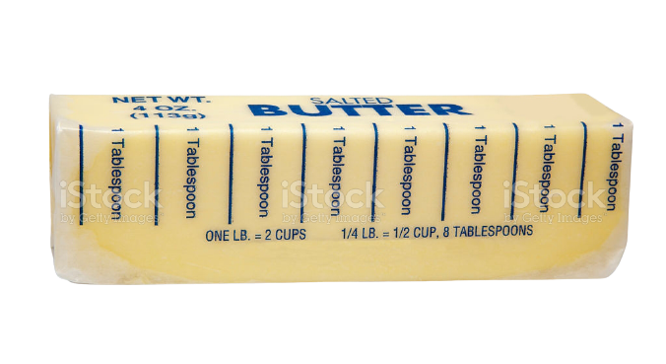
Measure 1/4 cup of butter
¼ cup of butter is equal to 4 TBSPs.
Cut the stick at ¼ cup

Slide 23
How will you melt the butter?

Slide 24
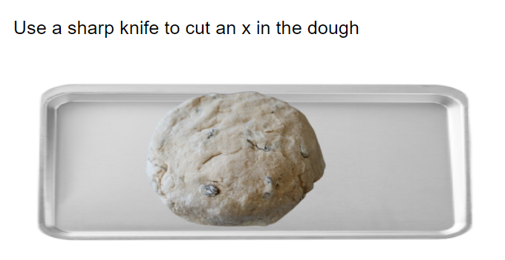

Slide 25
DIRECTIONS
Bake in preheated oven until a toothpick inserted into the center of the loaf comes out clean, 45 to 50 minutes.

Slide 26
How will you know if the bread is done?

Slide 27

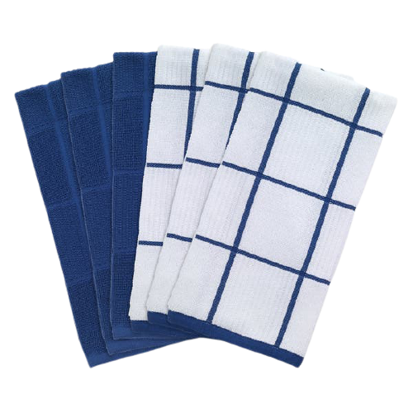
Before putting the bread in the oven you need?

Slide 28
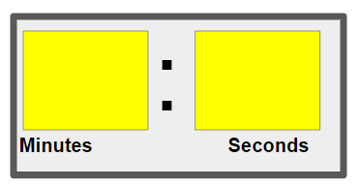
Bake for 45-50 minutes in the preheated oven
Set the timer

Slide 29
The bread baked for 50 minutes
If I you put it in at 10:00 am when will it be done.
:

