Slide 1



























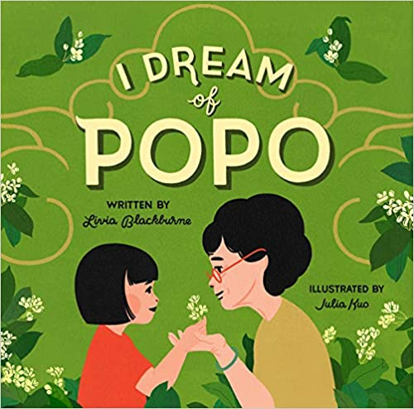






Asian & Pacific Islander
Library

Slide 2

Looking for more libraries?
Check out my linktree....
https://linktr.ee/missrachelsf
Buy Me A Coffee ☕️
Vemno

