Slide 1

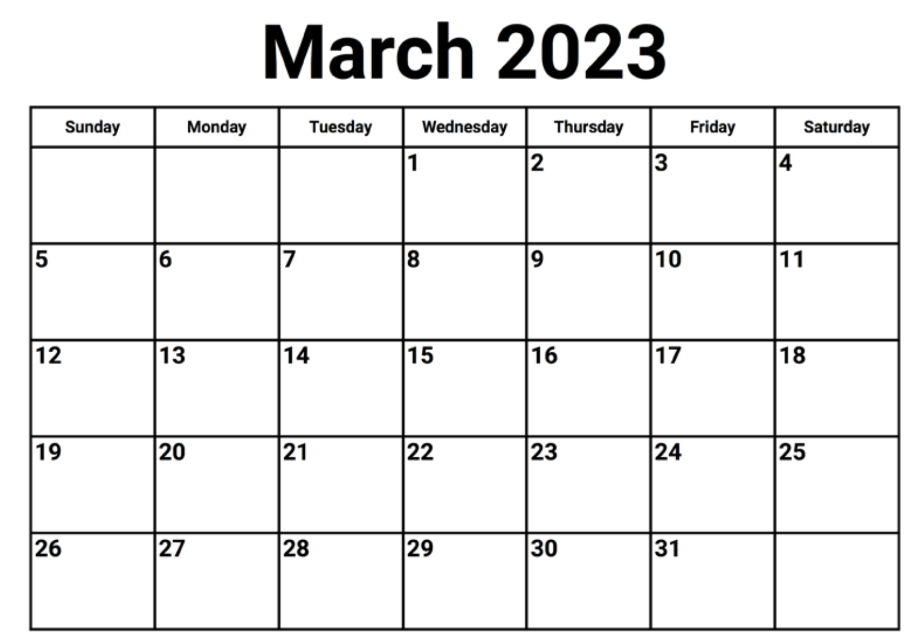
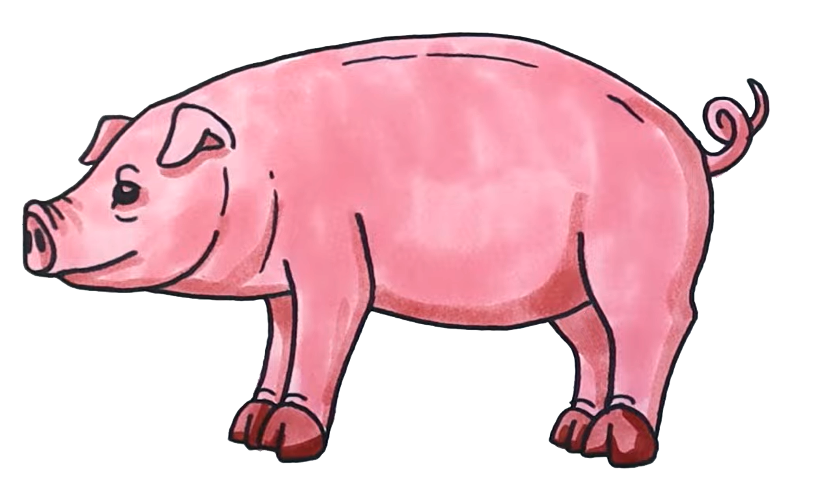







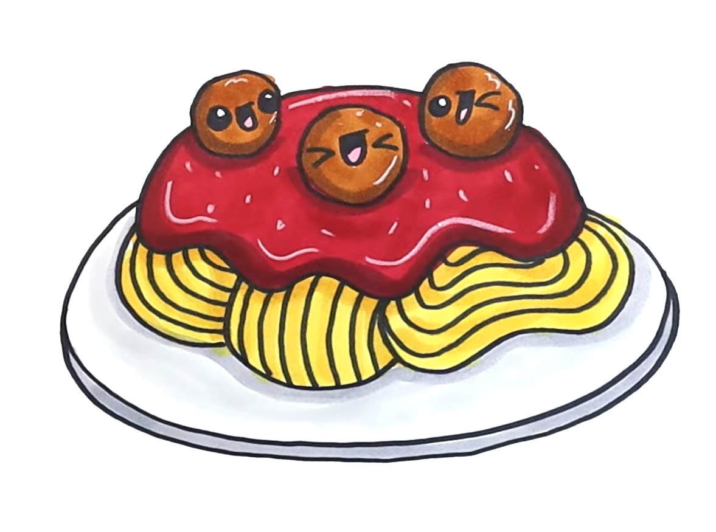
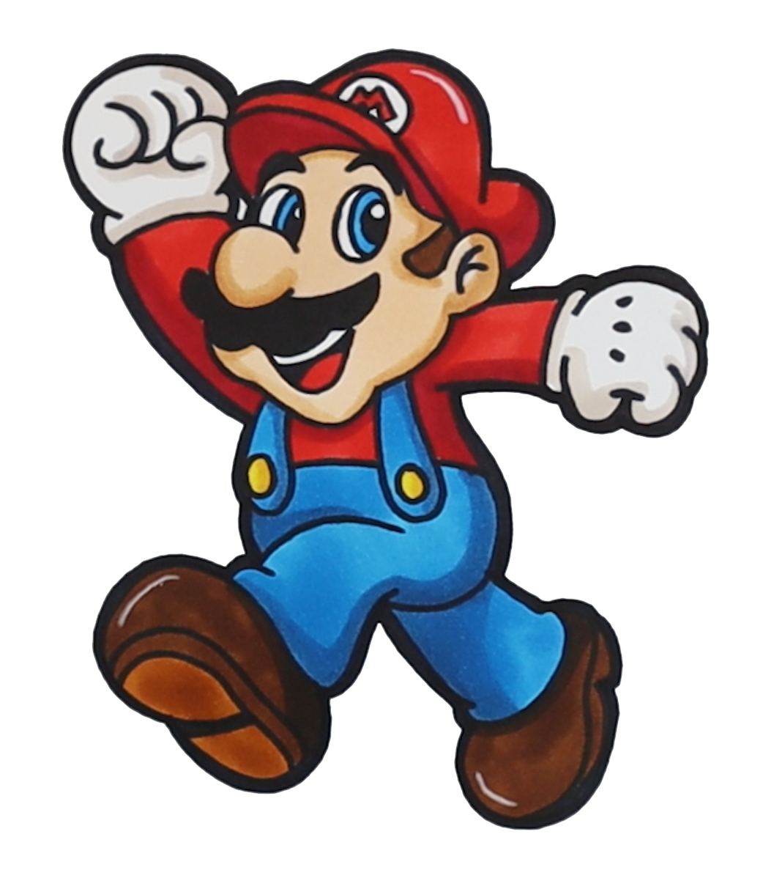
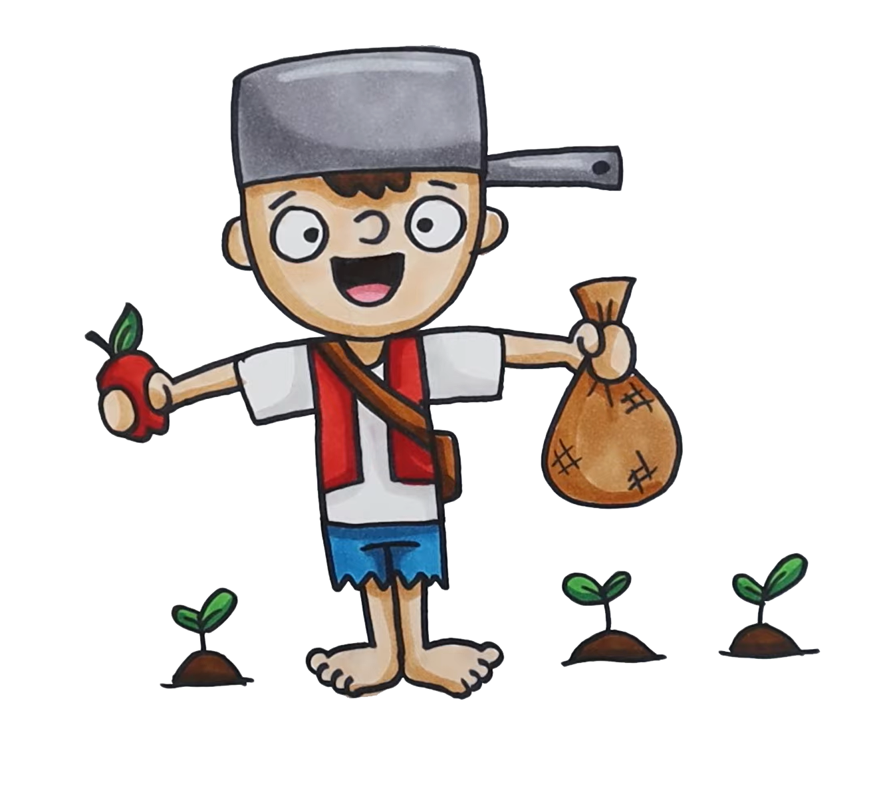
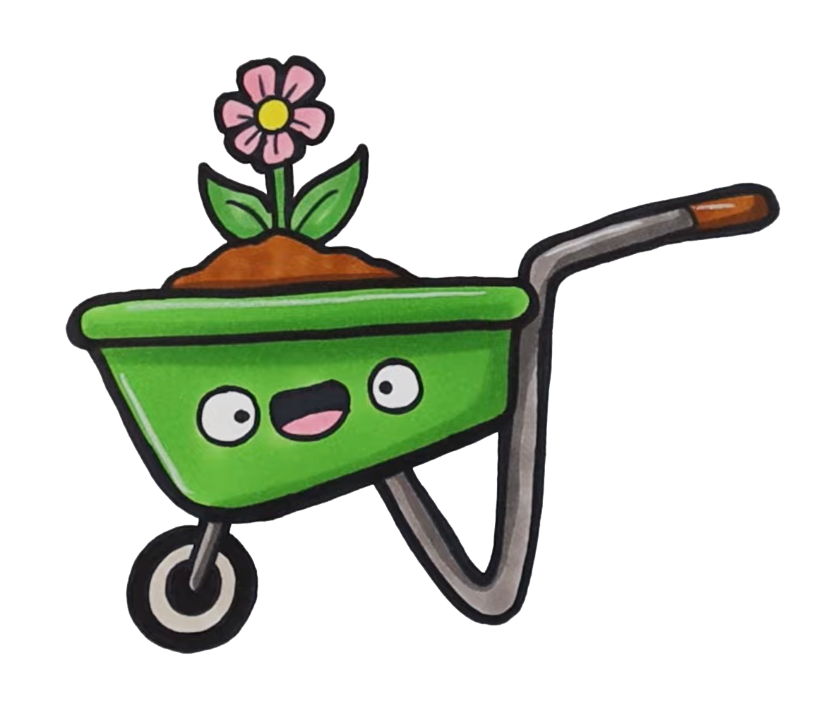
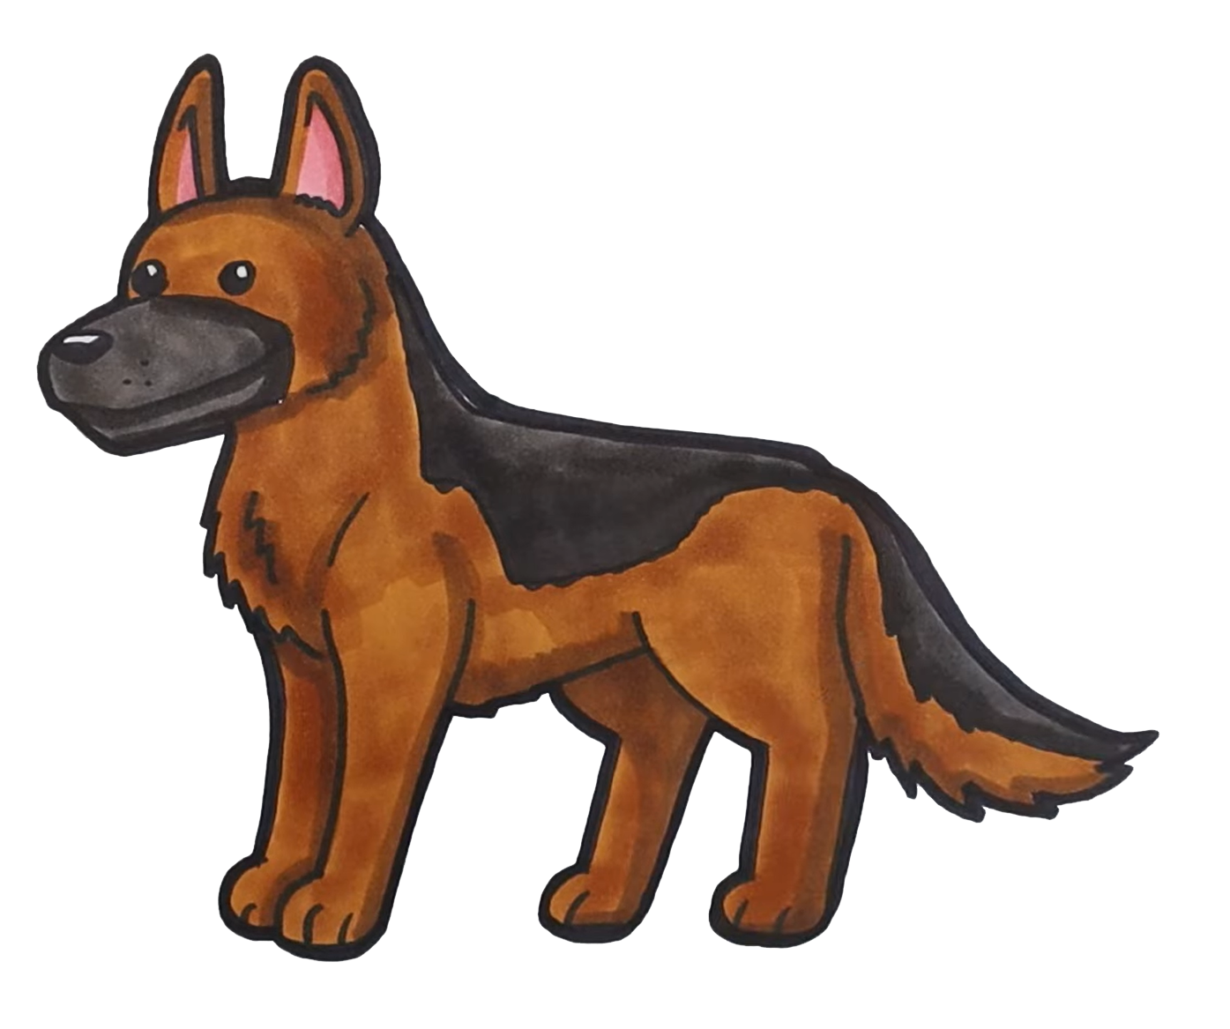
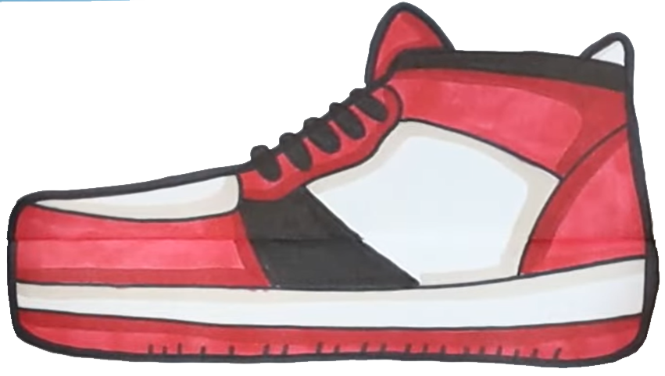

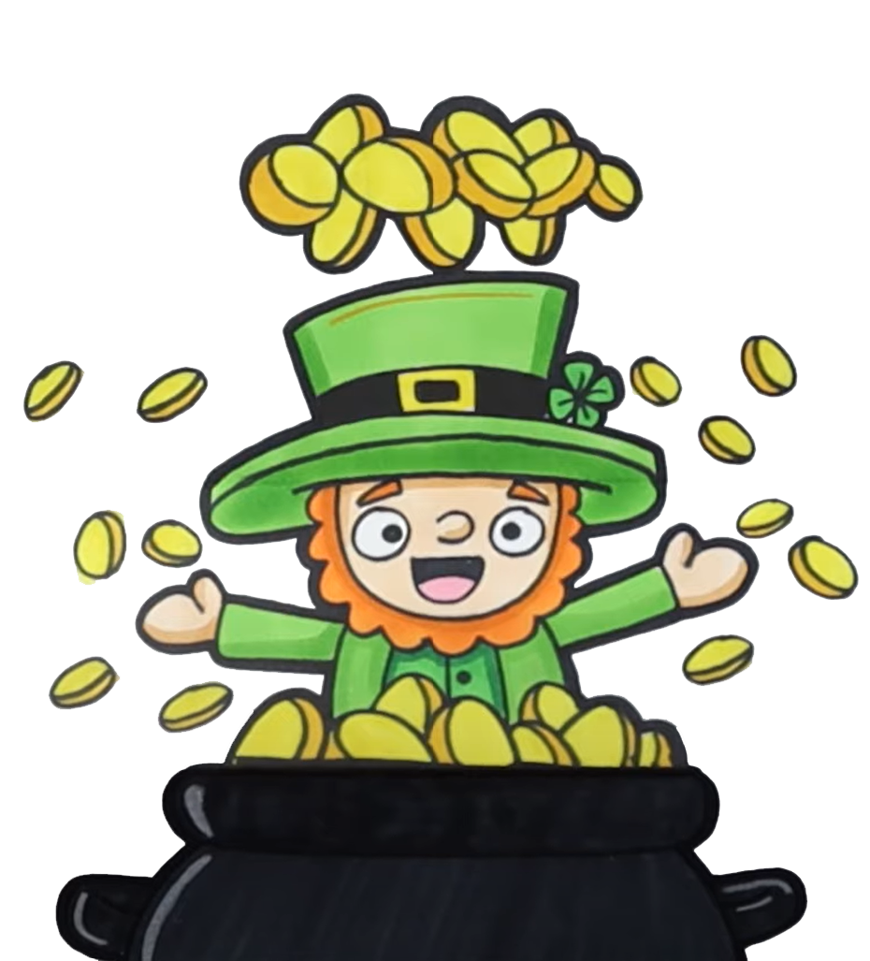



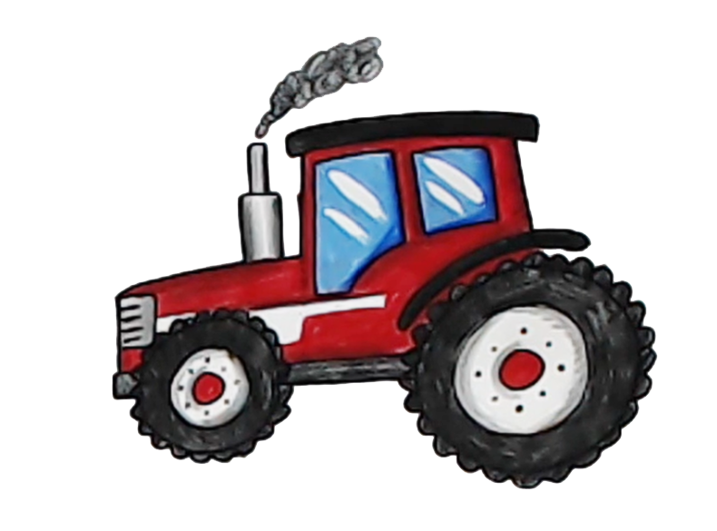



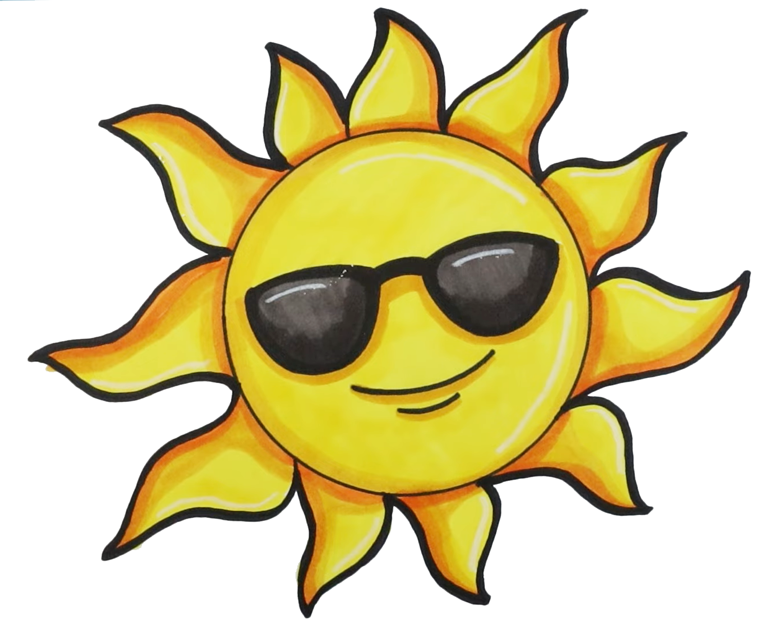



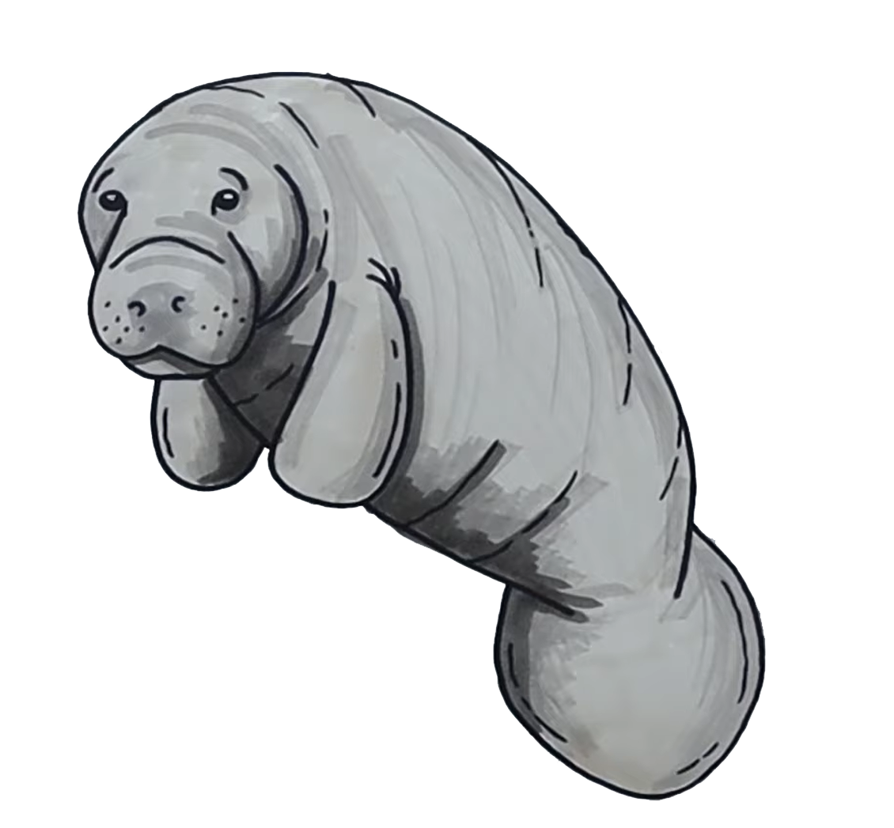
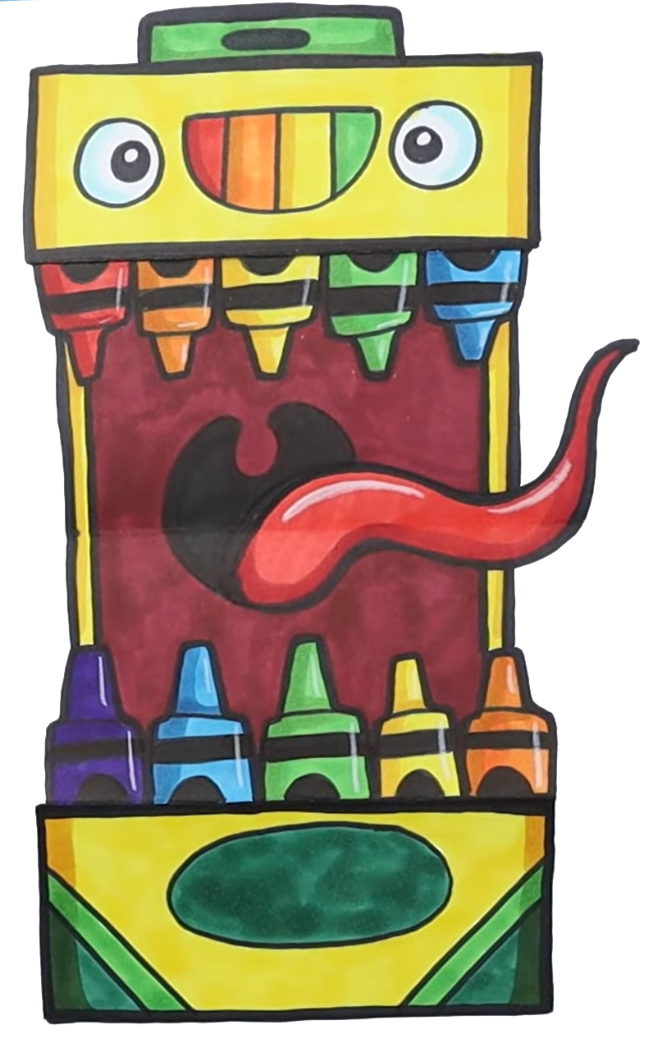

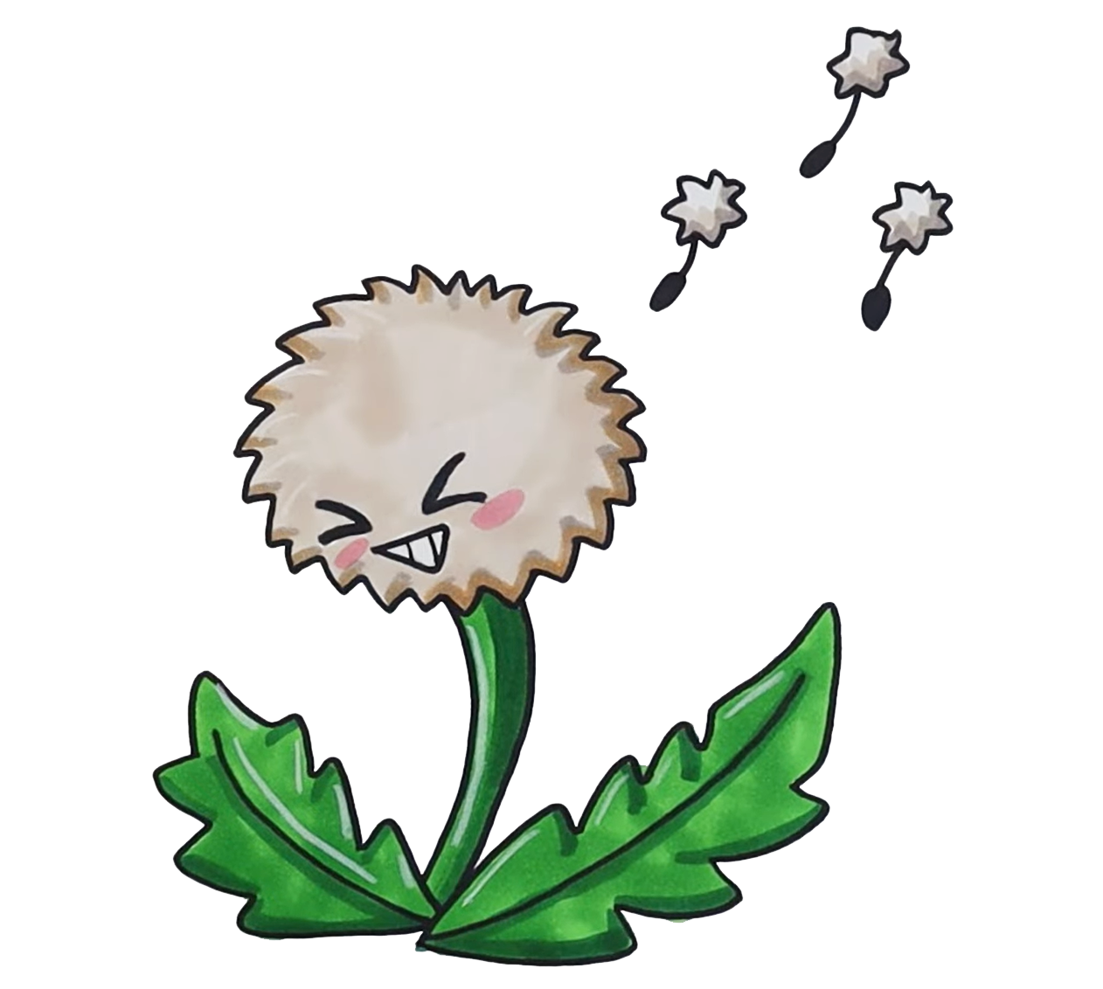
MARCH NATIONAL DAYS 2023
DR. SEUSS
DAY
GRAMMAR
DAY
NATIONAL ANTHEM DAY
PIG DAY
DENTIST
DAY
PEANUT CLUSTER DAY
MARIO
DAY
JOHNNY
APPLESEED DAY
CHEESE DOODLE DAY
FLAPJACK DAY
MEATBALL DAY
SLOPPY
JOE
DAY
K-9
VETERANS DAY
ST. PATRICK’S
DAY
PLANT A FLOWER
DAY
BUTTERFLY
DAY
SHOE THE WORLD DAY
PANDA DAY
FRENCH
BREAD
DAY
CHIP
AND
DIP DAY
TOLKEIN
DAY
CORN DOG DAY
SPRING BEGINS
AGRICULTURE DAY
CHEESESTEAK DAY
PURPLE
DAY
WEEDS
DAY
CRAYON
DAY
JOE DAY
VIETNAM VETERAN DAY
MANATEE DAY

