Slide 1
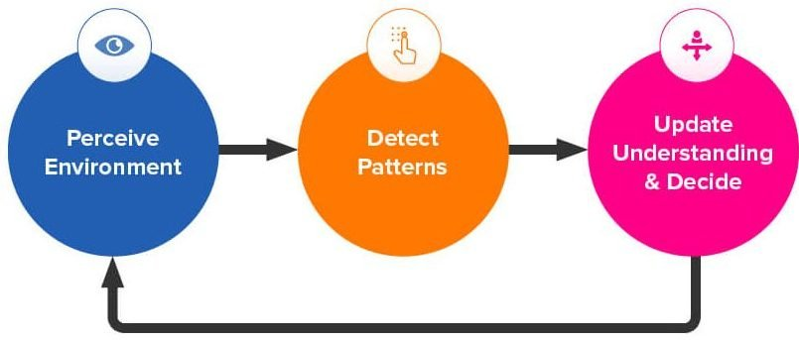
Teachable Machine
Teachable Machine is a web-based tool that lets you create custom machine learning models easily.
You can train models to recognize images, sounds, or poses without needing to write any code.

Slide 2
Directions
Go to https://teachablemachine.withgoogle.com/.
Project Type: Choose the “Image Project” which will recognize images or photos.
Define Classes: Classes represent the categories you want the model to recognize. (the phases of the cell cycle)
Add Data: Upload images or capture them with your webcam.
Train the Model: Once you've added enough examples for each class, click the “Train Model” button.
Export and Use Your Model: Click “Export Model” and test out how you’ve trained your machine.

Slide 3
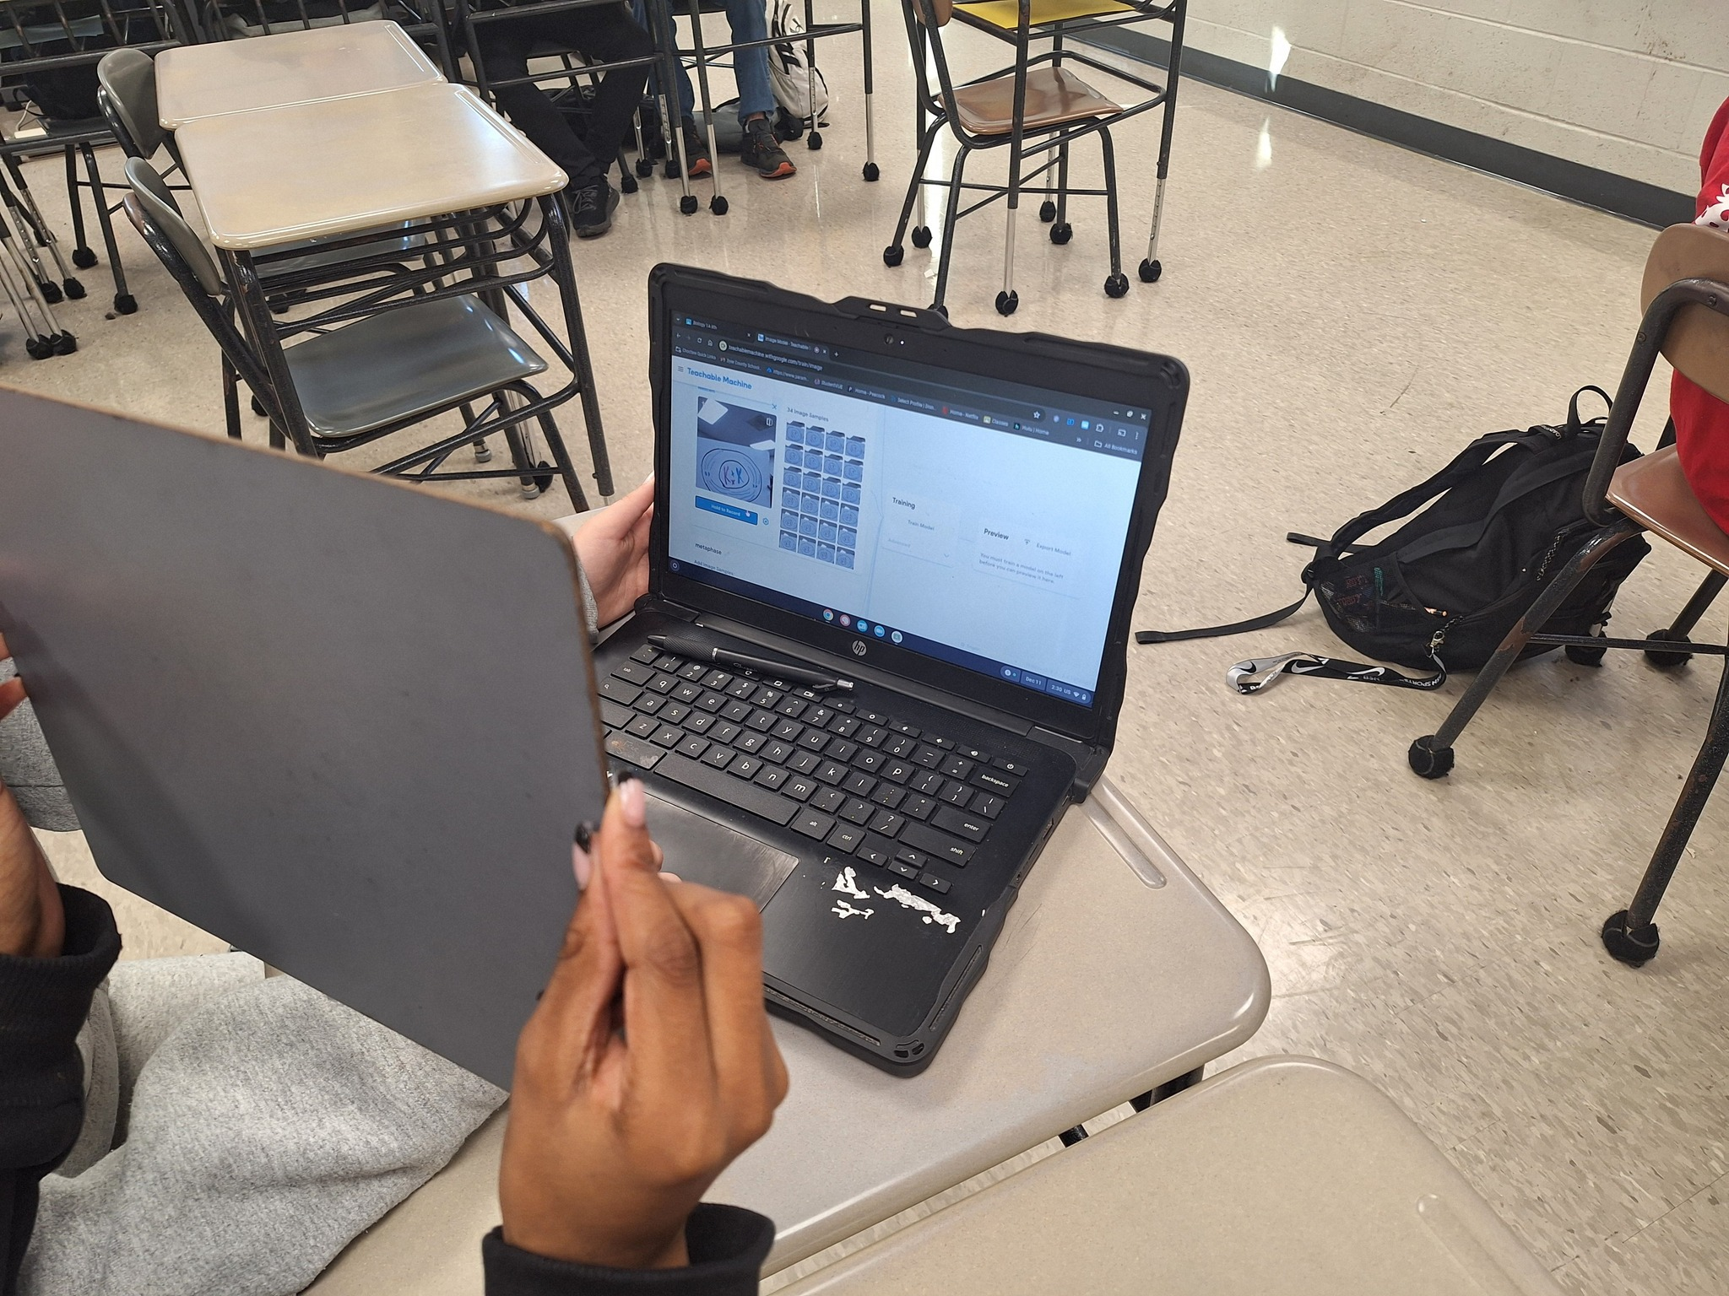
Tips for Better Results
Diverse Examples: Include a variety of samples for each class.
Balanced Data: Ensure each class has a similar number of examples.
Clear Backgrounds: For images and poses, use simple backgrounds to improve accuracy.

