Slide 1
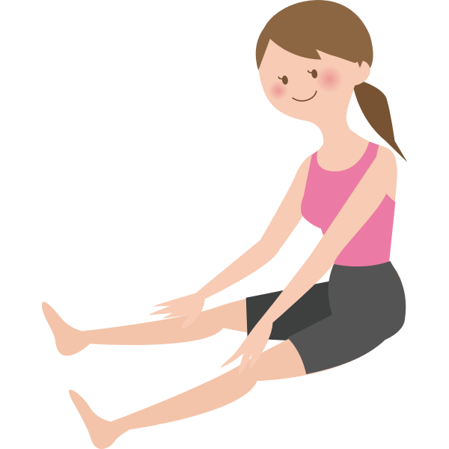

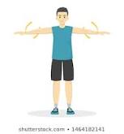
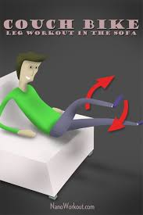
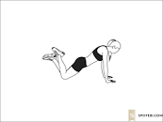
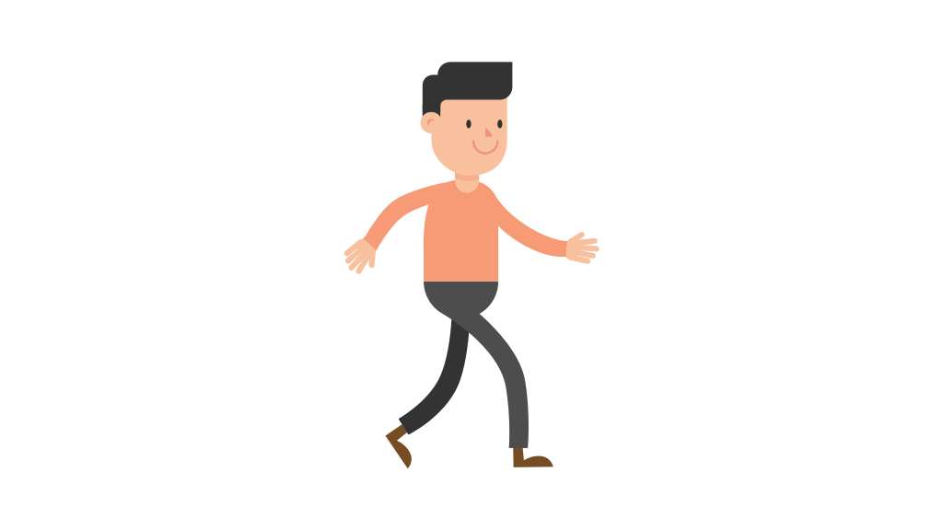


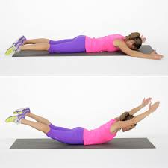

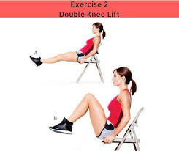

APE FITNESS TASK SHEET
DAY
DAY
DAY
1
2
3
Warm-up:
30 seconds walk in place
30 sec. each
1 minute each
Arm circles
Knee pushups
Overhead press
Bicep curls
Sofa bicycle abs
March in place (high knees)
Superman lifts
Chair double
leg lifts
15 minute walk
Complete 2 more times!
I am DONE!
Slide check mark here!
Complete 1 more time!
I am DONE!
Slide check mark here!
I am DONE!
Slide check mark here!

