Slide 1

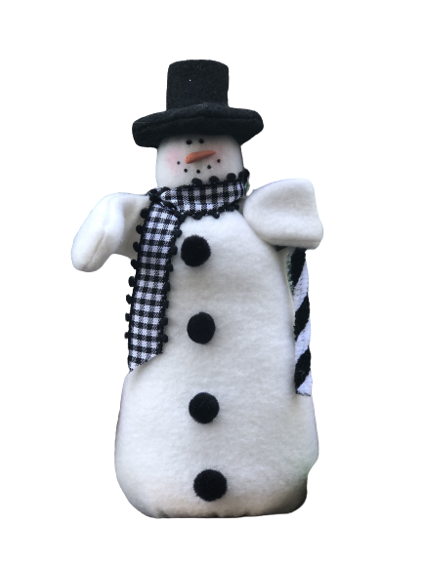







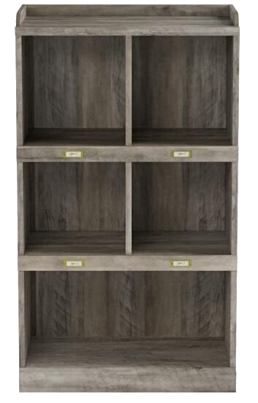










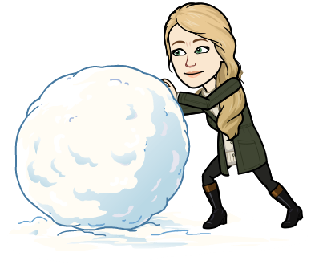









Chapter 1 Stillwater | Chapter 2 The Voice In the Air | Chapter 3 Out of the Antarctic | Chapter 4 Captain Cook
Chapter 5 Troubles With a Penguin | Chapter 6 More Troubles | Chapter 7 Captain Cook Builds a Nest | Chapter 8 Penguin’s Promenade
Chapter 9 In the Barber Shop | Chapter 10 Shadows | Chapter 11 Greta | Chapter 12 More Mouths to Feed
Chapter 13 Money Worries | Chapter 14 Mr. Greenbaum | Chapter 15 Pepper’s Performing Penguins | Chapter 16 On the Road
Chapter 17 Fame | Chapter 18 April Winds | Chapter 19 Admiral Drake | Chapter 20 Farewell Mr. Popper
This Month’s
Chapter Book

