Slide 1
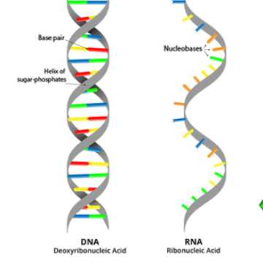
Lesson 4- Protein Synthesis Part 1- From DNA to mRNA
Learning Objectives:
Identify the role of the nucleus and the ribosome in protein synthesis
Explain how DNA and RNA compare and contrast
Synthesize a strand of mRNA from a DNA template
Explain the role of mRNA in protein synthesis

Slide 2
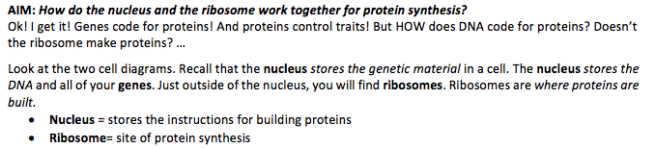
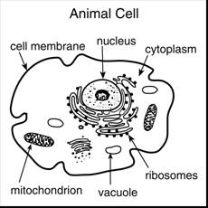
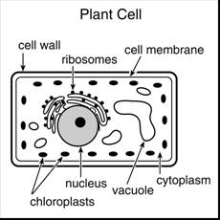

Slide 3
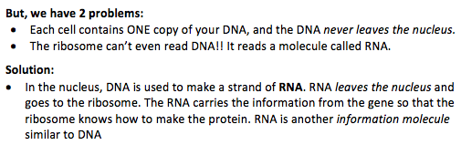

Slide 4
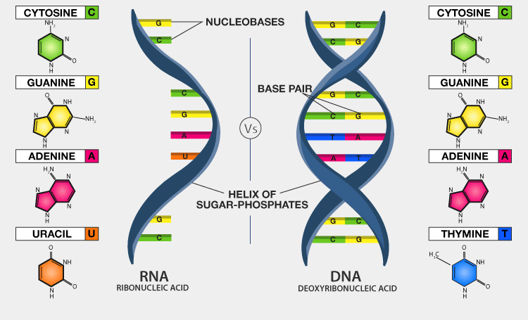

Slide 5
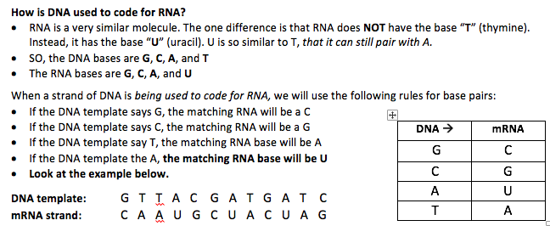

Slide 6
DNA template:
mRNA:
G T A T G T C A C
C A U A C A G U G

Slide 7
DNA template:
mRNA:
T T A G A G A C T
A A U C U C U G A

Slide 8
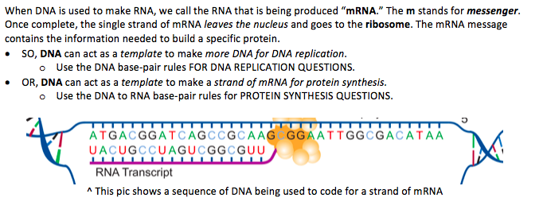

Slide 9
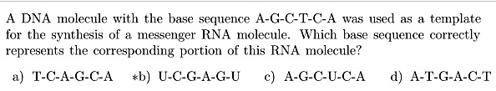


Slide 10
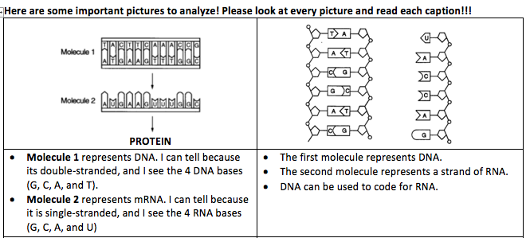

Slide 11
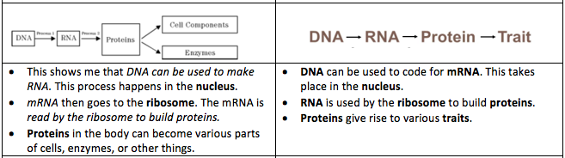

Slide 12
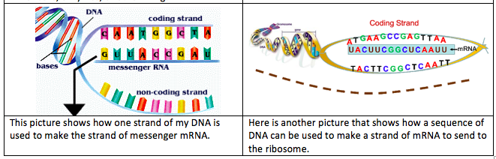

Slide 13
Lesson 4- Protein Synthesis Part 1- From DNA to mRNA
Learning Objectives:
Identify the role of the nucleus and the ribosome in protein synthesis
Explain how DNA and RNA compare and contrast
Synthesize a strand of mRNA from a DNA template
Explain the role of mRNA in protein synthesis

