Slide 1
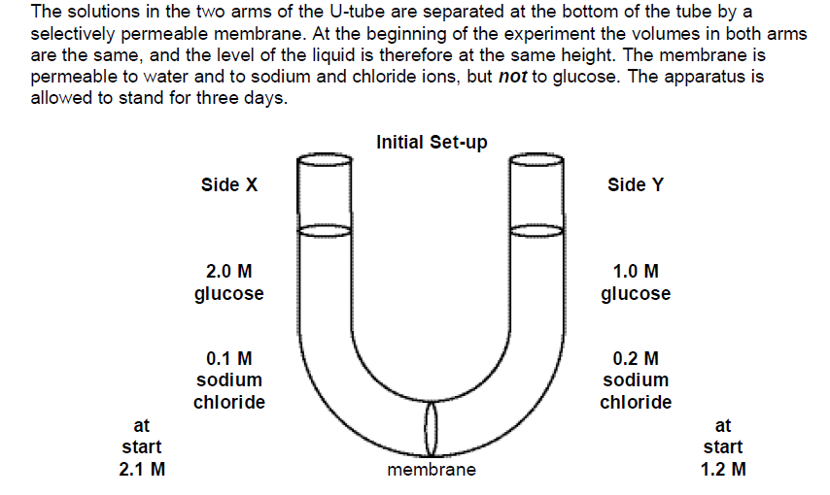
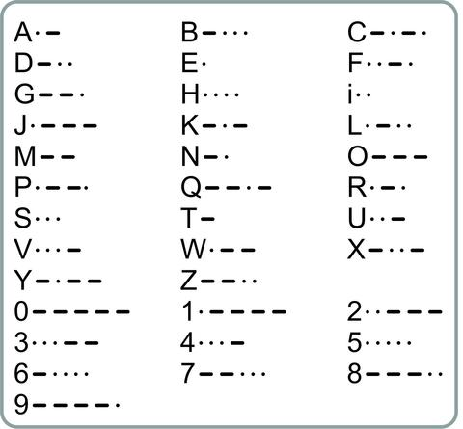
Choose the following options below for each of the questions 1-4 to move up to escape the cell!!
Both the statement and the reason are correct.
Both the statement and the reason are incorrect.
…-- The statement is incorrect, but the reason is a fact or a principle.
The statement is correct, but the reason is incorrect.
Q1. The sodium chloride solution on Side X will become more concentrated while Side Y will become less concentrated because a substance tends to diffuse from regions of lower concentration to regions of higher concentration of that substance.
Q2. The concentrations of the glucose solutions on Sides X & Y will remain unchanged because the membrane is impermeable to glucose and so glucose cannot diffuse from one side to the other.
Q3. Water molecule will have a net movement from Side X to Side Y, because water molecules move from regions of higher to regions of lower concentration.
Q4. The fluid on Side X will rise because the solution in Side X had lower water concentration than the solution in Side Y.

