Slide 1



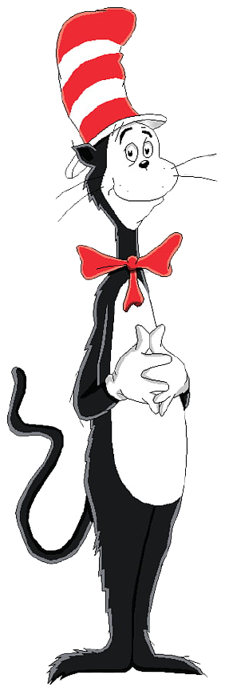


Happy Birthday, Dr. Seuss!
March 2, 2021
Mixed CVC Rhyming
Sharon E. Peabody, MA, CCC-SLP

Slide 2



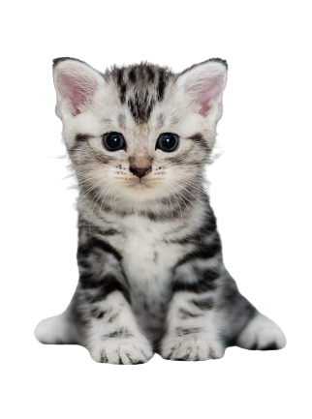


 | a | t
 | a | t

Slide 3

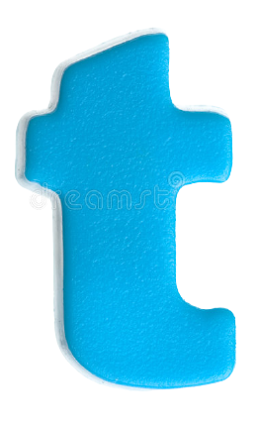
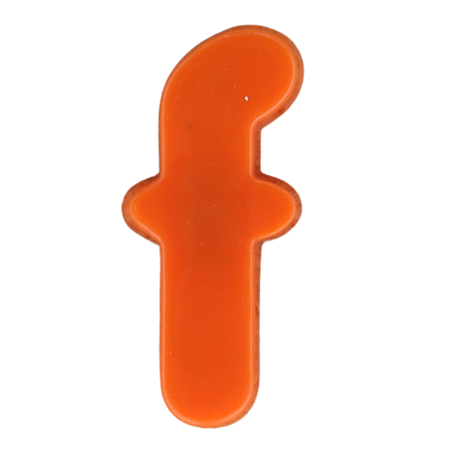
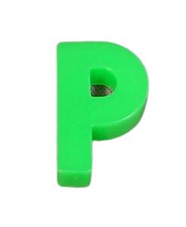
 | i | n
 | i | n

Slide 4
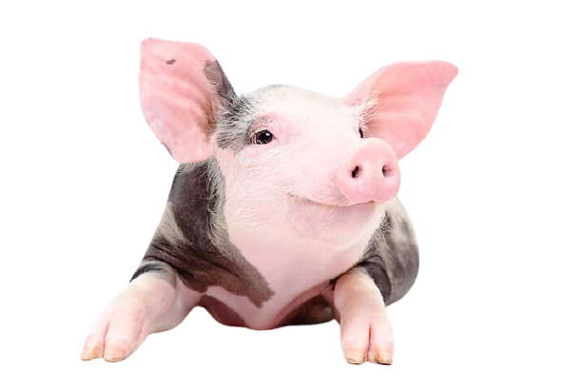
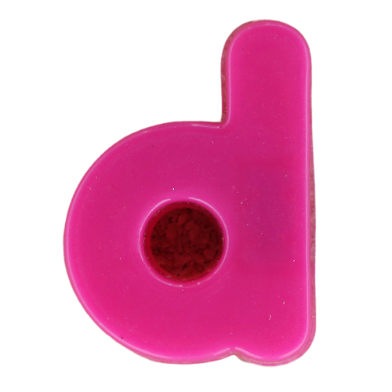
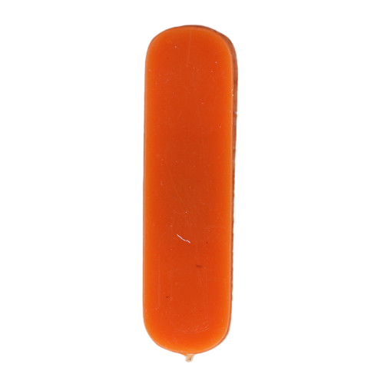

 | o | g
 | o | g

Slide 5

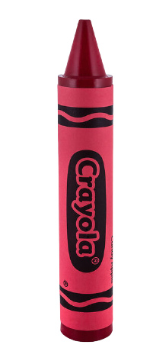
 | e | d
 | e | d

Slide 6

 | a | n
 | a | n

Slide 7
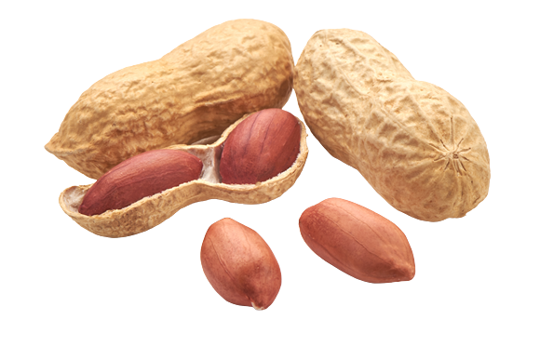
 | u | t
 | u | t

Slide 8
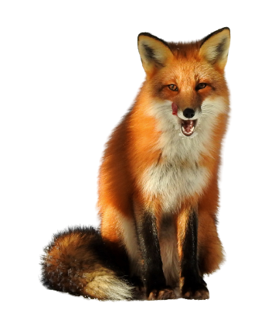
 | o | x
 | o | x

Slide 9


 | a | d
 | a | d

Slide 10

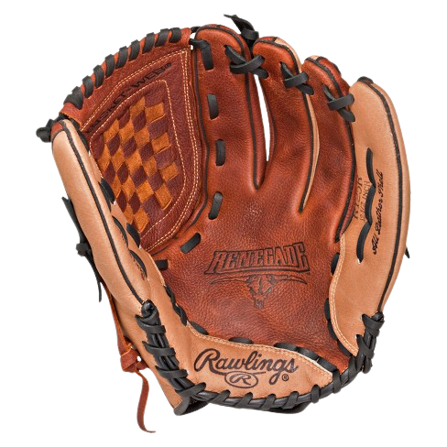
 | i | tt
 | i | t

Slide 11
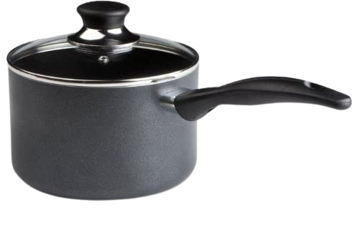
 | o | t
 | o | t

Slide 12
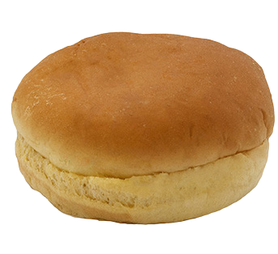
 | u | n
 | u | n

Slide 13
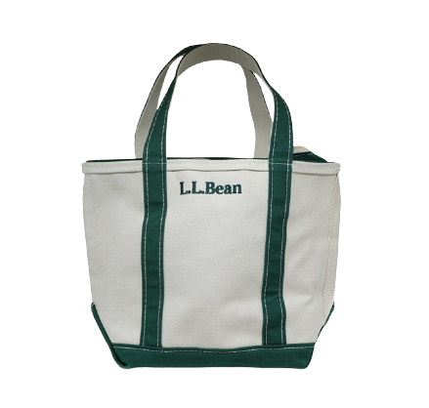
 | a | g
 | a | g

Slide 14
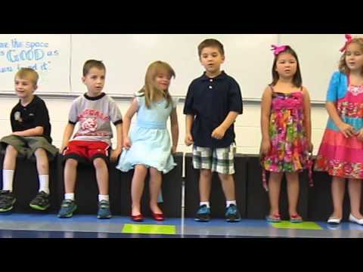

Willaby Wallaby Woo

Slide 15



When is your birthday?
Let’s rhyme with your name.
________________________

