Slide 1



Happy 100
Days of School

Slide 2


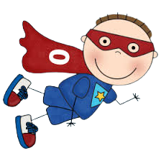
Color Super Hero 0

Slide 3


Slide 4
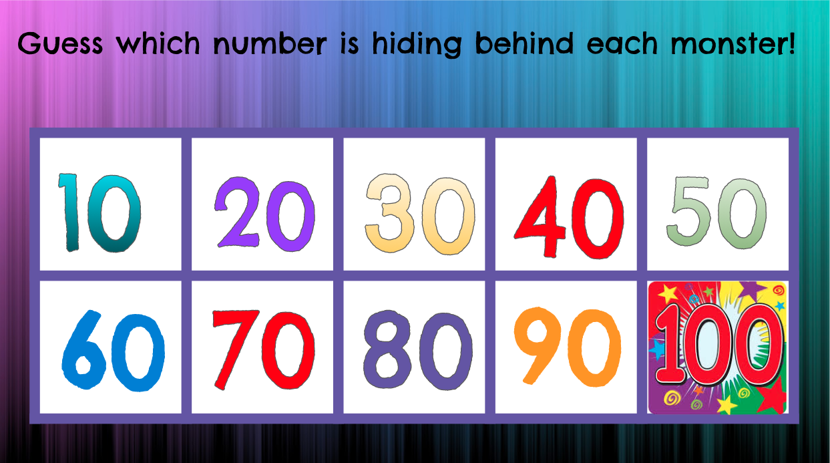








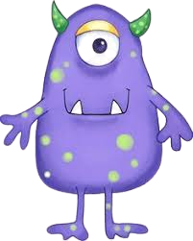


Slide 5
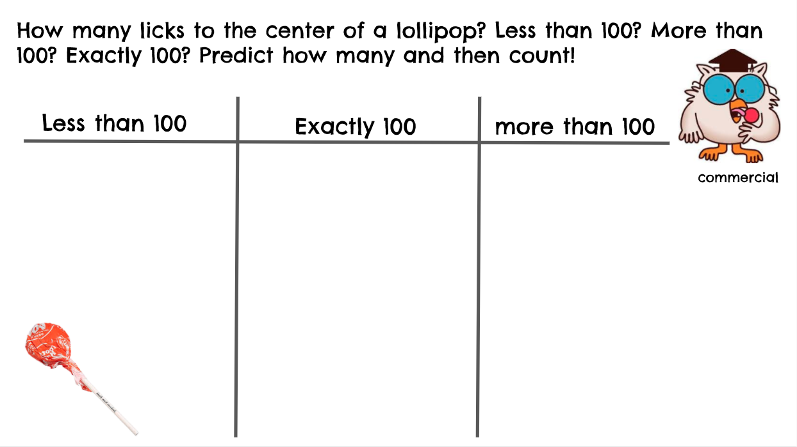

Slide 6



Slide 7


Can you hop for 100 seconds?

Slide 8



Slide 9
What would you look like if you were 100 years old? Draw a picture of yourself as a 100 year old person.

Slide 10
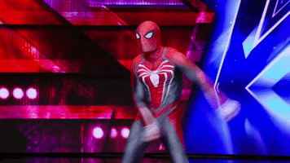

Can you floss for 100 seconds?

Slide 11
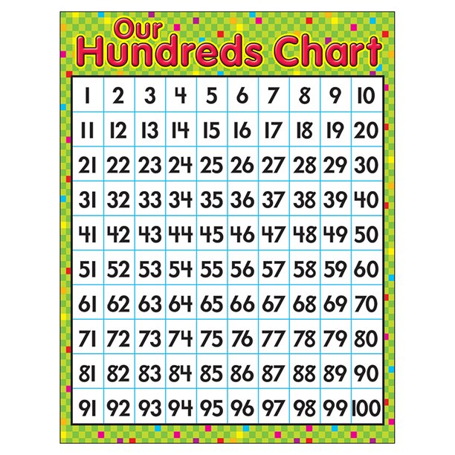
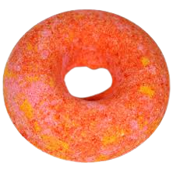
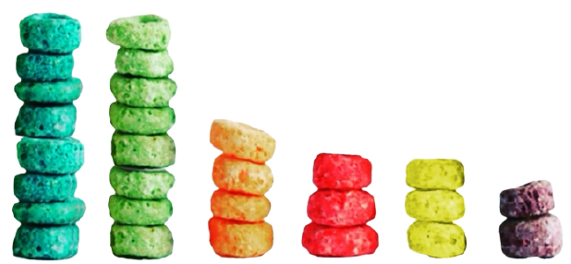

Place your froot Loops on your 100s chart and when all of the spaces has a froot loop, make a necklace with them!

Slide 12
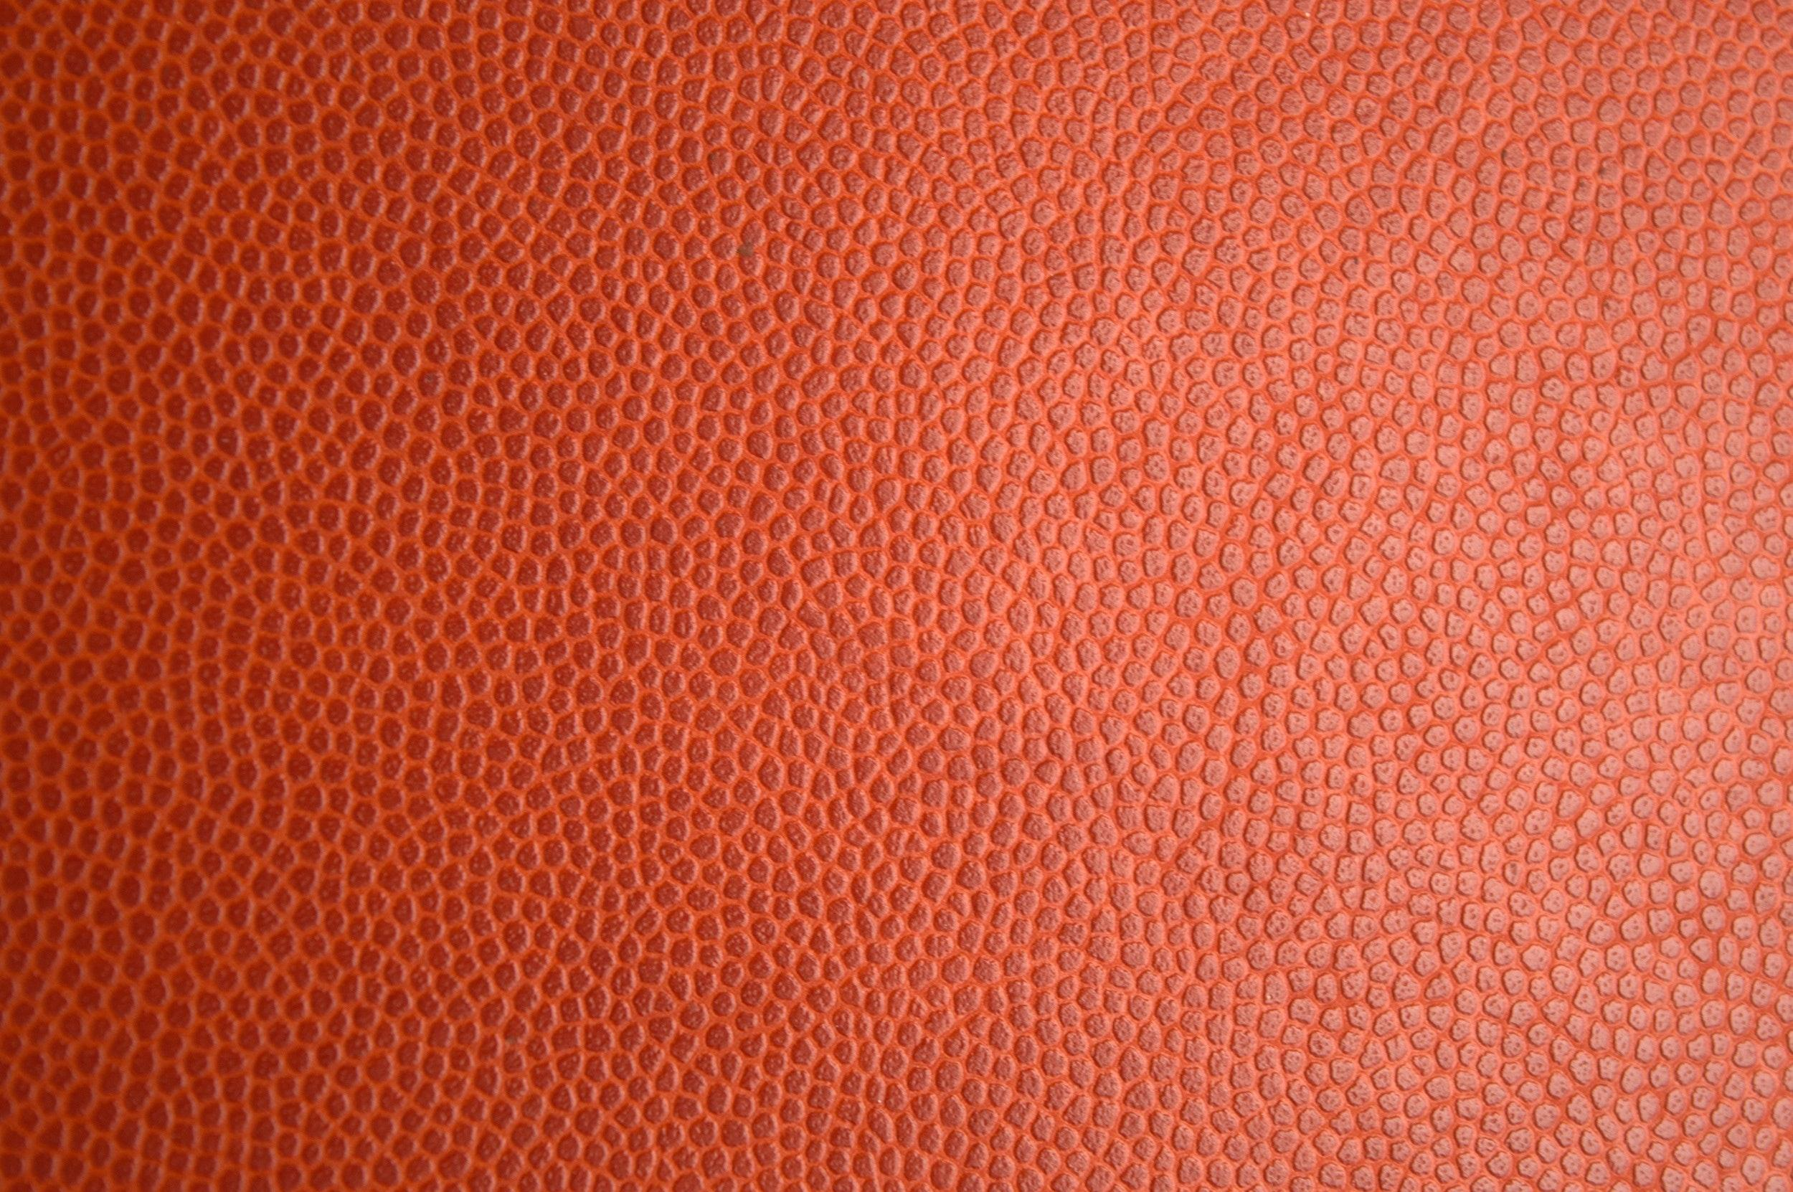


Slide 13

Would You Rather?
100 Days of School

Slide 14

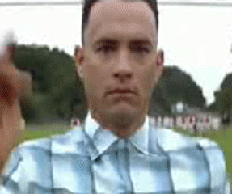
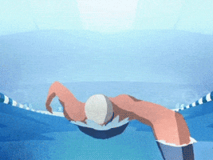
Would you rather?
OR
swim with 100 sharks
run from 100 tigers

Slide 15

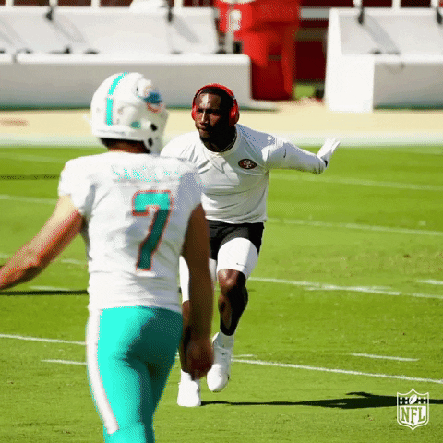
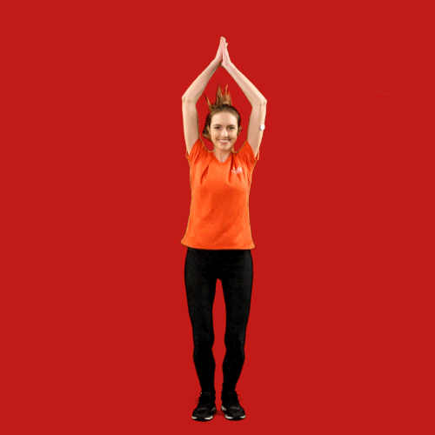
Would you rather?
build 100 snowmen
make 100 snow angels
OR

Slide 16

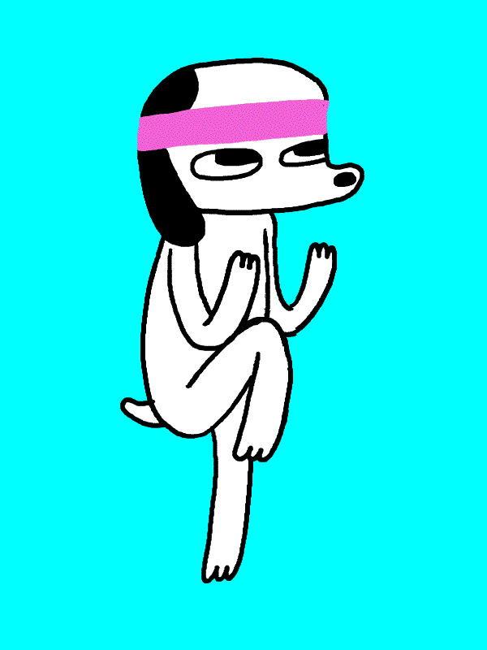

Would you rather?
OR
eat 100 shoes
eat 100 slobbbery dog bones

Slide 17

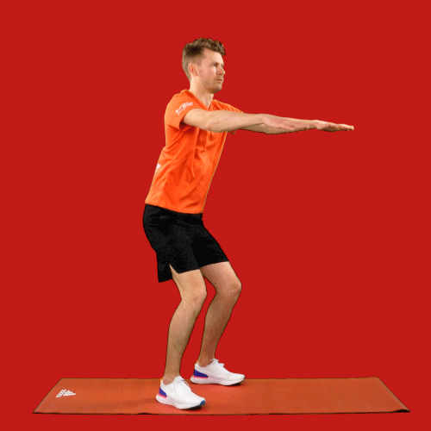
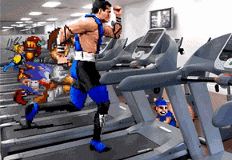
Would you rather?
OR
clean 100 toilets
clean 100 litter boxes

Slide 18

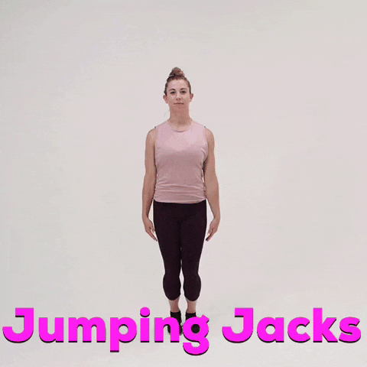
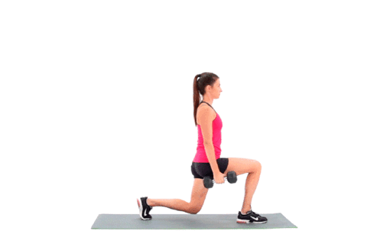
Would you rather?
OR
find 100 dollars
find 100 bags of candy

Slide 19

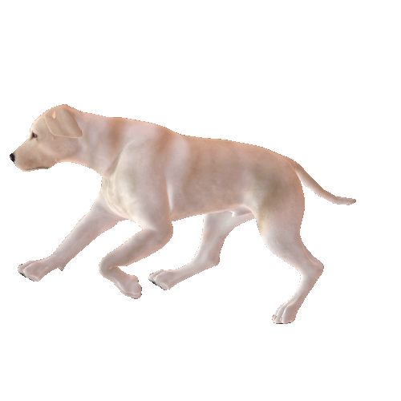
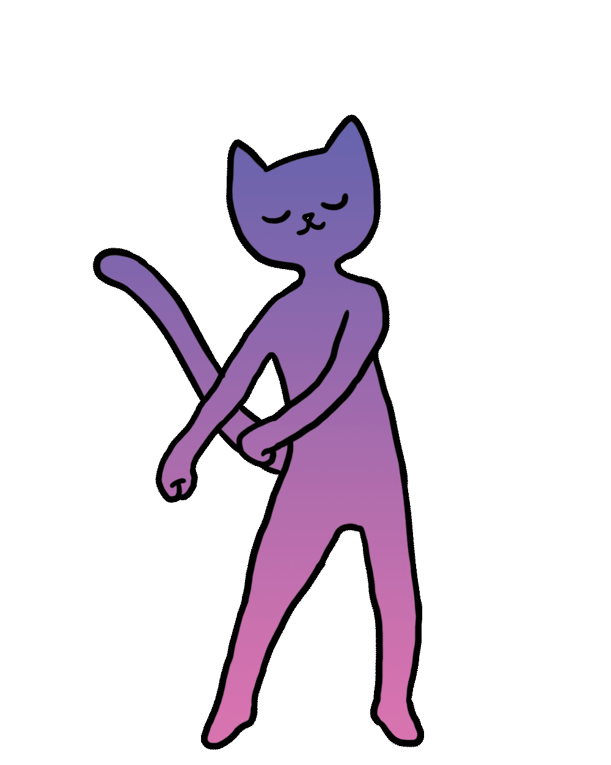
Would you rather?
OR
be licked by 100 puppies
be licked by 100 kittens

Slide 20
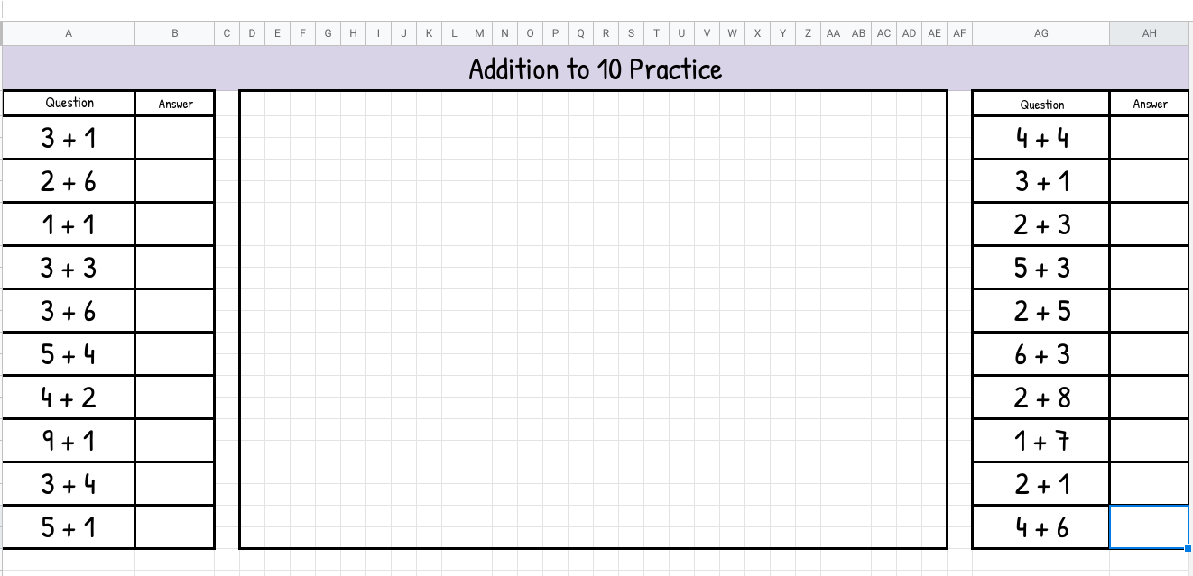
Guess what the picture is? Answer the questions and see if you guessed correctly!
I do not know who made this but I would love to give credit!

Slide 21



Slide 22
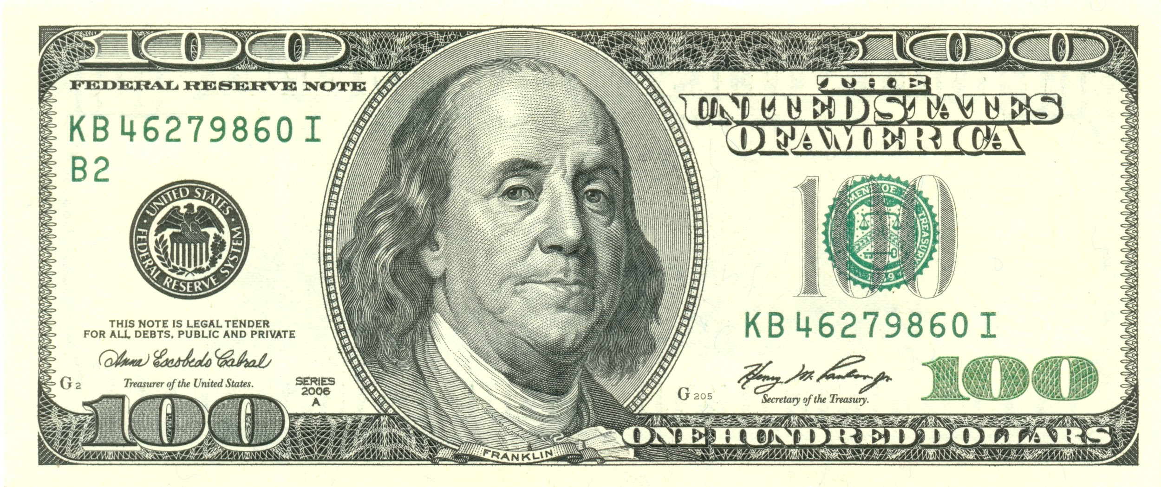
If I had 100 dollars, I would buy a ______________.

Slide 23


Slide 24

Can you jump for 100 seconds?

Slide 25




Slide 26
Digital Activities

Slide 27
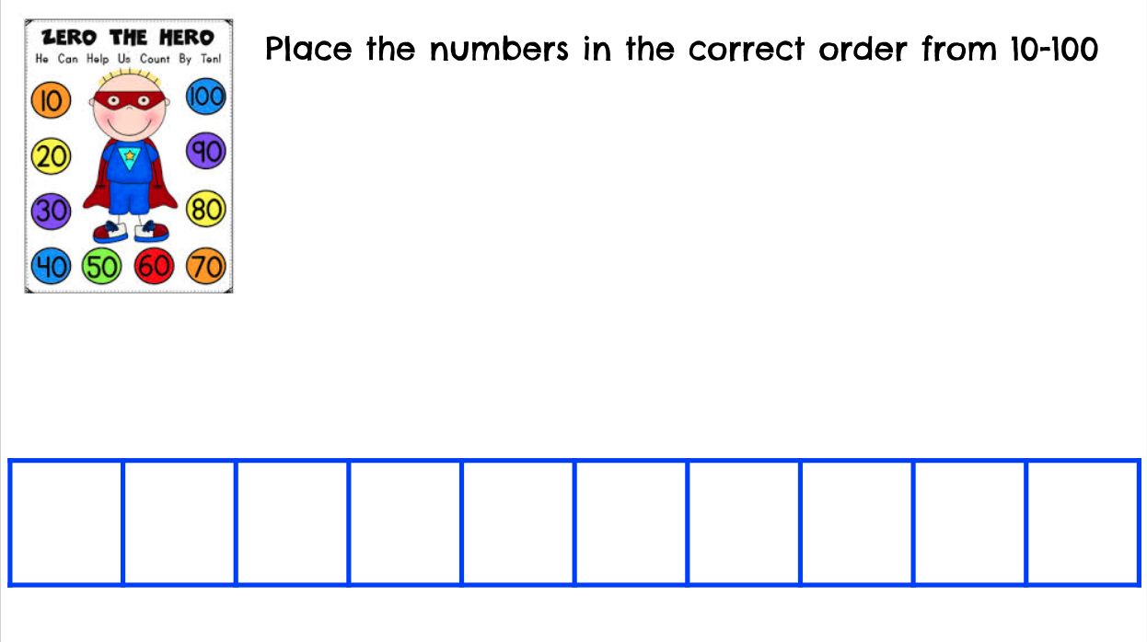











Slide 28


Play fireworks
grid
game
1-100

Slide 29


Play
popping
bubbles
game!

Slide 30
