Slide 1
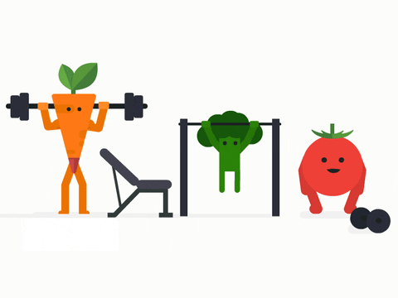
100th Day of School Exercise Challenge

Slide 2
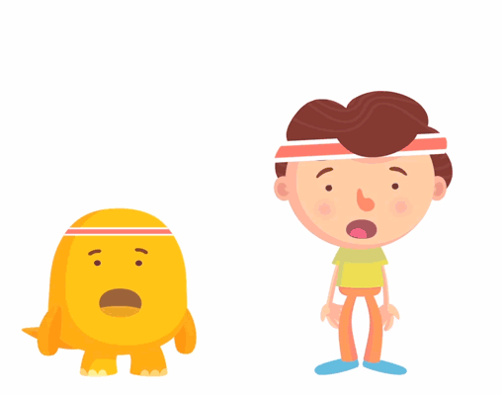
10 Jumping Jacks

Slide 3
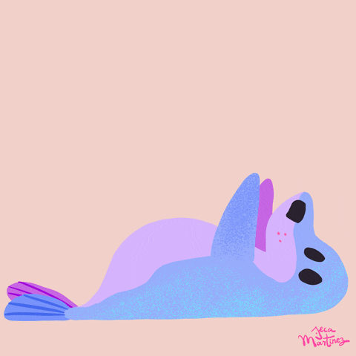
10
Sit Ups

Slide 4
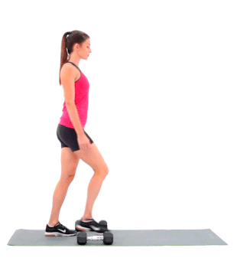
10 Lunges

Slide 5
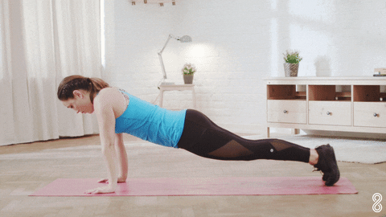
10 Push-Ups

Slide 6
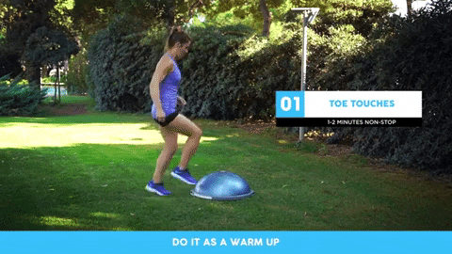
10 Toe Touches

Slide 7
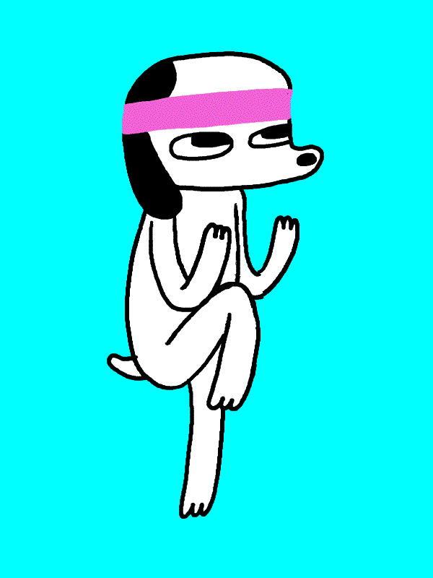
10 Knee Raises

Slide 8
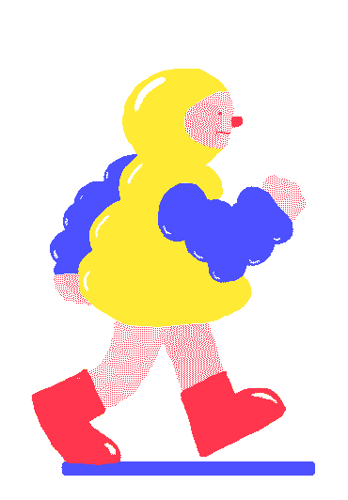
10
Steps

Slide 9

10 Arm Curls

Slide 10
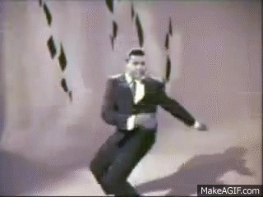
10
Twists

Slide 11
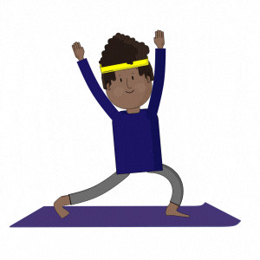
10 Stretches

