Slide 1

















Slide 2
100 Days questions - type in your answer
I wish I had 100
I can eat 100
I can
100 times
I would not want 100
I can make 100

Slide 3





How many?

Slide 4
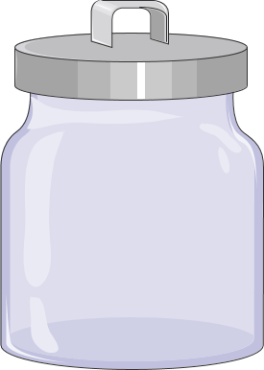

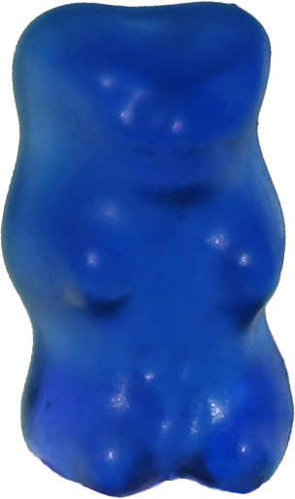


Put 100 candies in the jar

Slide 5





Want to see more free stuff? OR say thank you?
Feel free to edit and use my stuff in your class, but remember to give credit and don’t remove my info if sharing. Do not claim my work as your own or use it to make a profit.

