Slide 1




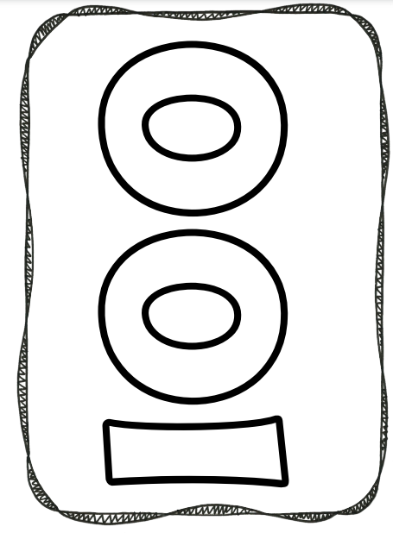


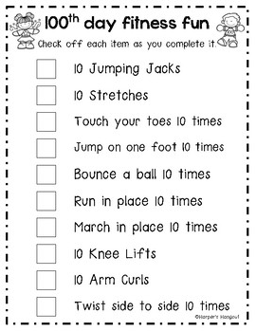
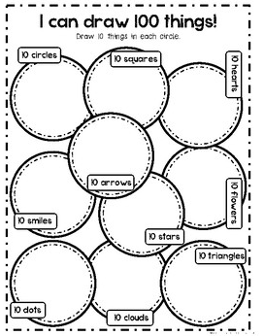
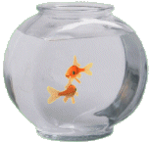




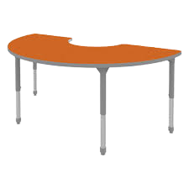
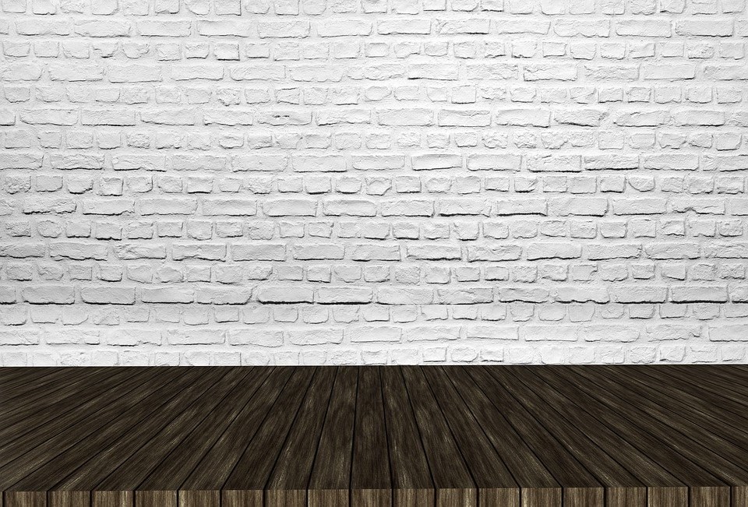


Slide 2



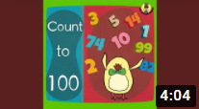
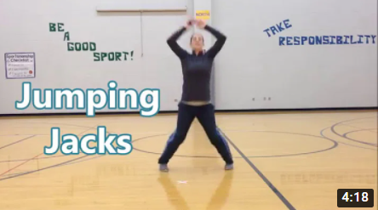


Slide 3
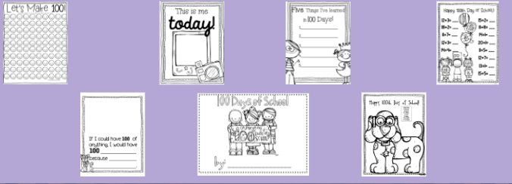

Slide 4

Decorate your 100 using the objects to the side on the slide!
(If you would like to decorate a printed copy, click on this one below)

Slide 5
Exercise to 100, take pictures or video and send them to your teacher!

Slide 6
Download the pdf and draw 100 things! Send a picture to your teacher!

Slide 7








