Slide 1



WE DID IT!
100 VIRTUAL DAYS!!!
Notes:
Every Activity is 10 - TO get to 100 exercises by the end!
Click on my Bitmoji to get back to the Menu
Click for Music

Slide 2



EYE SPY!
Ms. Kinyatta?
How should we CELEBRATE?
Ms. Sampietro
ZOO!
RUN!
SPOT IT!
Ms. Jorgensen

Slide 3

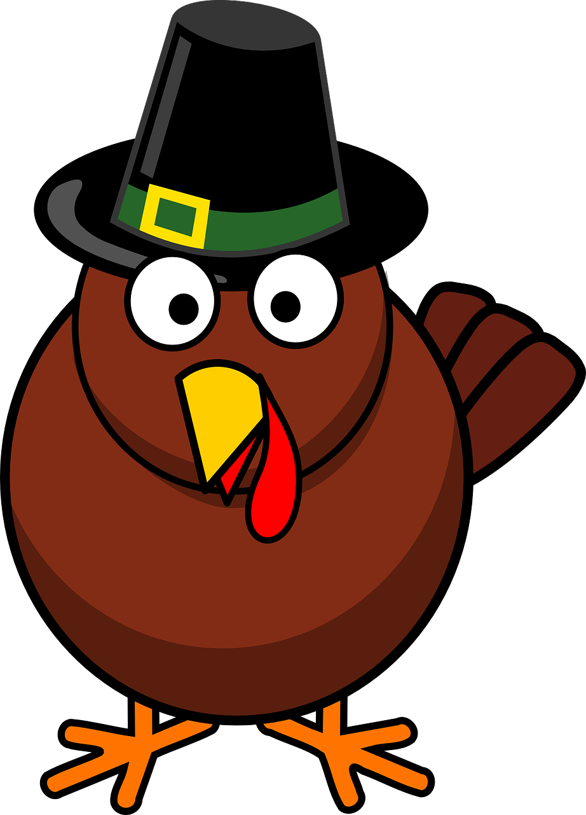
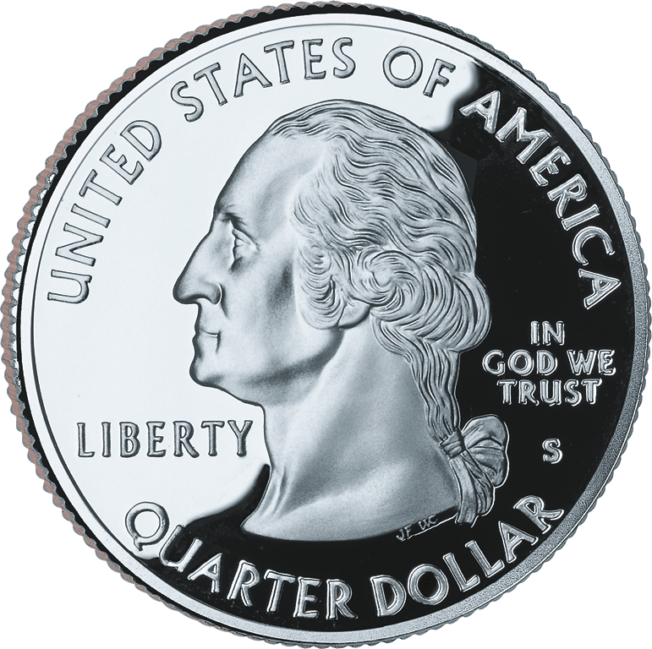
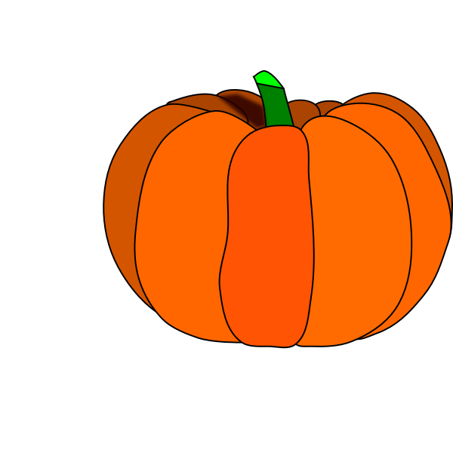



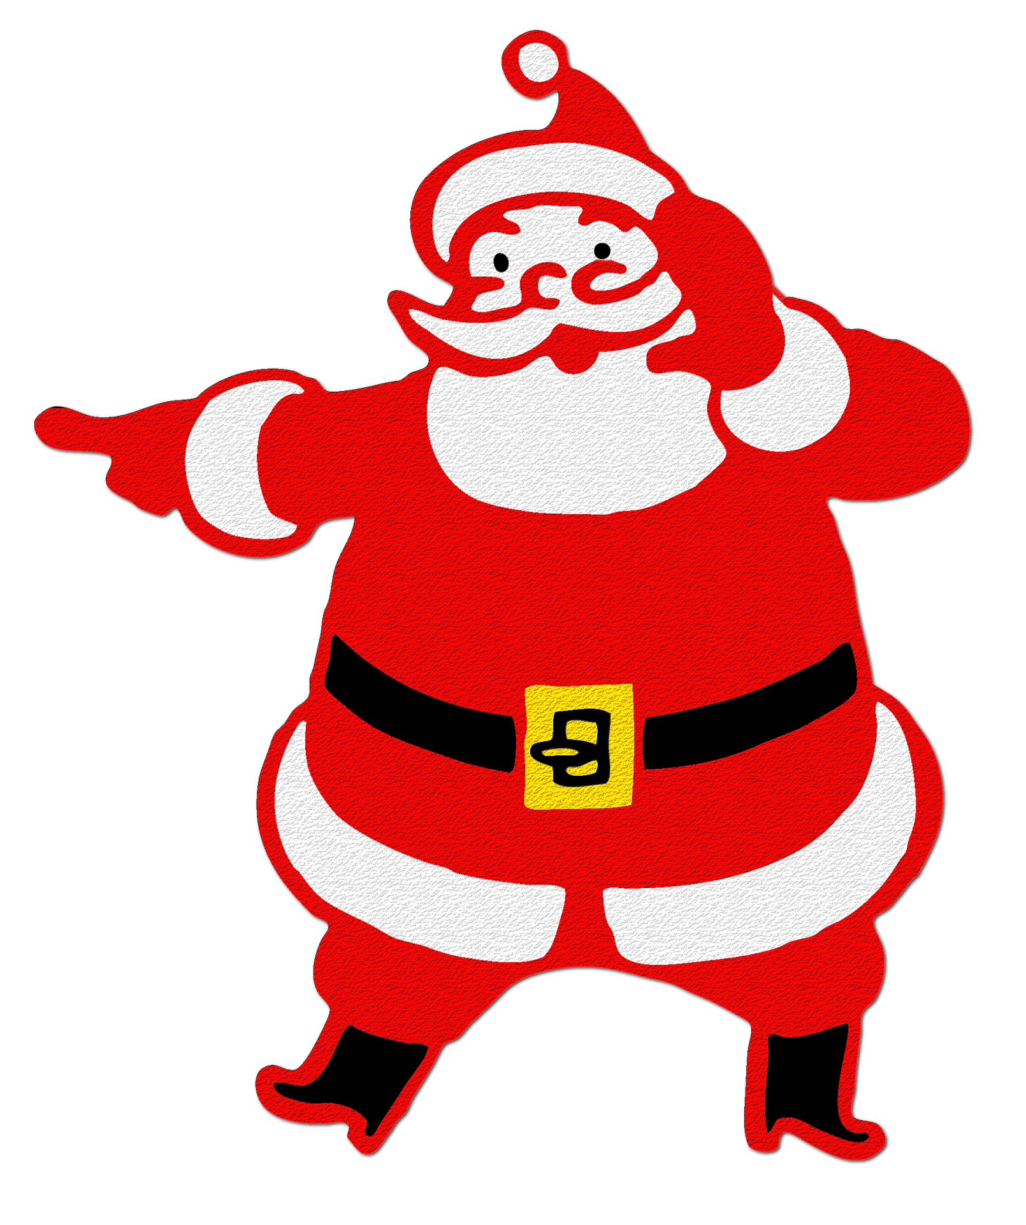





Let’s revisit
some of our favorite Activities!

Slide 4
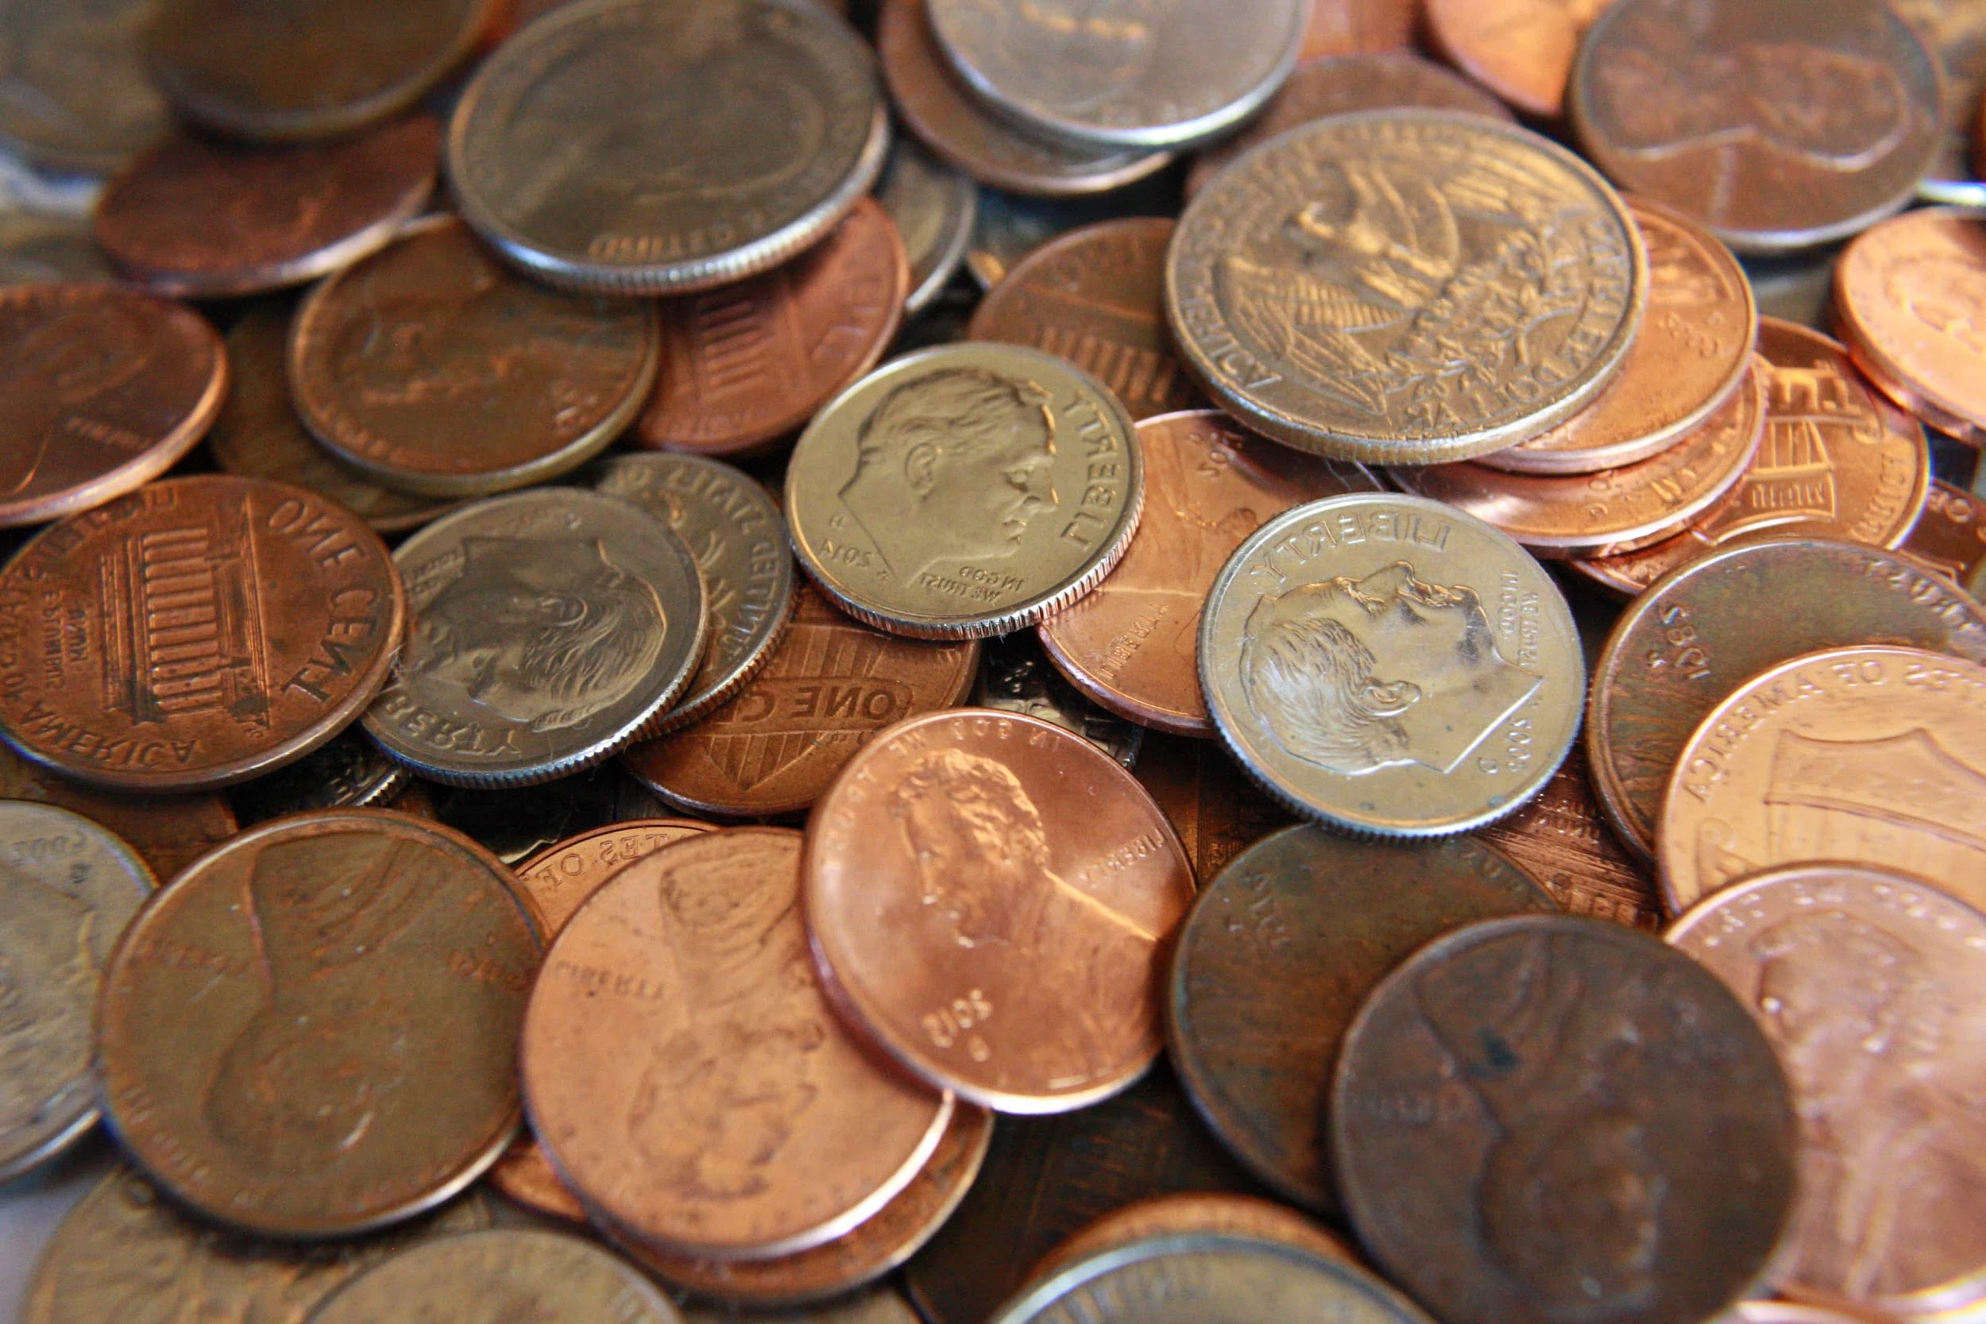

Heads or Tails

Slide 5
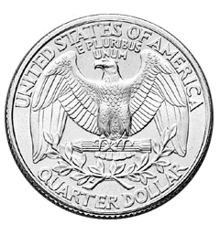
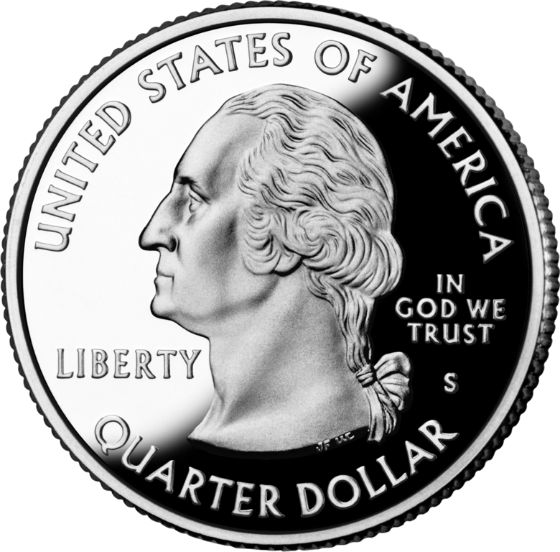
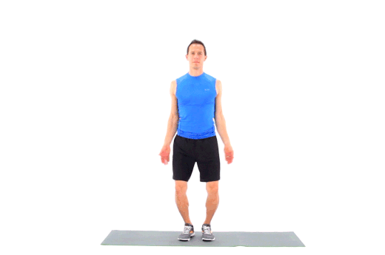
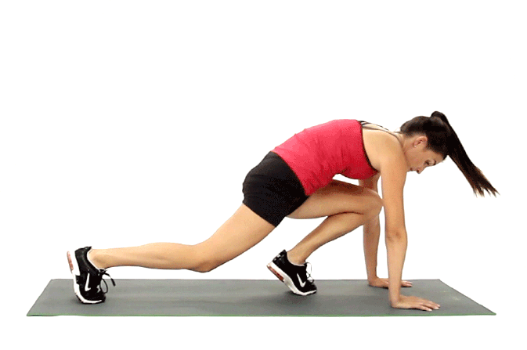
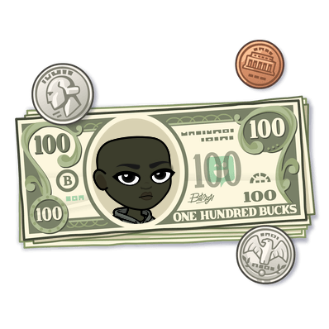

HEADS OR TAILS?

Slide 6

Eye Spy
HALLOWEEN EDITION

Slide 7
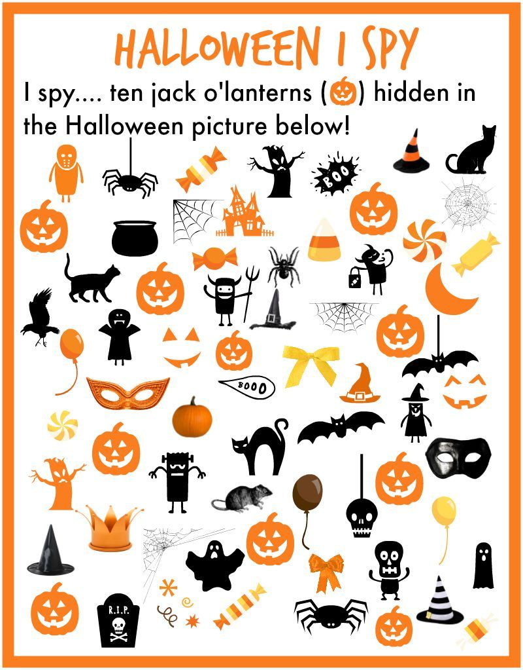


EYE SPY [ ]
PUMPKINS...

Slide 8
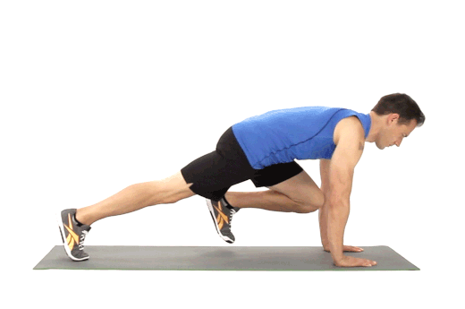
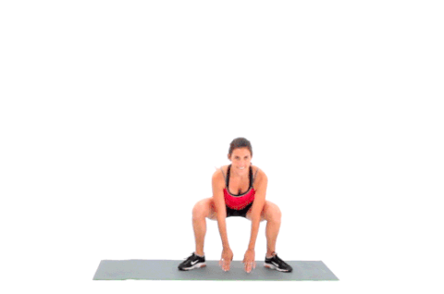
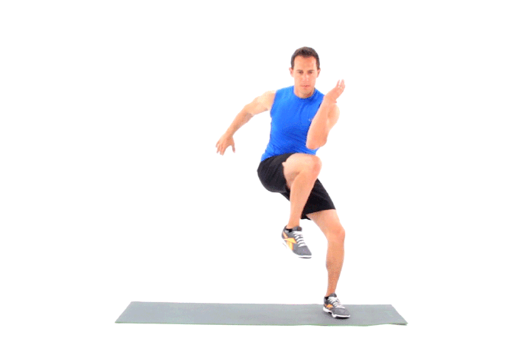

EYE SPY...
1
7
10
6

Slide 9

EYE SPIED...
1
7
10
6

Slide 10

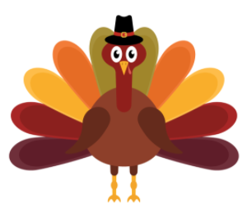

MASHED POTATOES
Let's get to WORKING to making a FEAST

Slide 11
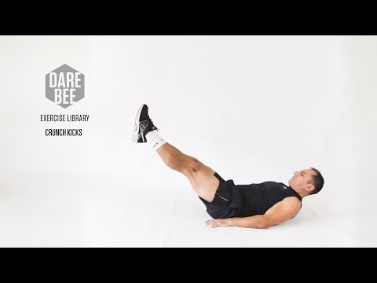
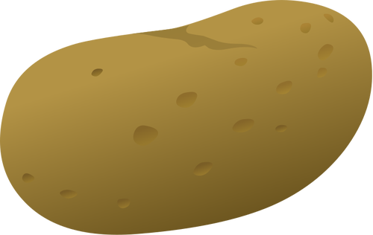
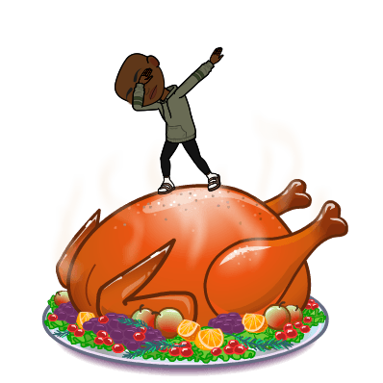
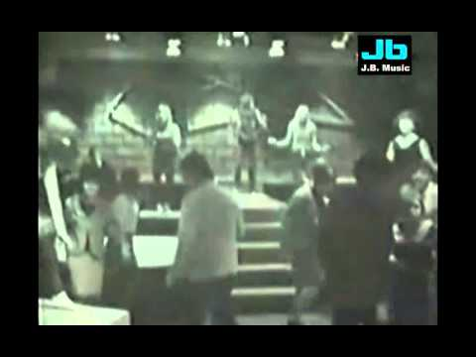
MASHED
POTATOES
Time to MASH the Potatoes
Will you have lumpy or smooth potatoes?

Slide 12
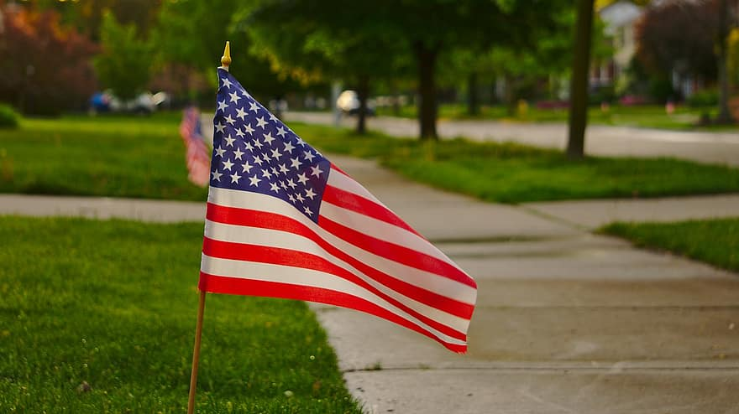

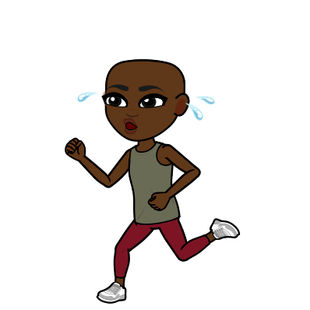



SWEAT FOR A VET
Thank you for your Service!

Slide 13

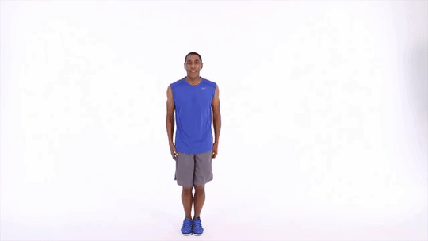
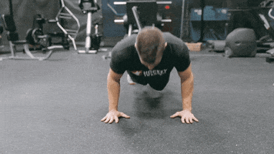
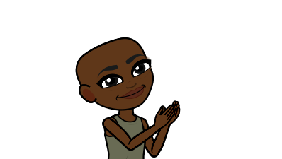
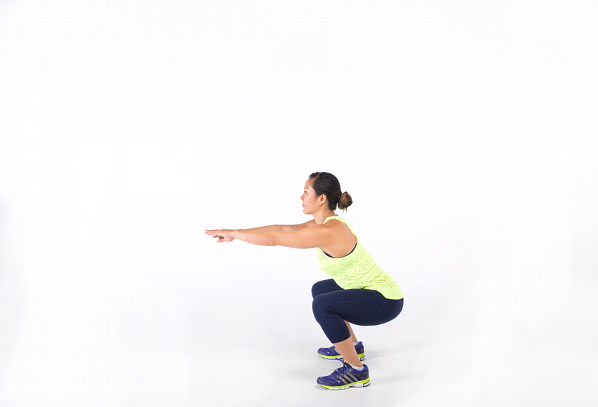
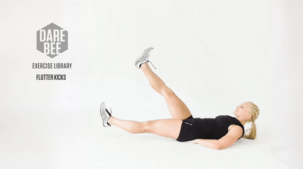
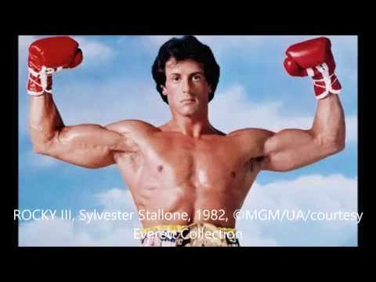
2 PUSH UPS
3 JUMPING JACKS
Can you do all these movements before the music ends?
2 Squat jumps
3 flutter kicks

Slide 14


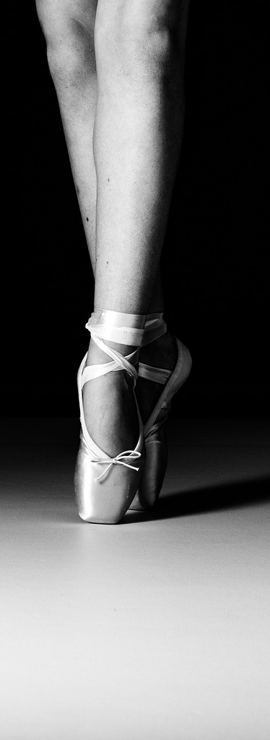


WHAT CAN SPIN LONGER THAN A
DREIDEL?

Slide 15



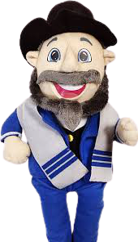
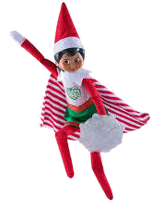
YES OR NO?
Can you do 10 of these movements
before the dancer finishes spinning like a dreidel?

Slide 16
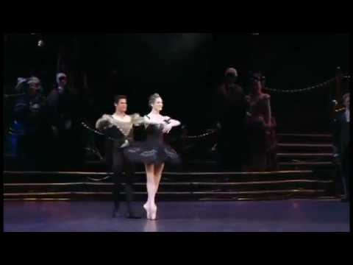
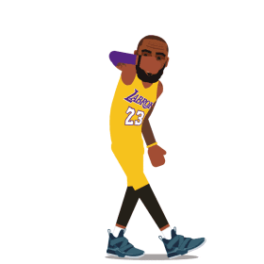
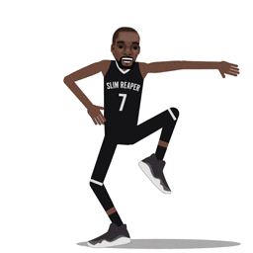
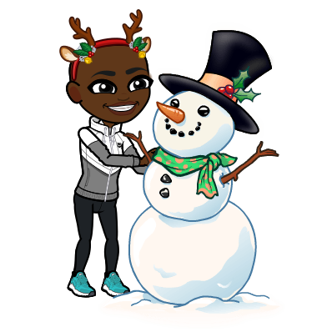
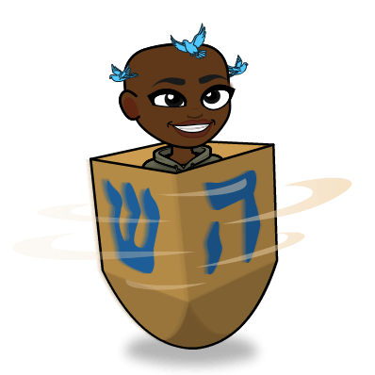
YES OR NO?

Slide 17
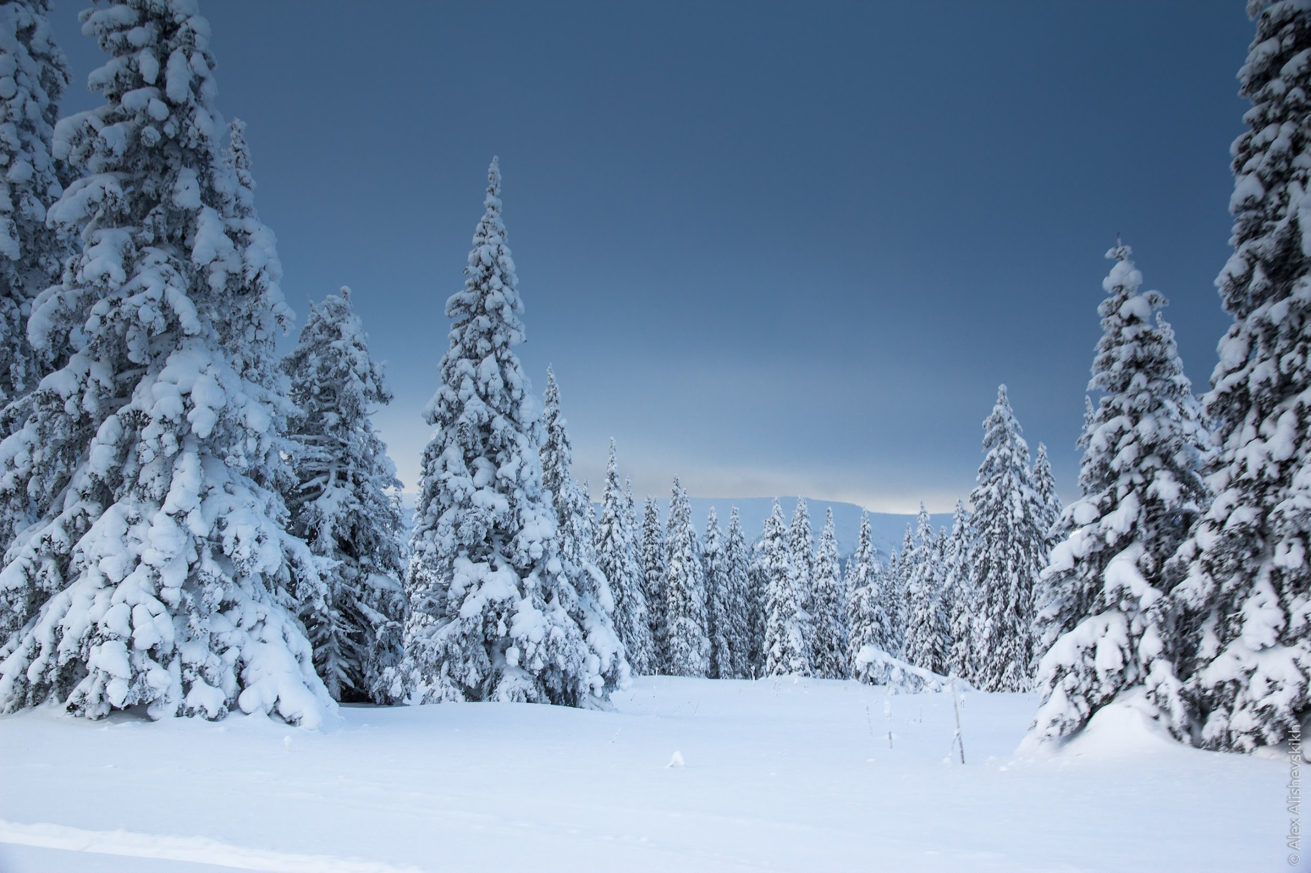
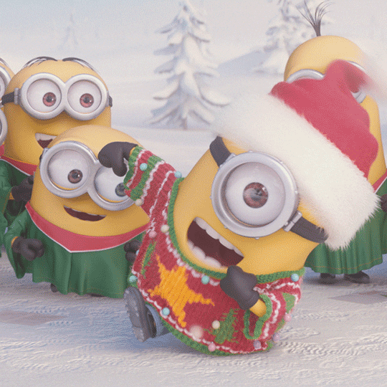

I SPY
Directions: spy the pictures for clues
Answer by doing the Exercise that goes with your guess
Notes:
I Spy

Slide 18
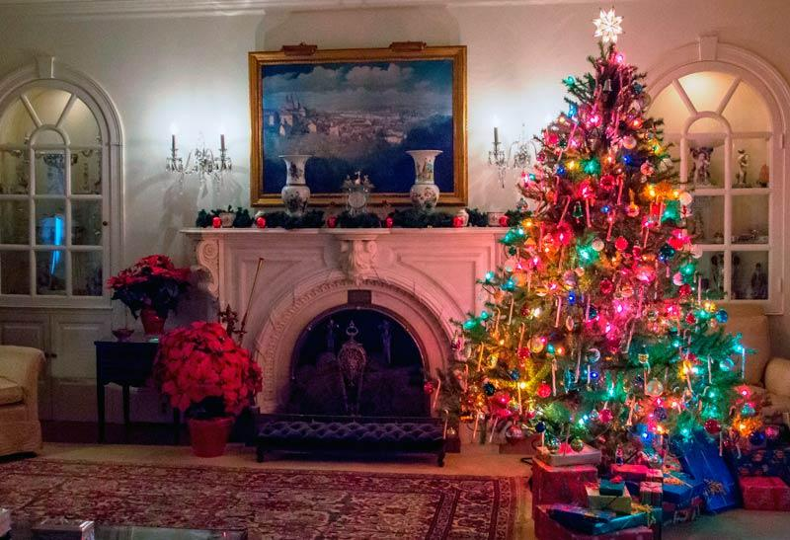
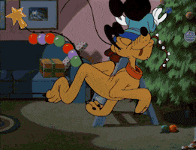
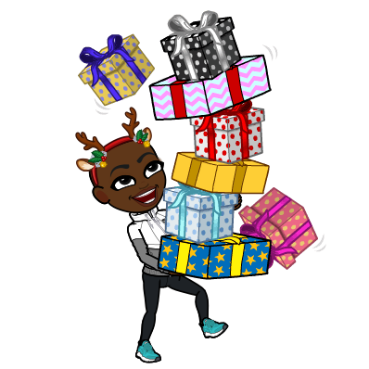
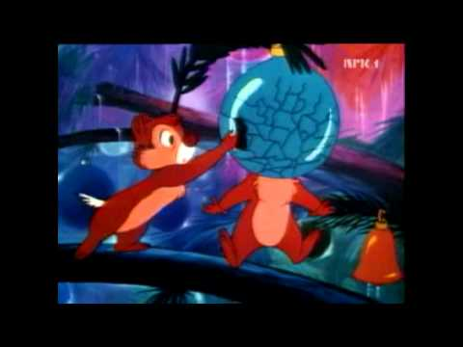
DO YOU SEE WHAT I SEE?

Slide 19
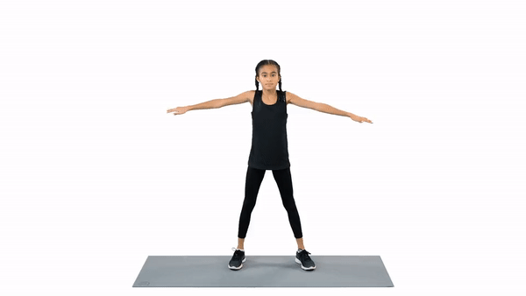
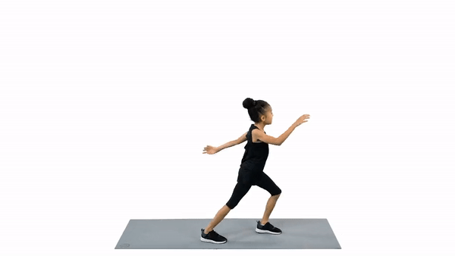
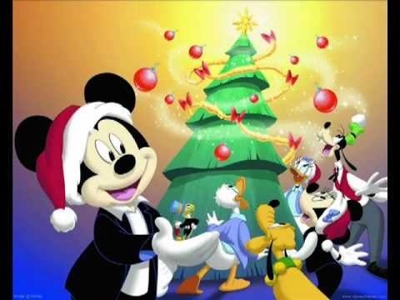
HOW MANY ornaments on pluto’s tail dID YOU SPY?
7
6

Slide 20
Did YOU SEE WHAT I Saw?
7

Slide 21
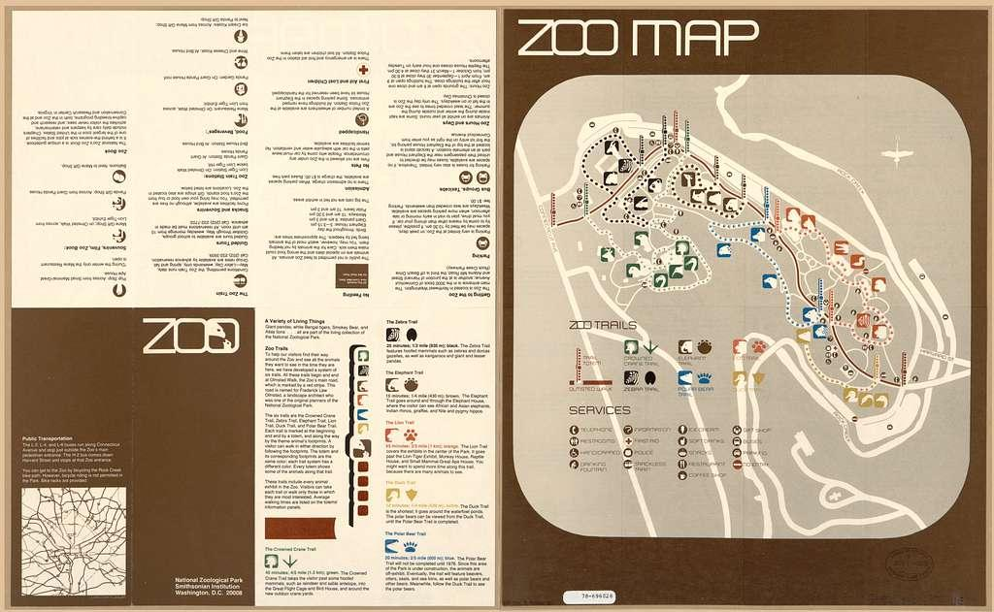
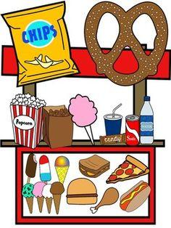

Slide 22
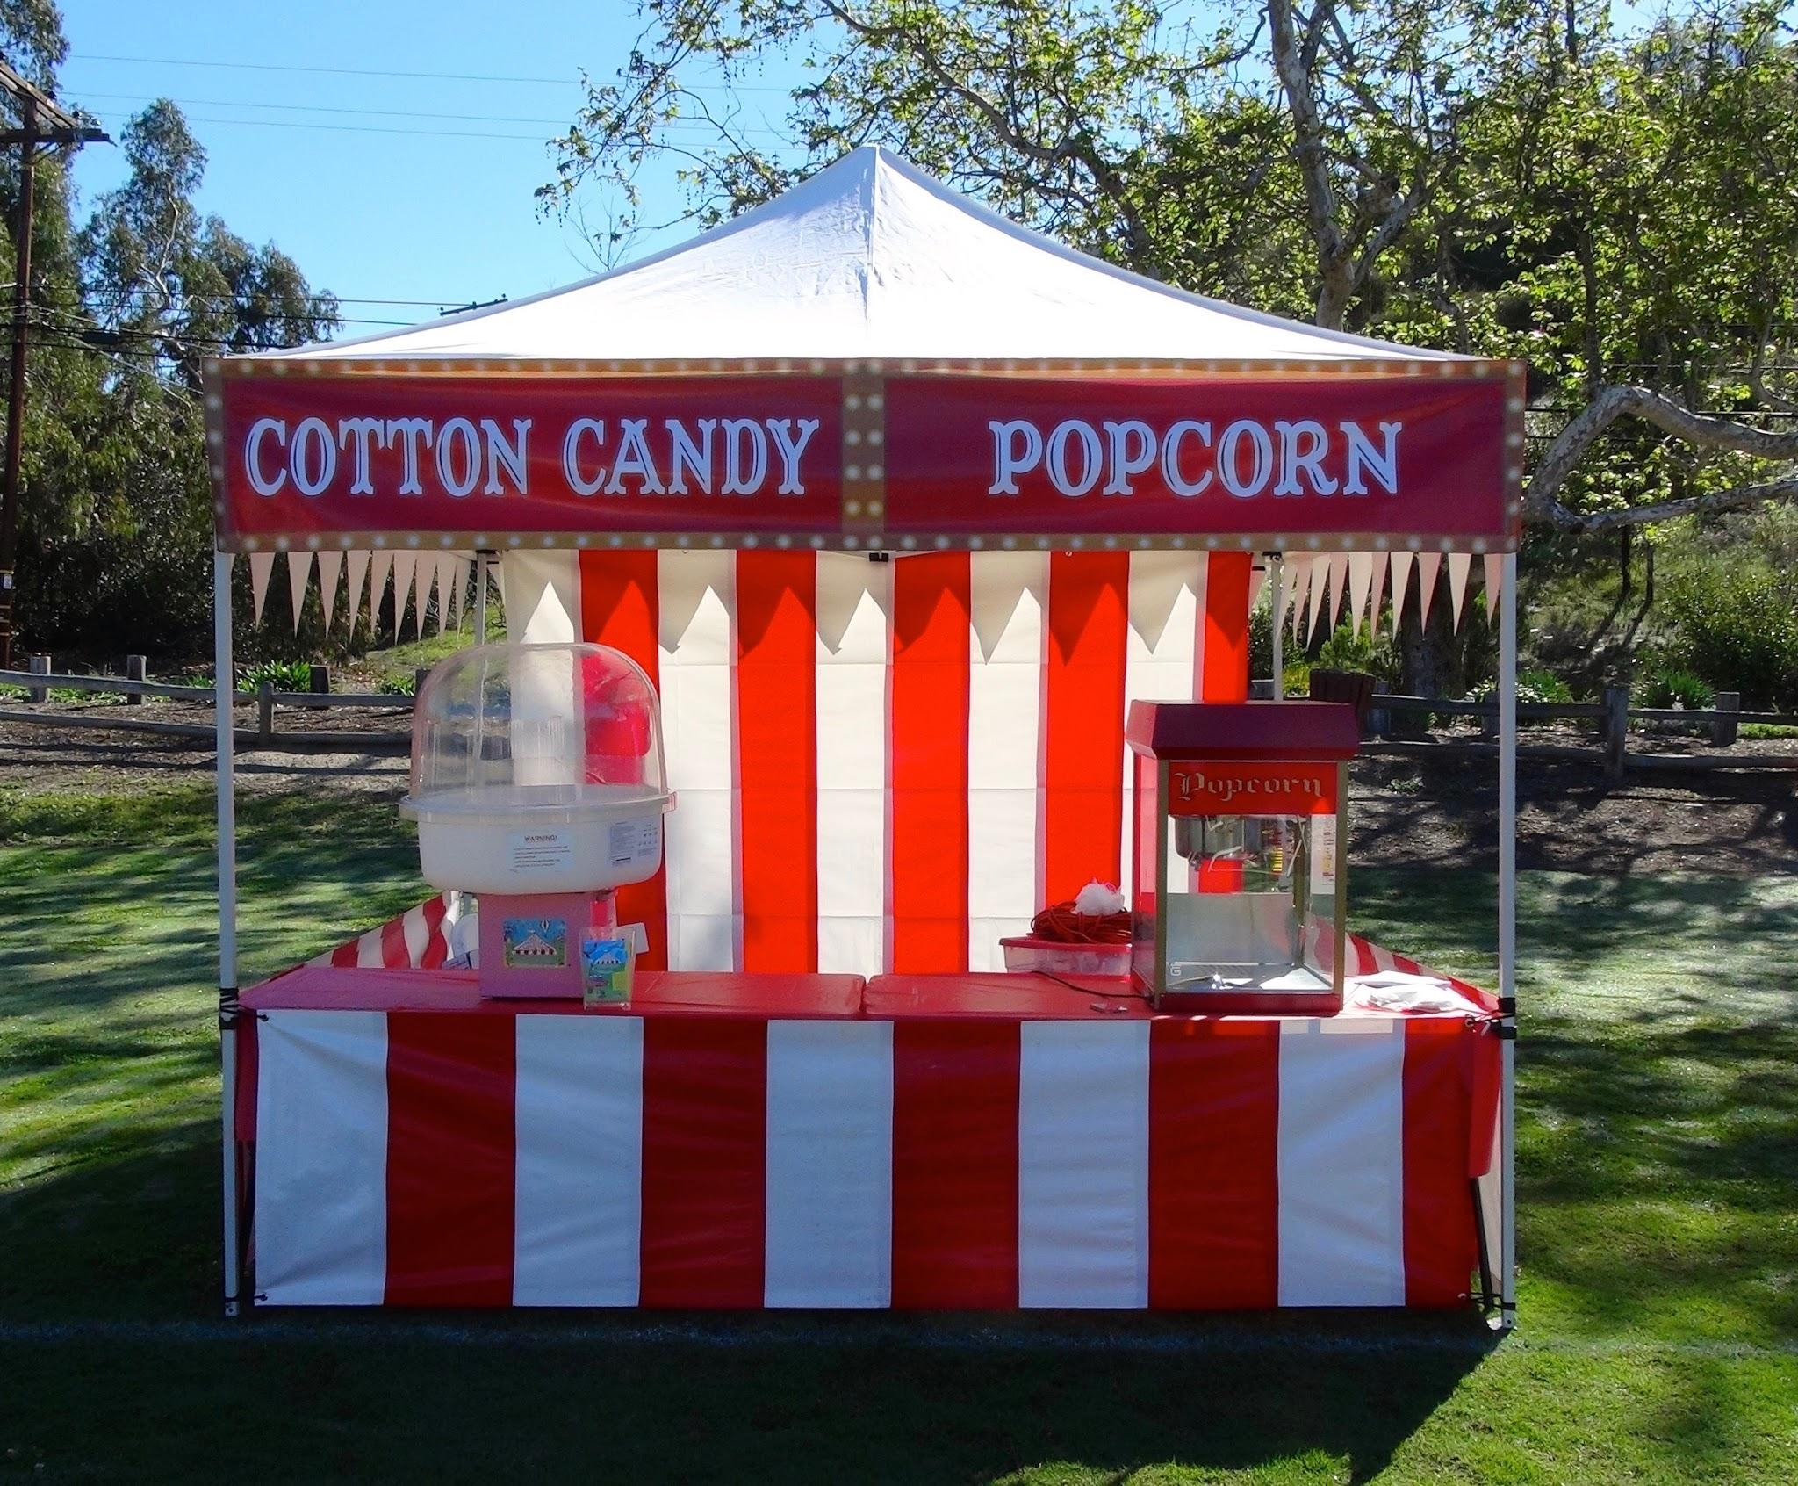


SNACK STAND

Slide 23
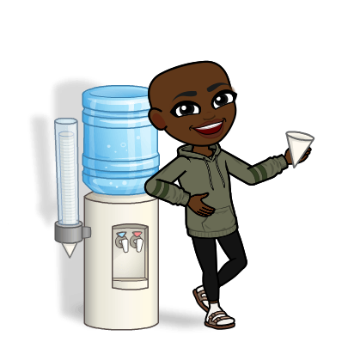
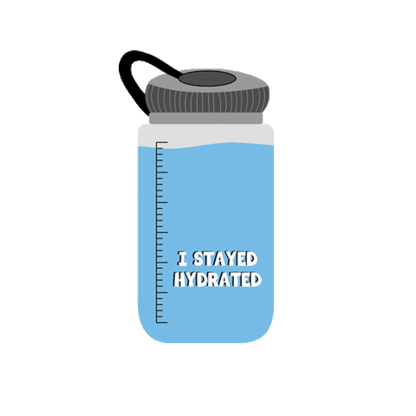
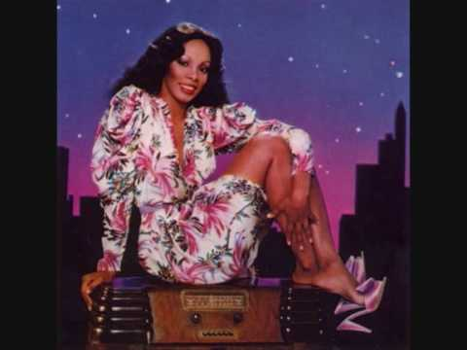
Lets get hydrated!
Go and get a glass of water!
Take 10 sips of WATER or COUNT to 10 while drinking your Water!

Slide 24


Sunny
Rain
Snow
More
Snow
Wind
Tornado
Rainbow

Slide 25






Rain

Slide 26

MyPlate
Nutrition
Activity!

Slide 27










What is your Favorite FOOD group to have on your PLATE?

Slide 28



WE DID IT!
VIRTUAL MOVEMENTS!

