Slide 1
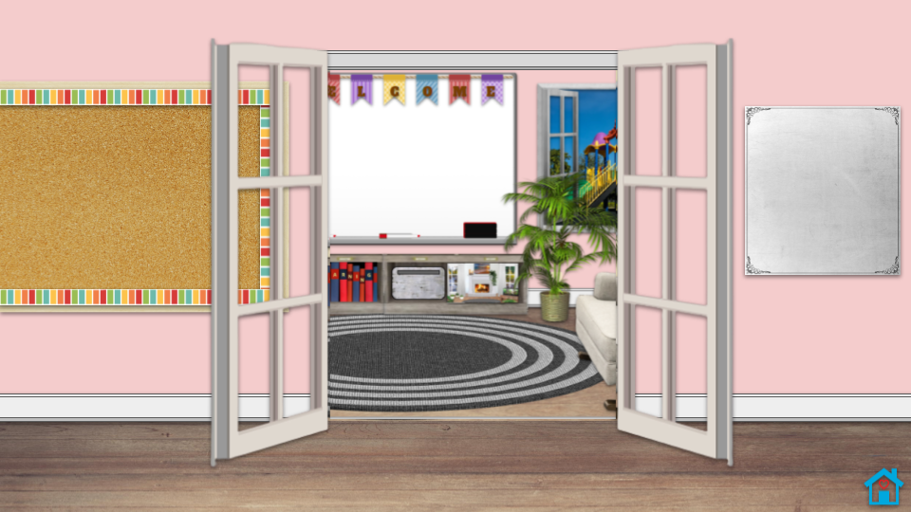





To Customize the entry to the main classroom - Delete the message on the whiteboard and remove the clipart from the bulletin board and replace with your own; Bitmoji search term: pose
Welcome to our Class!
Click on this symbol
to return to the main classroom when in Present mode
Notes:
😊Like Teachers Using Tech on FB https://www.facebook.com/teachersusingtech & Join our FB Group https://www.facebook.com/pg/teachersusingtech/groups Follow on Instagram @teachersusingtech ☕☕If you want to say thanks - https://www.buymeacoffee.com/gail.f or www.venmo.com/Gail-Feix ☕☕
⏲See full Blog Post for this slide deck and check out other resources at https://www.teachersusingtech.com/
@TeachersUsingTech

Slide 2
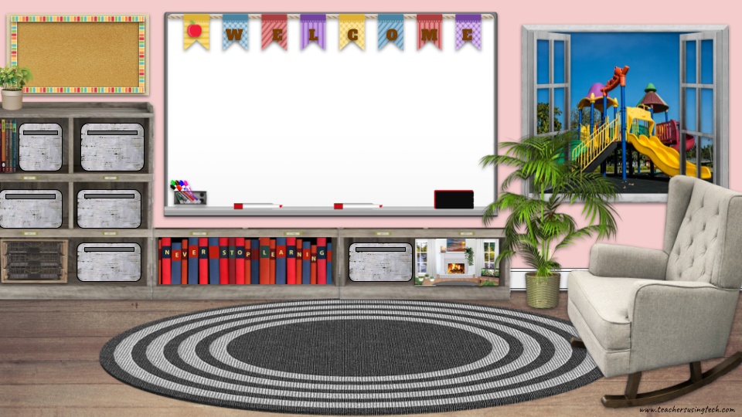

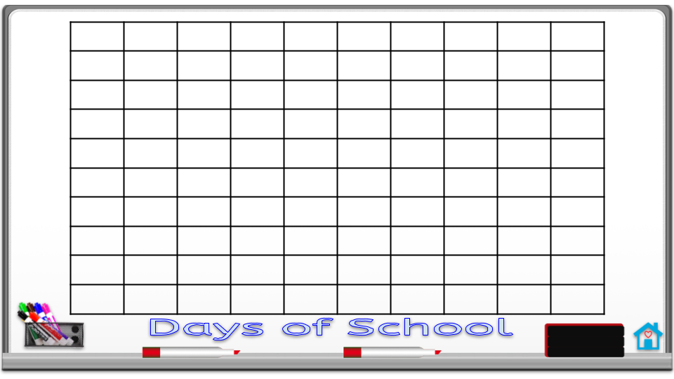
Main Classroom
Add a text box to each of the bins and label it, then link them to websites, other slides in this presentation, or other slide decks
Use the white board for Morning Meeting (boxes included for typing responses or delete info on the whiteboard and bulletin boards and replace with your own
Morning Meeting
Today is:
Weather:
# of Days of School
Use the 6 bins and wire shelf below to link to other items such as slides for each subject, period, websites, other slide decks of resources, etc
Daily Special:
When you replace my Bitmoji for your own, be sure to crop the box around it so that it does not cover the bins which will make clicking difficult; link the Bitmoji to the Slide so that it does not advance to next slide
Notes:
Created by www.teachersusingtech.com
Use this classroom daily, then use Bonus - 100th Day of School Celebration Classroom! (see below)

Slide 3












NOTE: If you buy a coffee, be sure to make a copy of the Bonus Thank You Supporter Bundle when logged into the coffee page - in the Posts tab at the top of the coffee page - link is in the Thank You post on the Post tab/Thank you dated April 18th 😊
Preview of ☕ Monthly Member Extras shown below
Would you like ALL of the EXTRAS for just a cup of ☕each month? Then become a Monthly MEMBER! 😊
Thank you for your comments, likes, shares, following on Instagram, and joining the Teachers Using Tech Facebook Group
Notes:
😊Like Teachers Using Tech on FB https://www.facebook.com/teachersusingtech & Join our FB Group https://www.facebook.com/pg/teachersusingtech/groups Follow on Instagram @teachersusingtech ☕☕If you want to say thanks - https://www.buymeacoffee.com/gail.f or www.venmo.com/Gail-Feix ☕☕
⏲See full Blog Post for this slide deck and check out other resources at https://www.teachersusingtech.com/

Slide 4


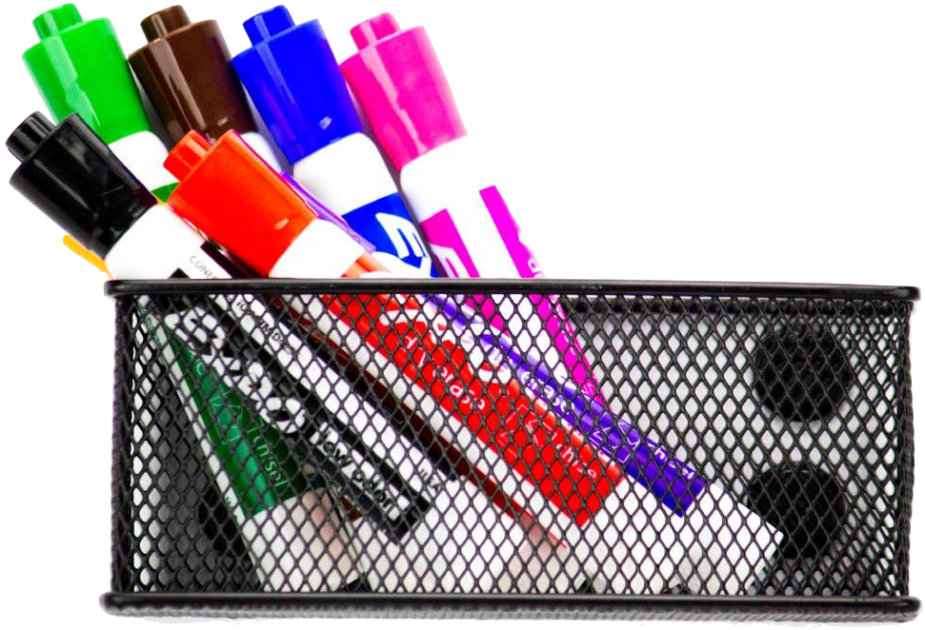
Whiteboard
Choose to either use slides 3 & 4 OR only slide #5 - currently, the main page is linked to slide #4, you can delete others if not needed
Days of School
Notes:
Options in EDIT mode: Can use X images to drag & drop OR
Click in a box - you can choose to type an ‘X’ or type the number to keep count or even use the paint can (Fill Color) to fill in the box to keep track of days in school
NOTE: This grid has 100 cells to count 100 days of school (there is a second slide with 100 more cells to count the remaining days of school OR there is a 3rd whiteboard option with 190 cells in case you want the count all on one slide)
@TeachersUsingTech

Slide 5
Whiteboard
Choose to either use slides 3 & 4 OR only slide #5 - currently, the main page is linked to slide #4, you can delete others if not needed
Days of School
Notes:
Options in EDIT mode: Can use X images to drag & drop OR
Click in a box - you can choose to type an ‘X’ or type the number to keep count or even use the paint can (Fill Color) to fill in the box to keep track of days in school
NOTE: This grid has 100 cells to count 100 days of school (there is a second slide with 100 more cells to count the remaining days of school OR there is a 3rd whiteboard option with 190 cells in case you want the count all on one slide)
@TeachersUsingTech

Slide 6
Whiteboard
Choose to either use slides 3 & 4 OR only slide #5 - currently, the main page is linked to slide #4, you can delete others if not needed
Days of School
Notes:
Options in EDIT mode: Can use X images to drag & drop OR
Use the paint can (Fill Color) to fill in the box to keep track of days in school (the font size has to be so small to fit 190 cells on one slide,
so typing the number in the cell is Not an option for this particular slide)
NOTE: This grid has 190 cells to count all the days of school
@TeachersUsingTech

Slide 7

Playground
Notes:
Use this slide to link back to the Main Classroom - could add Fun Friday links, Brain Breaks, etc.
@TeachersUsingTech

Slide 8
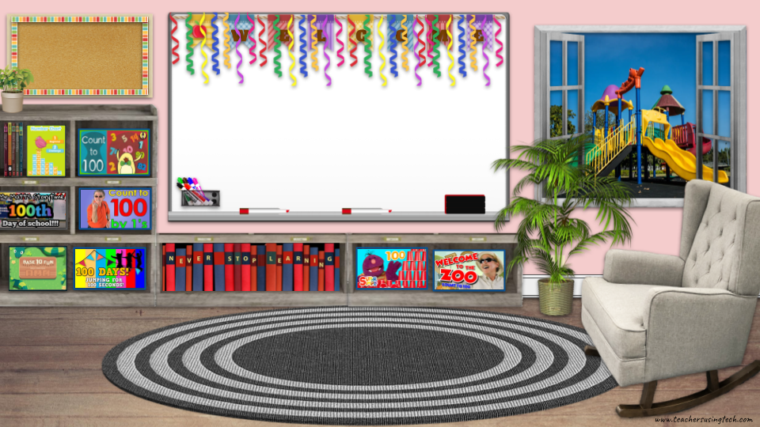









100 Main Classroom
There are 2 hidden links to 100 themed games - in the window and bulletin board
www.teachersusingtech.com
Notes:
Bonus - 100th Day of School Celebration Classroom!
Items in room are linked to embedded videos on the following slides, as well as games on abcya.com related to 100
(some on shelf, additional links in bulletin board and window) - use in Present mode to make links active on bulletin boards
@TeachersUsingTech

Slide 9


Bulletin Board
Notes:
@TeachersUsingTech
NOTE: Videos are embedded and play on the bulletin board slides when in Present Mode
https://dorkydoodles.com/blogs/the-blog/back-to-school-planner-stickers-freebie

Slide 10

Bulletin Board
Notes:
@TeachersUsingTech
NOTE: Videos are embedded and play on the bulletin board slides when in Present Mode
https://dorkydoodles.com/blogs/the-blog/back-to-school-planner-stickers-freebie

Slide 11

Bulletin Board
Notes:
@TeachersUsingTech
NOTE: Videos are embedded and play on the bulletin board slides when in Present Mode
https://dorkydoodles.com/blogs/the-blog/back-to-school-planner-stickers-freebie

Slide 12

Bulletin Board
Notes:
@TeachersUsingTech
NOTE: Videos are embedded and play on the bulletin board slides when in Present Mode
https://dorkydoodles.com/blogs/the-blog/back-to-school-planner-stickers-freebie

Slide 13

Bulletin Board
Notes:
@TeachersUsingTech
NOTE: Videos are embedded and play on the bulletin board slides when in Present Mode
https://dorkydoodles.com/blogs/the-blog/back-to-school-planner-stickers-freebie

Slide 14

Bulletin Board
Notes:
@TeachersUsingTech
NOTE: Videos are embedded and play on the bulletin board slides when in Present Mode
https://dorkydoodles.com/blogs/the-blog/back-to-school-planner-stickers-freebie

