Slide 1

Click on Would You Rather to move to the next slide.
Would
You
Rather?

Slide 2
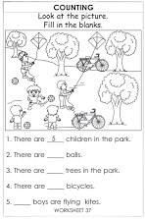

Would You Rather…
Option #1:
Read 100 Books
Option #2:
Complete 100 Worksheets

Slide 3
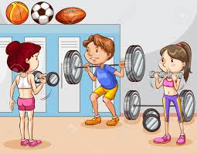
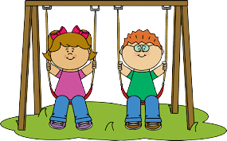
Would You Rather…
Option #1:
100 Hours of Gym
Option #2:
100 Hours of
Recess

Slide 4


Would You Rather…
Option #1:
Sing 100 Songs
Option #2:
Read 100 Poems

Slide 5
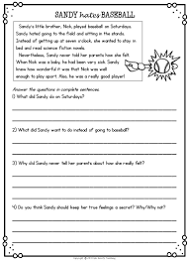
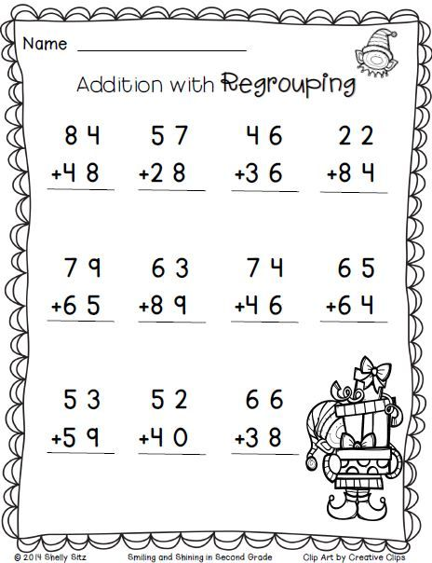
Would You Rather…
Option #1:
Do 100 Reading Problems
Option #2:
Do 100 Math
Problems

Slide 6

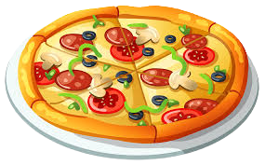
Would You Rather…
Option #1:
Eat Pizza for 100 Days at Lunch
Option #2:
Eat Chicken Nuggets for 100 Days at Lunch

Slide 7
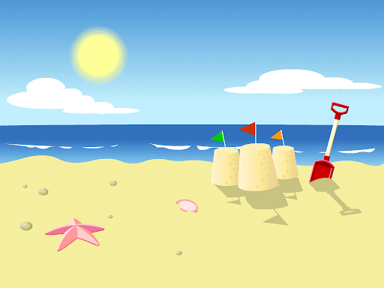
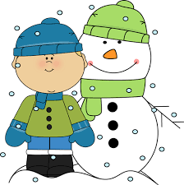
Would You Rather…
Option #1:
Spend 100 minutes of Recess in the Snow
Option #2:
Spend 100 Minutes of Recess on the Beach

Slide 8

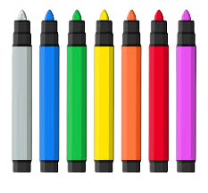
Would You Rather…
Option #1:
Color with 100 Crayons
Option #2:
Color with 100
Markers

Slide 9
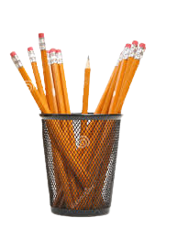

Would You Rather…
Option #1:
Write with 100 Colored Pencils
Option #2:
Write with 100
Pencils

Slide 10
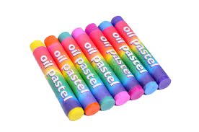
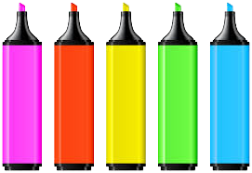
Would You Rather…
Option #1:
Draw with 100 Highlighters
Option #2:
Draw with 100
Oil Pastels

Slide 11
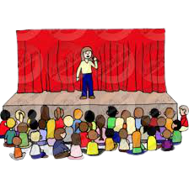

Would You Rather…
Option #1:
Go to 100 Assemblies
Option #2:
Go on 100
Field Trips

Slide 12
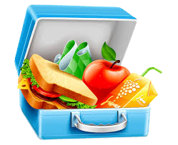
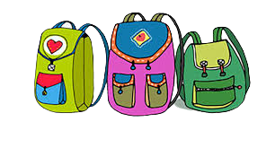
Would You Rather…
Option #1:
Carry 100 Bookbags
Option #2:
Carry 100
Lunch Box

Slide 13
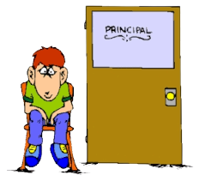
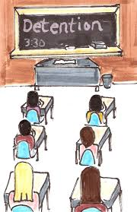
Would You Rather…
Option #1:
Go to the Principal’s Office 100 Times
Option #2:
Have Detention
100 Times

Slide 14
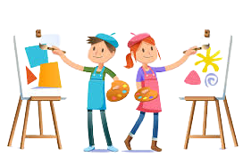
Would You Rather…
Option #1:
100 Days of Art
Option #2:
100 Days of Music

Slide 15
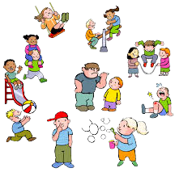

Would You Rather…
Option #1:
100 Days of Indoor Recess
Option #2:
100 Days of
Outdoor Recess

Slide 16
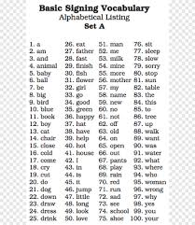
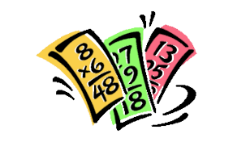
Would You Rather…
Option #1:
Spell 100
Words
Option #2:
Recite 100
Math Facts

Slide 17


Would You Rather…
Option #1:
100 Days of Tests
Option #2:
100 Days of
Homework

Slide 18
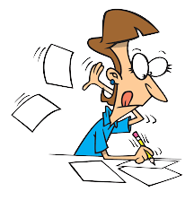

Would You Rather…
Option #1:
Write Your Name 100 Times
Option #2:
Type Your Name
100 Times

Slide 19
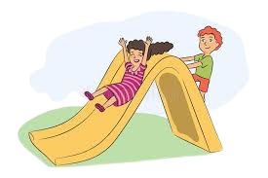
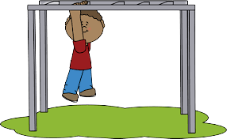
Would You Rather…
Option #1:
Ride the Slide 100 Times
Option #2:
Climb the Monkey Bars
100 Times

Slide 20

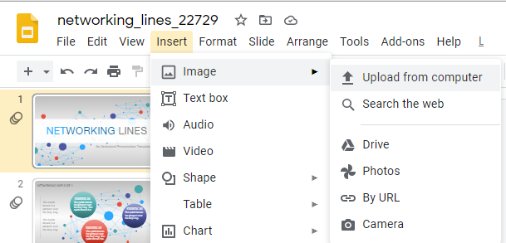
Would You Rather…
Option #1:
Answer 100 Questions on a Google Slide
Option #2:
Answer 100
Questions on Paper

Slide 21


Would You Rather…
Option #1:
Drink 100 Cartons of White Milk at Lunch
Option #2:
Drink 100
Cartons of Chocolate
Milk at Lunch

Slide 22

Would You Rather…
Option #1:
Answer 100 Math Problems with Addition
Option #2:
Answer 100 Math Problems with Subtraction

Slide 23
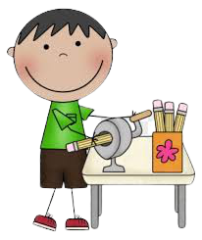
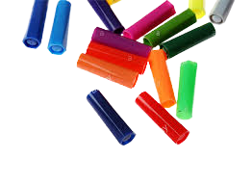
Would You Rather…
Option #1:
Sharpening 100 Pencils
Option #2:
Matching 100 Marker Tops to the Correct Marker Color

Slide 24


Would You Rather…
Option #1:
Attending 100 Google Meets with Mrs. Gabriel
Option #2:
Attending 100 Google Meets with the Principal

