Slide 1


I am going to show you pictures
that have been magnified 100 times!
You are going to write down your guess for each picture.
There are 15 pictures total.
I will reveal the answers at the end.
Good luck!

Slide 2
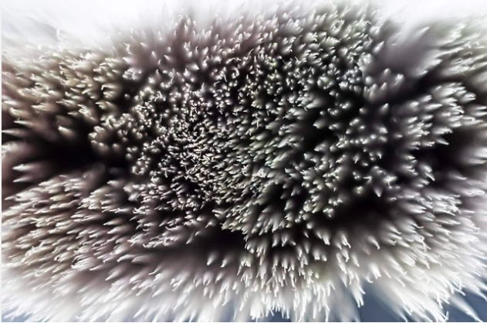
1.

Slide 3
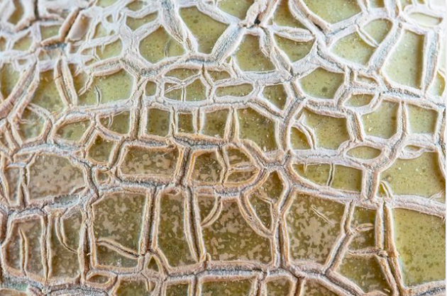
2.

Slide 4
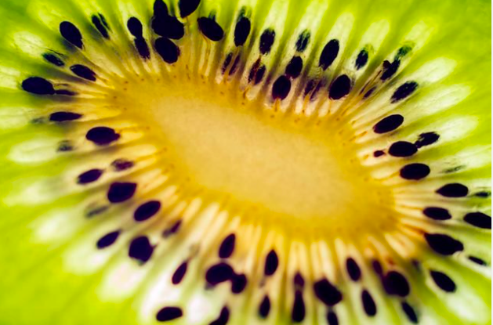
3.

Slide 5
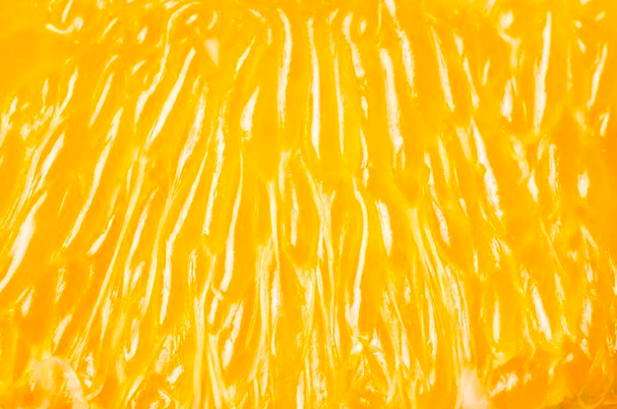
4.

Slide 6
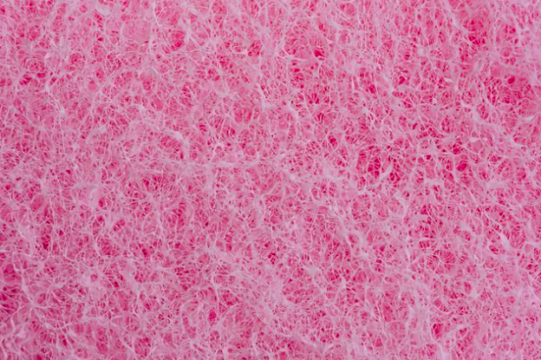
5.

Slide 7
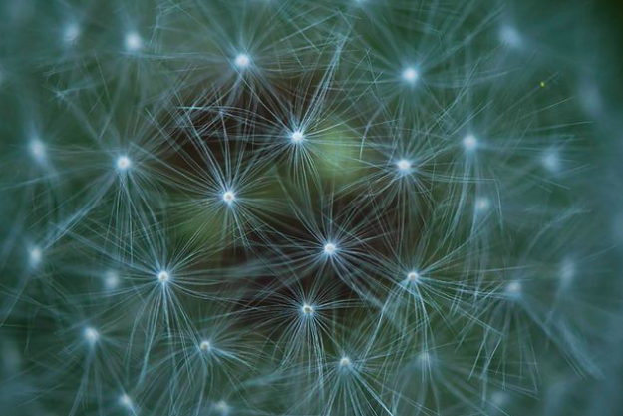
6.

Slide 8
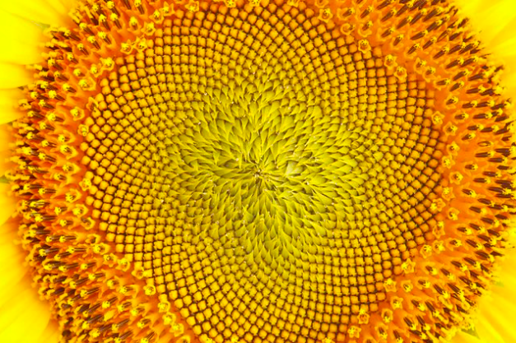
7.

Slide 9
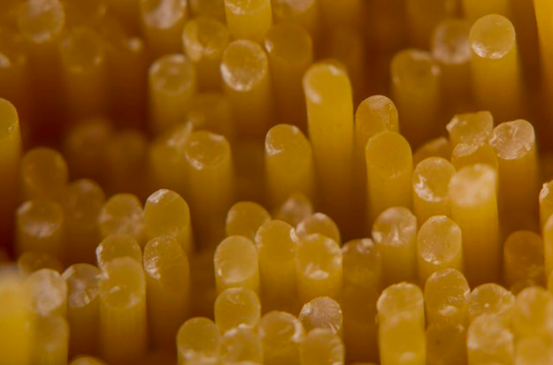
8.

Slide 10
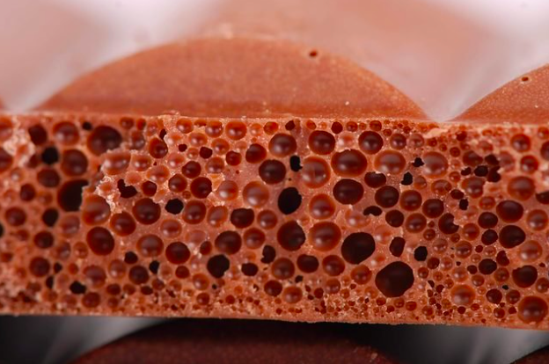
9.

Slide 11
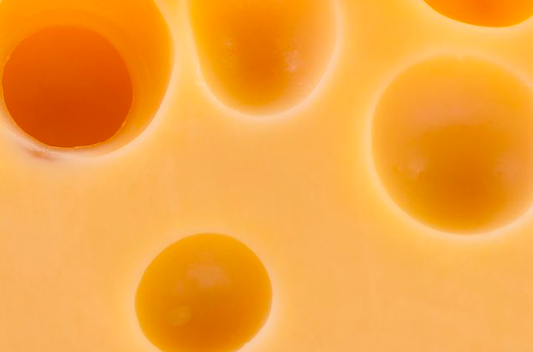
10.

Slide 12
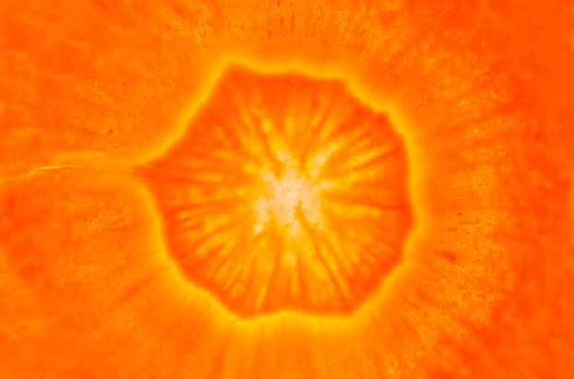
11.

Slide 13
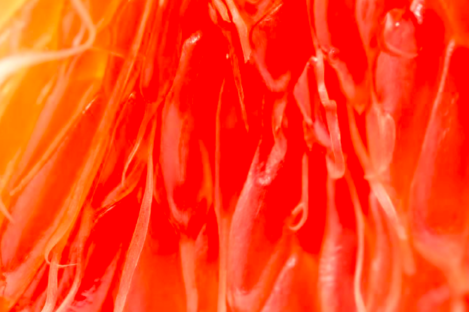
12.

Slide 14
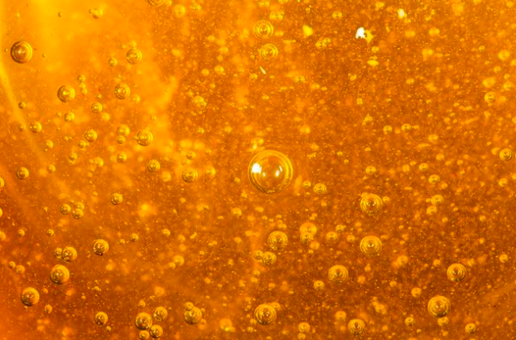
13.

Slide 15
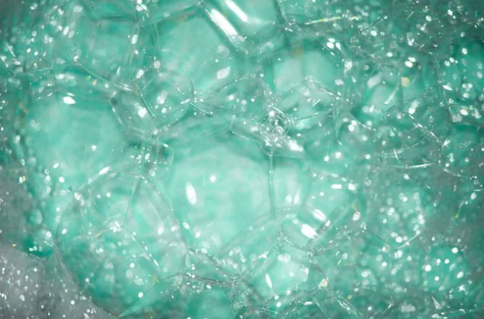
14.

Slide 16
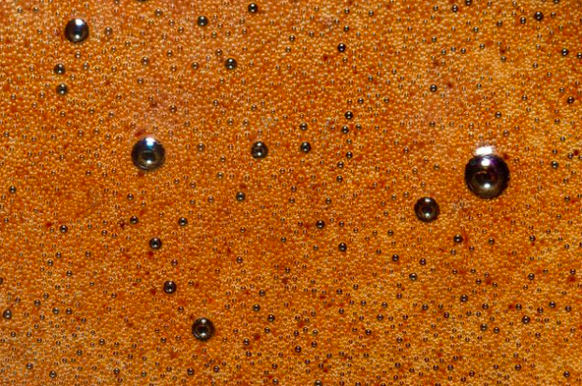
15.

Slide 17
Ready to see what they are?

Slide 18


1.

Slide 19
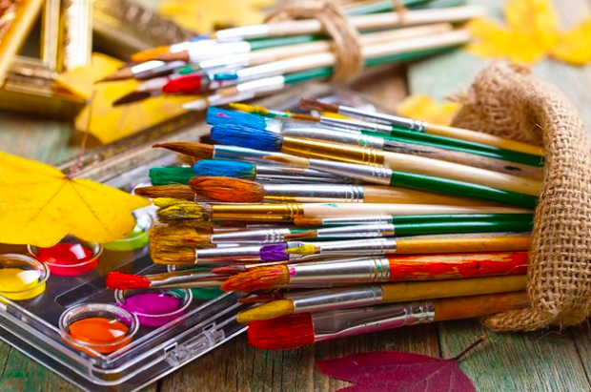
1.
Paint brush

Slide 20
2.

Slide 21
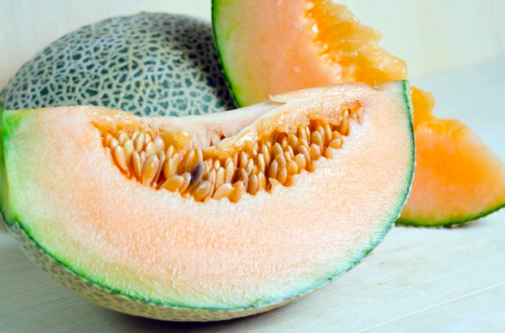
2.
Cantaloupe

Slide 22
3.

Slide 23
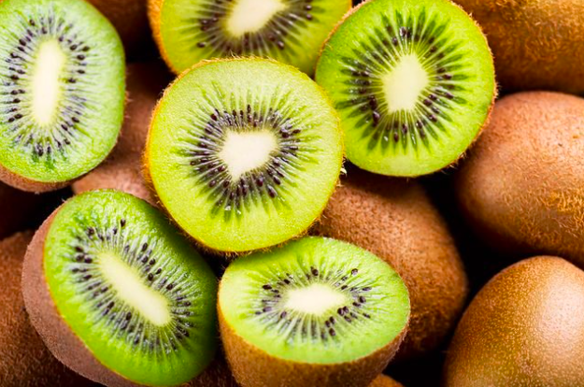
3.
Kiwi

Slide 24
4.

Slide 25
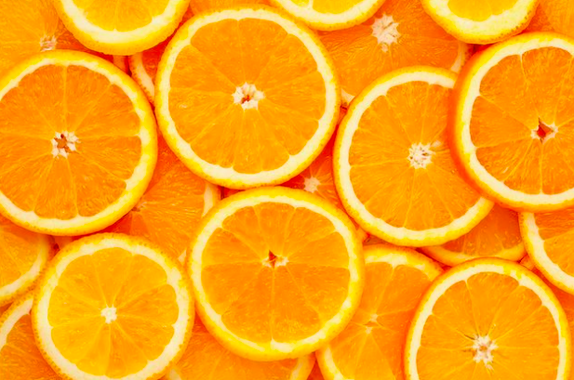
4.
Orange

Slide 26
5.

Slide 27
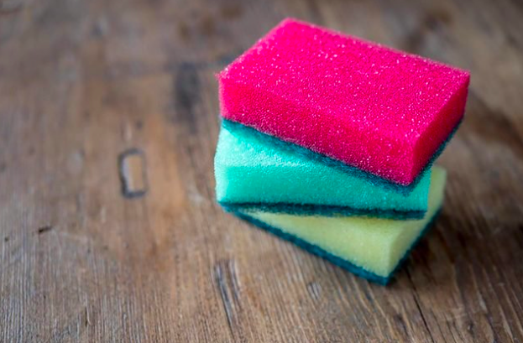
5.
Sponge

Slide 28
6.

Slide 29
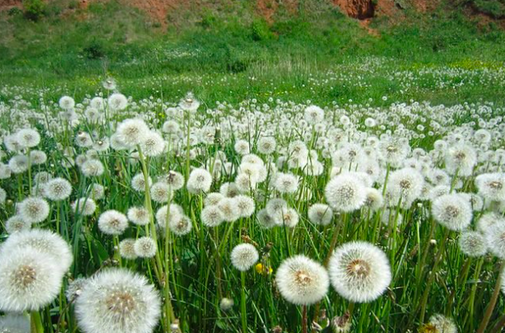
6.
Dandelion

Slide 30
7.

Slide 31
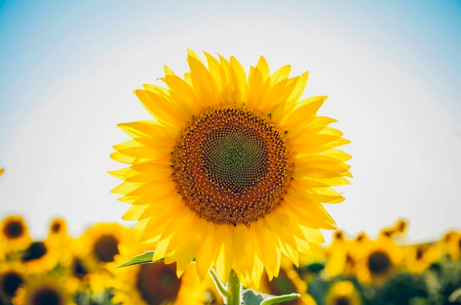
7.
Sunflower

Slide 32
8.

Slide 33
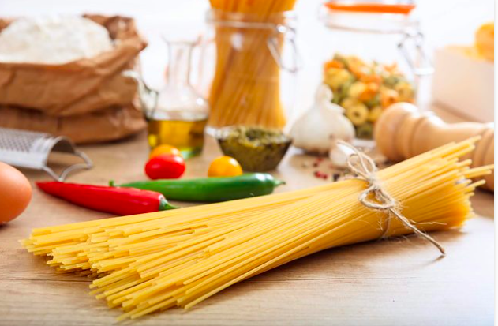
8.
Pasta

Slide 34
9.

Slide 35
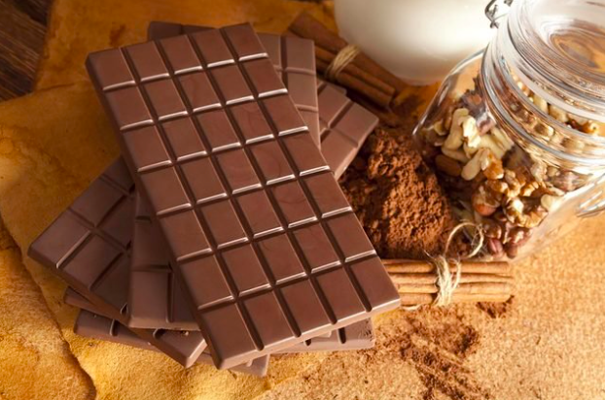
9.
Chocolate

Slide 36
10.

Slide 37
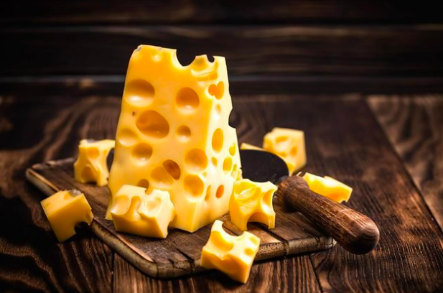
10.
Cheese

Slide 38
11.

Slide 39
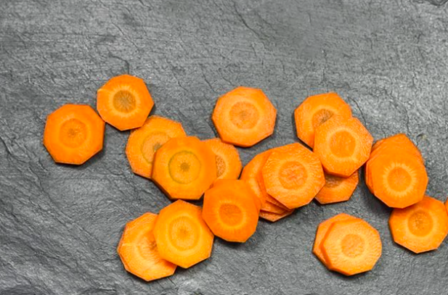
11.
Carrot

Slide 40
12.

Slide 41
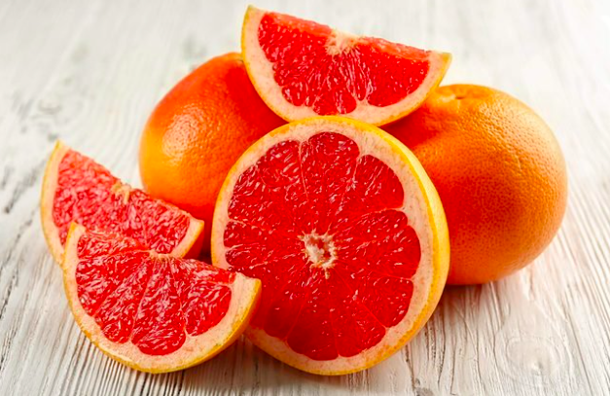
12.
Grapefruit

Slide 42
13.

Slide 43
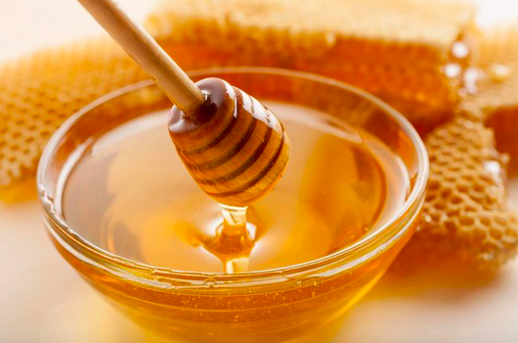
13.
Honey

Slide 44
14.

Slide 45
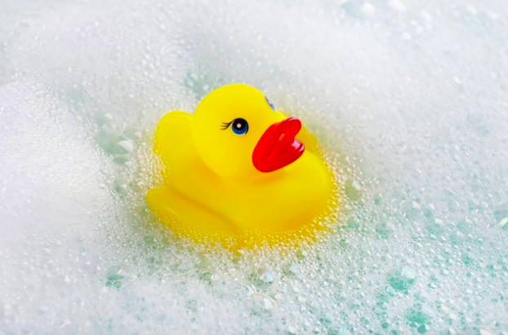
14.
Soap bubbles

Slide 46
15.

Slide 47
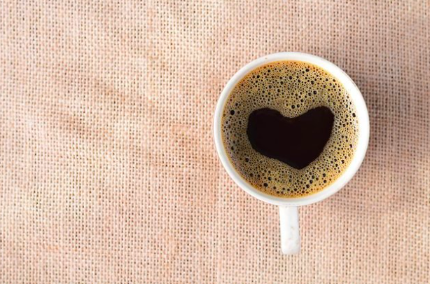
15.
coffee

Slide 48

Nice job

