Slide 1
Lesson 11 Lesson 15
Lesson 12 Lesson 16
Lesson 13 Lesson 17
Lesson 14
Unit 1

Slide 2
Get Enough
Unit 1
Lesson 11
Math in Our World
Notes:
For quick access to the presentation from your own drive, go to File > Add shortcut to Drive.
To customize for your students, go to File > Make a copy to make a copy of the slide deck in your Google Drive that you can edit.
Report a Typo

Slide 3
Let’s get enough pencils for everyone.
Unit 1 ● Lesson 11

Slide 4

In a Flash
How many do you see?
How do you see them?
Use your fingers to show your partner how many dots you see.
Tell your partner how many dots you see and how you see them.
Unit 1 ● Lesson 11 ● Warm-up

Slide 5
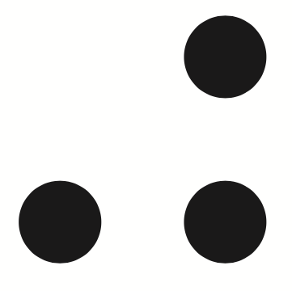
In a Flash
How many do you see?
How do you see them?
Use your fingers to show your partner how many dots you see.
Tell your partner how many dots you see and how you see them.
Unit 1 ● Lesson 11 ● Warm-up

Slide 6
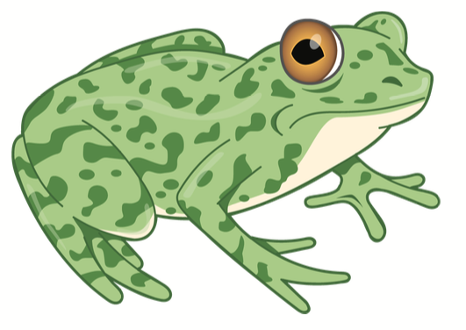
Act It Out: Four Little Speckled Frogs (Part 2)
4 little speckled frogs sat on a speckled log,
eating the most delicious bugs. Yum! Yum!
1 jumped into the pool, where it was nice and cool.
Now there are 3 green speckled frogs. Glub! Glub!
What is the story about?
Let’s read the story again.
How can you act out this story?
Unit 1 ● Lesson 11 ● Activity 1

Slide 7
Act It Out: Four Little Speckled Frogs (Part 2)
Discuss your thinking with your partner.
Unit 1 ● Lesson 11 ● Activity 1

Slide 8
Act It Out: Four Little Speckled Frogs (Part 2)
4 little speckled frogs sat on a speckled log,
eating the most delicious bugs. Yum! Yum!
1 jumped into the pool, where it was nice and cool.
Now there are 3 green speckled frogs. Glub! Glub!
Let’s act out the story.
Unit 1 ● Lesson 11 ● Activity 1

Slide 9

Get Enough
Work together with your group to get enough pencils so that everyone in your group has one pencil.
How many pencils are in the group you made?
How many people are at your table?
What do you notice?
Work with your group to get enough pencils so that each student pictured in your student workbook gets one.
Unit 1 ● Lesson 11 ● Activity 2

Slide 10
Get Enough
I need to get enough pencils so that each student has one. What should I do?
Unit 1 ● Lesson 11 ● Activity 2

Slide 11
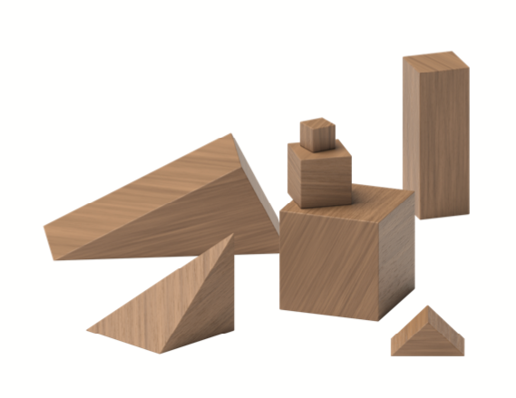
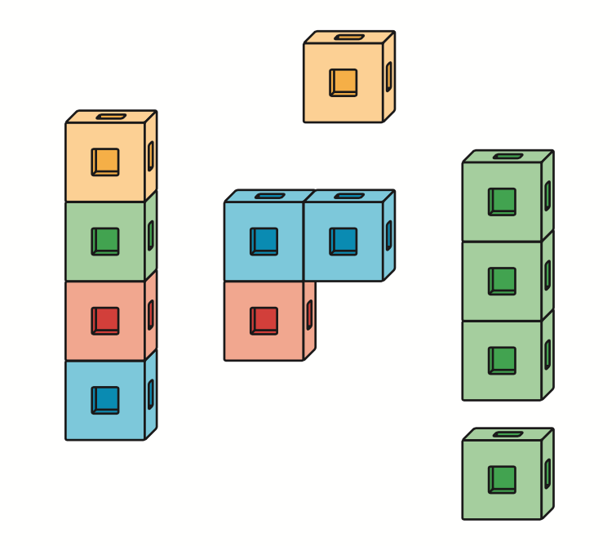
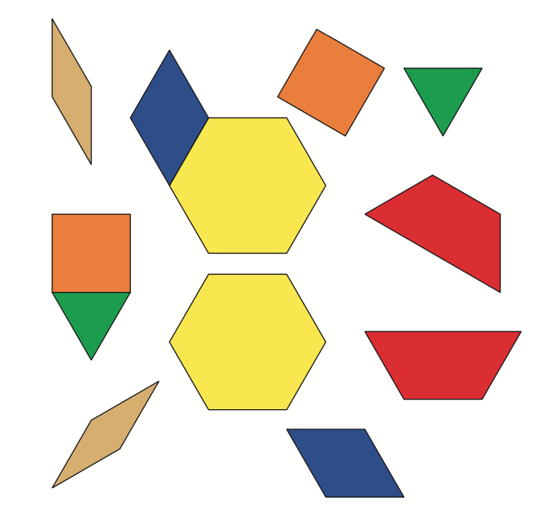
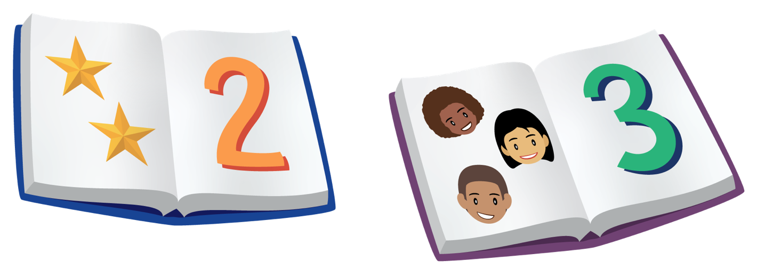
Centers: Choice Time
Choose a center.
Geoblocks
Connecting Cubes
Pattern Blocks
Picture Books
Unit 1 ● Lesson 11 ● Activity 3

Slide 12
Centers: Choice Time
Think of one thing someone did during center time today that helped you with your work.
Unit 1 ● Lesson 11 ● Activity 3

Slide 13
Get Enough
If this group of students is working with geoblocks during center time, how many blocks do we need so that each student can have one? How do you know?
Now, let’s count to 10.
Unit 1 ● Lesson 11

Slide 14
How Many Are There? (Part 1)
Unit 1
Lesson 12
Math in Our World
Notes:
For quick access to the presentation from your own drive, go to File > Add shortcut to Drive.
To customize for your students, go to File > Make a copy to make a copy of the slide deck in your Google Drive that you can edit.
Report a Typo

Slide 15
Let’s count collections of objects.
Unit 1 ● Lesson 12

Slide 16
How Many of Us Are Here Today?
How can we figure out how many of us are here?
How many of us are here today?
Did I count the students correctly?
Unit 1 ● Lesson 12 ● Warm-up

Slide 17
Counting Collections
Look at this collection of objects.
How can we figure out how many objects are in this collection?
Unit 1 ● Lesson 12 ● Activity 1

Slide 18
Counting Collections
Figure out how many objects are in your collection. Use the tools if they are helpful.
Switch collections with a partner. Figure out how many objects are in your new collection.
Unit 1 ● Lesson 12 ● Activity 1

Slide 19
Counting Collections
Let’s watch ____ count a collection.
What do you notice about how they counted?
There are _____ objects in their collection.
Unit 1 ● Lesson 12 ● Activity 1

Slide 20
Count to 10
I’m going to count to 10.
Unit 1 ● Lesson 12 ● Activity 2

Slide 21
Count to 10
Let’s count to 10 all together.
Let’s count to 10 and clap our hands when we say each number.
Let’s count to 10 and touch the table when we say each number.
Let’s count to 10 and put up 1 finger when we say each number.
Unit 1 ● Lesson 12 ● Activity 2

Slide 22
Count to 10
Take turns counting to 10 with your partner. You can clap your hands or touch the table when you say each number. You can also think of your own movement for each number.
Unit 1 ● Lesson 12 ● Activity 2

Slide 23
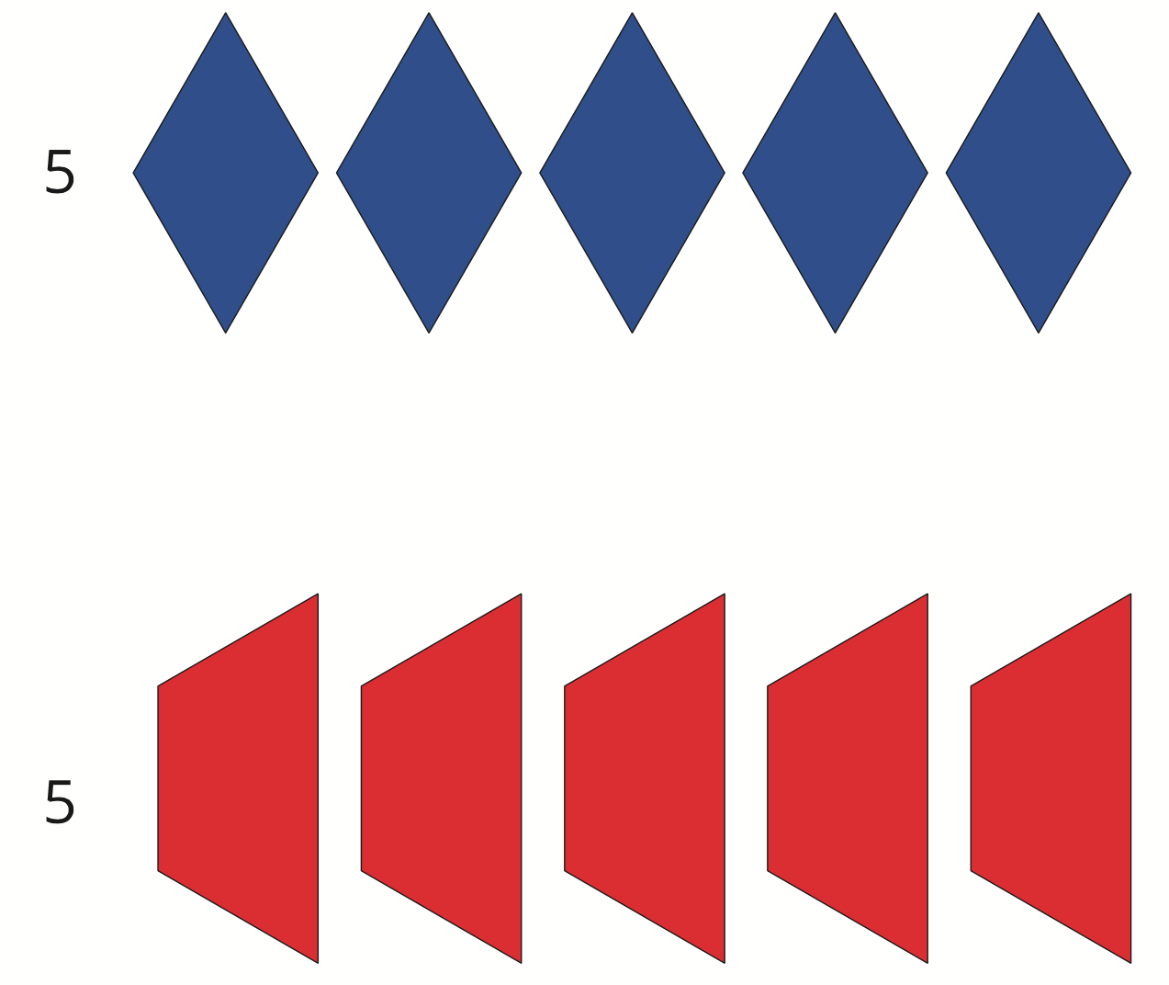
Introduce Pattern Blocks, Get and Build
What do you notice? What do you wonder?
Unit 1 ● Lesson 12 ● Activity 3

Slide 24
Introduce Pattern Blocks, Get and Build
This page shows you which pattern blocks you need. Work with your partner to take out all of the pattern blocks that you need.
Now you can use your pattern blocks to create whatever you’d like. You can make a robot or a design or something else.
Unit 1 ● Lesson 12 ● Activity 3

Slide 25
Introduce Pattern Blocks, Get and Build
Now you can choose another center. You can also continue playing Pattern Blocks.
Geoblocks
Connecting Cubes
Pattern Blocks
Picture Books
Unit 1 ● Lesson 12 ● Activity 3

Slide 26
Introduce Pattern Blocks, Get and Build
How did you figure out how many pattern blocks you needed?
Unit 1 ● Lesson 12 ● Activity 3

Slide 27
How Many Are There? (Part 1)
Today we counted collections of objects. Where do you see people count?
Unit 1 ● Lesson 12

Slide 28
How Many Are There? (Part 2)
Unit 1
Lesson 13
Math in Our World
Notes:
For quick access to the presentation from your own drive, go to File > Add shortcut to Drive.
To customize for your students, go to File > Make a copy to make a copy of the slide deck in your Google Drive that you can edit.
Report a Typo

Slide 29
Let’s count collections of objects.
Unit 1 ● Lesson 13

Slide 30
Attendance
We need to figure out how many of us are here.
How can we make sure that we count each person one time?
How many of us are here today?
Did we count everyone one time? How do you know?
Unit 1 ● Lesson 13 ● Warm-up

Slide 31
Counting Collections
Today you’re going to count another collection of objects.
As you’re working, think about how to make sure you count each object.
Unit 1 ● Lesson 13 ● Activity 1

Slide 32
Counting Collections
Figure out how many objects are in your collection.
Switch collections with a partner. Figure out how many objects are in your new collection.
Unit 1 ● Lesson 13 ● Activity 1

Slide 33
Counting Collections
Let’s watch ____ count a collection.
What do you notice about how they counted?
There are _____ objects in their collection.
Unit 1 ● Lesson 13 ● Activity 1

Slide 34
Pair Objects and Numbers
Let’s practice counting to 10.
Unit 1 ● Lesson 13 ● Activity 2

Slide 35
Pair Objects and Numbers
Move the objects in your collection into the bucket one at a time.
Move the objects in your collection into the bucket one at a time. Say a number each time you put an object in the bucket.
Unit 1 ● Lesson 13 ● Activity 2

Slide 36
Pair Objects and Numbers
I’m going to move each object into the bucket. When I move an object, say a number.
Why do we say one number as we move each object?
When we count, we say one number for each object.
Unit 1 ● Lesson 13 ● Activity 2

Slide 37
Centers: Choice Time
Choose a center.
Geoblocks
Connecting Cubes
Pattern Blocks
Picture Books
Unit 1 ● Lesson 13 ● Activity 3

Slide 38
Centers: Choice Time
When did you see a partner count during centers today?
Unit 1 ● Lesson 13 ● Activity 3

Slide 39
How Many Are There? (Part 2)
Today we counted collections of objects. What is something that you can count at home?
Unit 1 ● Lesson 13

Slide 40
Answer “How Many” Questions
Unit 1
Lesson 14
Math in Our World
Notes:
For quick access to the presentation from your own drive, go to File > Add shortcut to Drive.
To customize for your students, go to File > Make a copy to make a copy of the slide deck in your Google Drive that you can edit.
Report a Typo

Slide 41
Let’s count to figure out how many objects are in our collections.
Unit 1 ● Lesson 14

Slide 42
Represent Attendance (Part 1)
How can we show how many of us are here today?
How can we figure out how many of us are here?
How many of us are here today?
What did we do to show each student in our class?
Unit 1 ● Lesson 14 ● Warm-up

Slide 43
Counting Collections: How Many?
Figure out how many objects are in your collection.
Switch collections with a partner. Figure out how many objects are in your new collection.
Ask your partner “How many objects are in your collection?”
Unit 1 ● Lesson 14 ● Activity 1

Slide 44
Counting Collections: How Many?
Let’s watch ____ count a collection.
How many objects are in _____’s collection? How do you know?
There are _____ objects in their collection.
Unit 1 ● Lesson 14 ● Activity 1

Slide 45
Egg Carton Counting
How can the egg carton help us make sure that we say one number for each object while we count?
Unit 1 ● Lesson 14 ● Activity 2

Slide 46
Egg Carton Counting
Use the egg carton to figure out how many objects are in your collection.
Unit 1 ● Lesson 14 ● Activity 2

Slide 47
Egg Carton Counting
Take turns counting your collection with your partner. As you place each object in the egg carton, your partner says one number.
Unit 1 ● Lesson 14 ● Activity 2

Slide 48
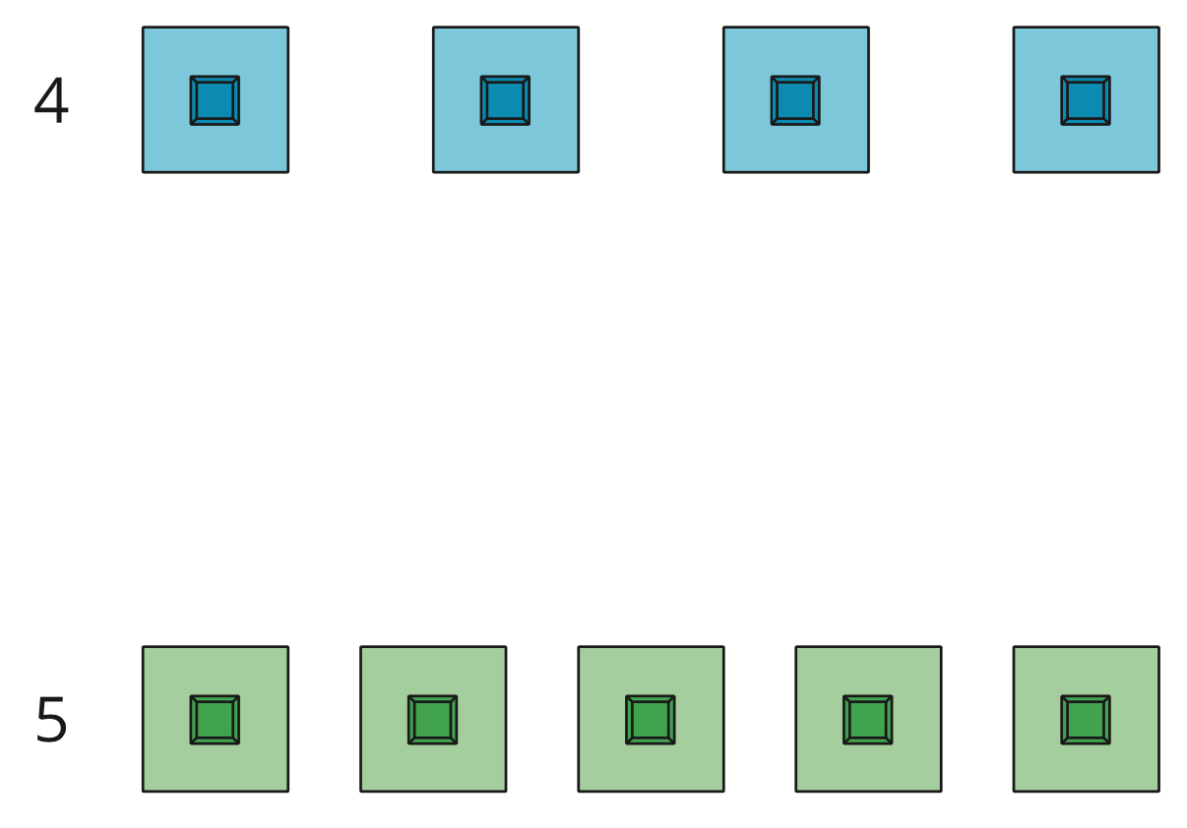
Introduce Connecting Cubes, Get and Build
What do you notice? What do you wonder?
Unit 1 ● Lesson 14 ● Activity 3

Slide 49
Introduce Connecting Cubes, Get and Build
This page shows me which connecting cubes I need. Work with your partner to take out all of the connecting cubes that you need.
Now you can use your connecting cubes to create whatever you’d like. You can make an animal or a tower or something else.
Unit 1 ● Lesson 14 ● Activity 3

Slide 50
Introduce Connecting Cubes, Get and Build
Now you can choose another center. You can also choose to continue working with Connecting Cubes.
Geoblocks
Connecting Cubes
Pattern Blocks
Picture Books
Unit 1 ● Lesson 14 ● Activity 3

Slide 51
Introduce Connecting Cubes, Get and Build
Let’s look at what two people built with connecting cubes.
Tell your partner what is the same about what ______ and ______ made.
Unit 1 ● Lesson 14 ● Activity 3

Slide 52
Answer “How Many” Questions
Today we counted collections to figure out how many objects there are. Ask your partner a question about our classroom that starts with “how many”.
Unit 1 ● Lesson 14

Slide 53
Explain How You Counted
Unit 1
Lesson 15
Math in Our World
Notes:
For quick access to the presentation from your own drive, go to File > Add shortcut to Drive.
To customize for your students, go to File > Make a copy to make a copy of the slide deck in your Google Drive that you can edit.
Report a Typo

Slide 54
Let’s count collections of objects and tell our partners how we counted.
Unit 1 ● Lesson 15

Slide 55
Represent Attendance (Part 2)
How can we show how many of us are here today?
How can we figure out how many of us are here?
How many of us are here today?
What did we do to show each student in our class?
Unit 1 ● Lesson 15 ● Warm-up

Slide 56
Counting Collections: Share How You Counted
Figure out how many objects are in your collection.
Switch collections with a partner. Figure out how many objects are in your new collection.
Tell your partner how many objects are in your collection. Show them how you counted the objects.
Unit 1 ● Lesson 15 ● Activity 1

Slide 57
Counting Collections: Share How You Counted
How did the 5-frame help you count your collection of objects?
How did the counting mat help you count your collection of objects?
Unit 1 ● Lesson 15 ● Activity 1

Slide 58
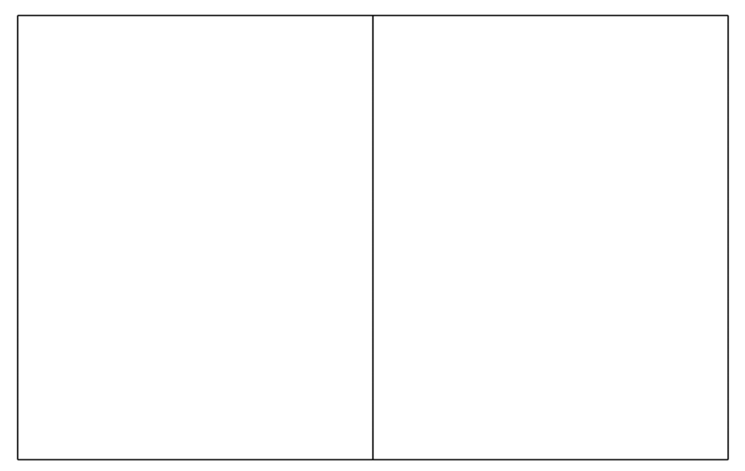
Use a Counting Mat to Keep Track
How can the counting mat help us make sure that we count each object 1 time?
Unit 1 ● Lesson 15 ● Activity 2

Slide 59
Use a Counting Mat to Keep Track
Use the counting mat to figure out how many objects are in your collection.
Unit 1 ● Lesson 15 ● Activity 2

Slide 60
Use a Counting Mat to Keep Track
Which objects do I still need to count?
Which objects did I already count?
How do you know?
Unit 1 ● Lesson 15 ● Activity 2

Slide 61
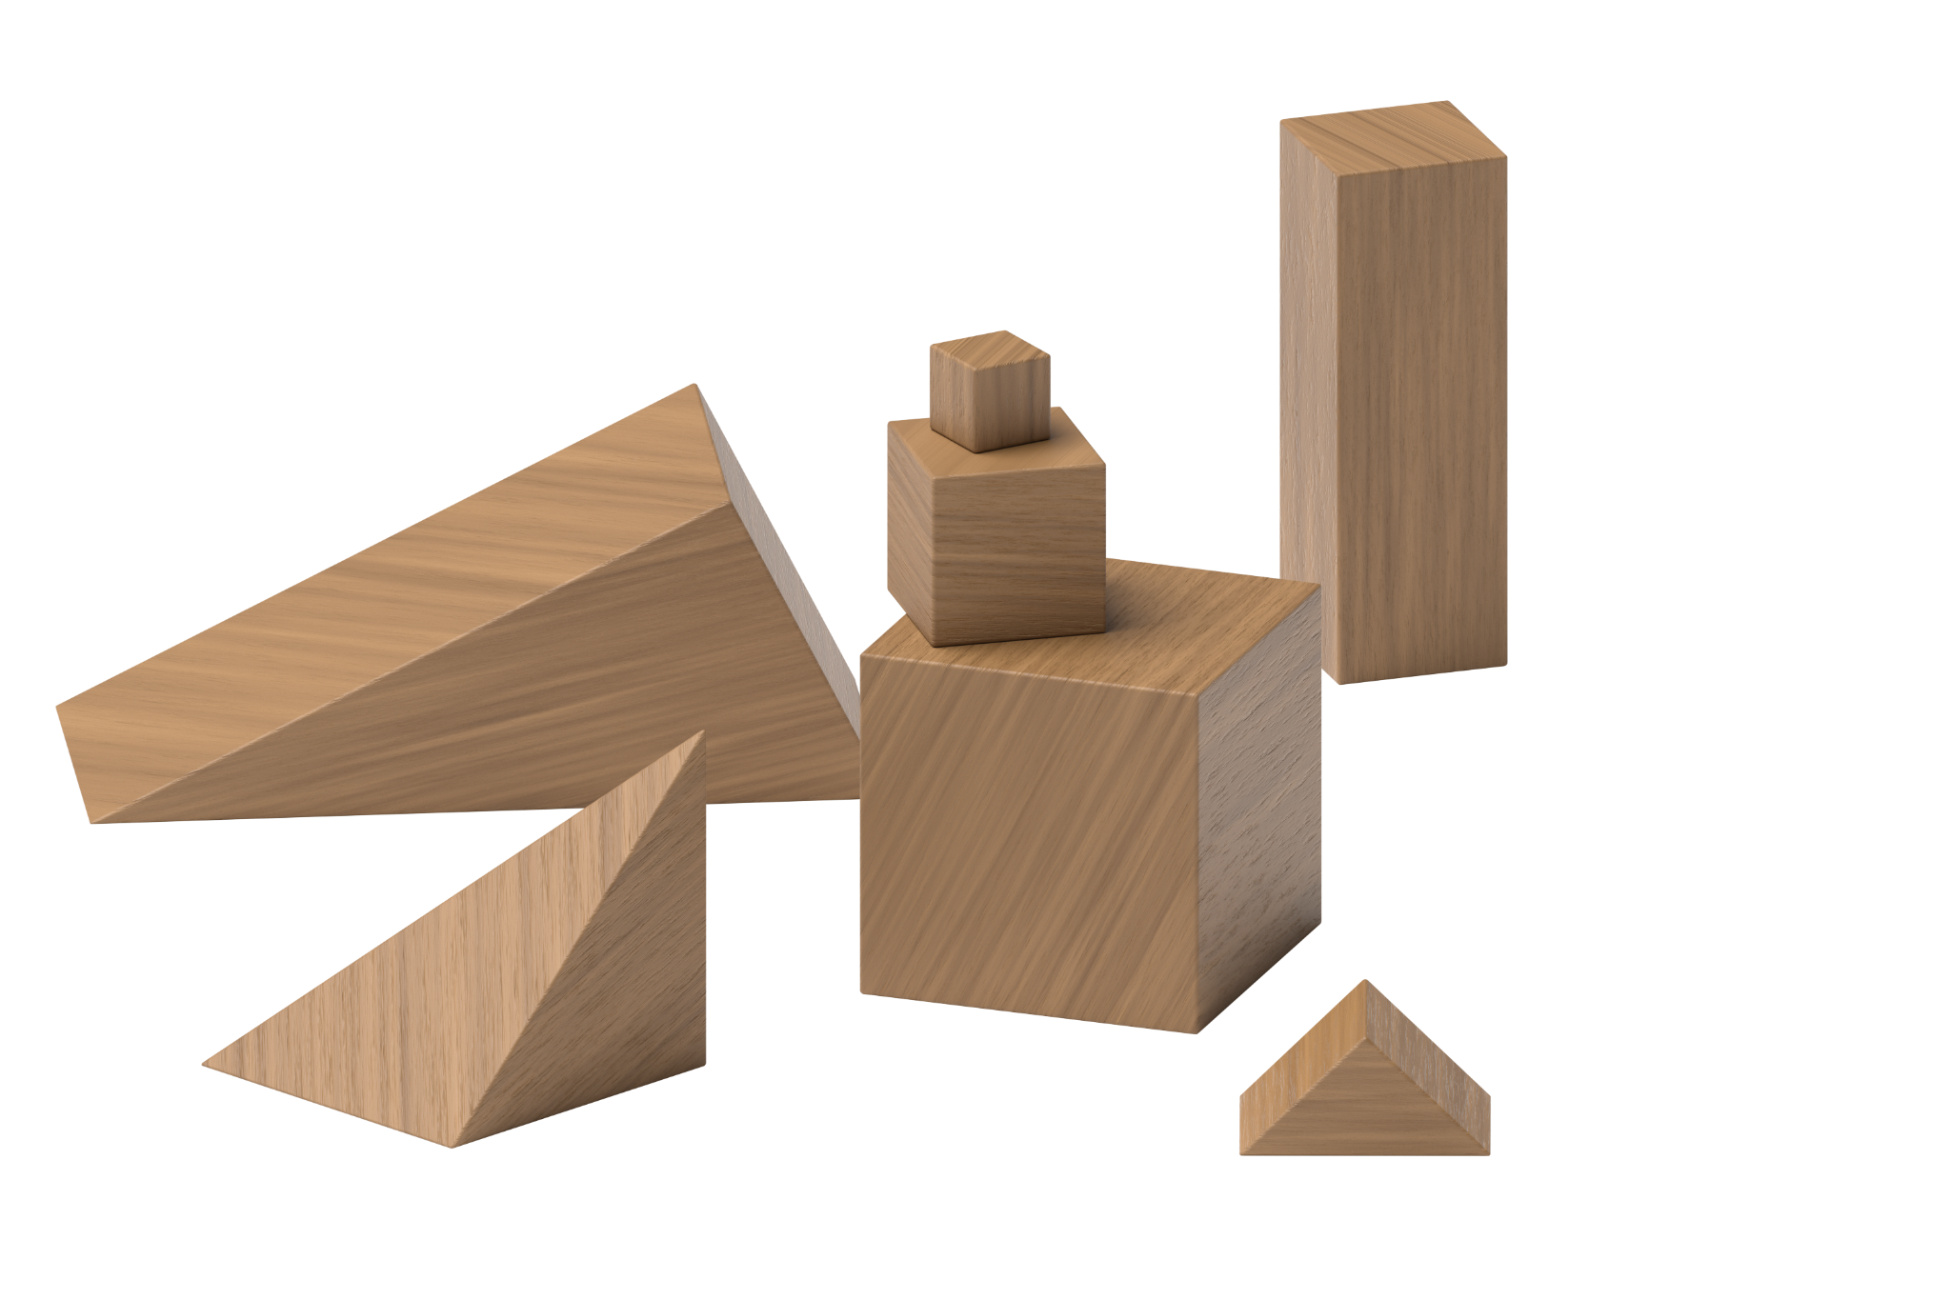
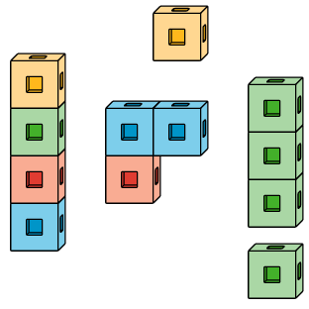
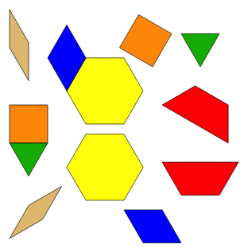

Centers: Choice Time
Choose a center.
Geoblocks Connecting Cubes
Pattern Blocks Picture Books
Unit 1 ● Lesson 15 ● Activity 3

Slide 62
Centers: Choice Time
Tell us about a time when something was challenging for you during centers. What did you do?
Unit 1 ● Lesson 15 ● Activity 3

Slide 63
Explain How You Counted
Today we counted collections of objects.
Did you use any math tools to help you count?
How did they help you count?
Unit 1 ● Lesson 15

Slide 64
Represent Our Collections
Unit 1
Lesson 16
Math in Our World
Notes:
For quick access to the presentation from your own drive, go to File > Add shortcut to Drive.
To customize for your students, go to File > Make a copy to make a copy of the slide deck in your Google Drive that you can edit.
Report a Typo

Slide 65
Let’s count collections of objects and show how we counted.
Unit 1 ● Lesson 16

Slide 66
Attendance Display
How can we use the 5-frames to show how many of us are here?
How can we figure out how many of us are here?
How many of us are here today?
What do you notice about the different ways that we showed how many of us are here?
Unit 1 ● Lesson 16 ● Warm-up

Slide 67
Counting Collections: Show How Many
Today you’re going to count another collection of objects.
During Questions About Us, we showed how many of us are here today. As you’re counting your collection, think about how you can show how you counted your collection.
Unit 1 ● Lesson 16 ● Activity 1

Slide 68
Counting Collections: Show How Many
Figure out how many objects are in your collection.
Switch collections with a partner. Figure out how many objects are in your new collection.
Tell your partner how many objects are in your collection. Show them how you counted the objects.
Show how you counted your collection. Show your thinking using objects, drawings, numbers, or words.
Unit 1 ● Lesson 16 ● Activity 1

Slide 69
Counting Collections: Show How Many
What is the same about how they each counted their collections?
What is different about how they each showed how they counted?
There are _____ objects in their collection.
Unit 1 ● Lesson 16 ● Activity 1

Slide 70
Answer How Many Questions
Figure out how many objects are in your collection.
How many objects are in your collection? Tell your partner how many objects are in your collection without counting the objects again.
Unit 1 ● Lesson 16 ● Activity 2

Slide 71
Answer How Many Questions
Let’s count to figure out how many objects are in this collection.
How many objects are in the collection?
Unit 1 ● Lesson 16 ● Activity 2

Slide 72
Centers: Choice Time
Choose a center.
Geoblocks
Connecting Cubes
Pattern Blocks
Picture Books
Unit 1 ● Lesson 16 ● Activity 3

Slide 73
Centers: Choice Time
We have been working with pattern blocks, connecting cubes, geoblocks, and picture books throughout the unit. Which center is your favorite? Why?
Unit 1 ● Lesson 16 ● Activity 3

Slide 74
Represent Our Collections
Today we counted collections to figure out how many objects there are. Ask your partner a question about our classroom that starts with “how many”.
Unit 1 ● Lesson 16

Slide 75
Connecting Cube Sculptures
Unit 1
Lesson 17
Math in Our World
Notes:
For quick access to the presentation from your own drive, go to File > Add shortcut to Drive.
To customize for your students, go to File > Make a copy to make a copy of the slide deck in your Google Drive that you can edit.
Report a Typo

Slide 76
Let’s build with connecting cubes and figure out how many we have.
Unit 1 ● Lesson 17

Slide 77

Connecting Cube Flash
How many do you see?
How do you see them?
Use your fingers to show your partner how many cubes you see.
Tell your partner how many cubes you see and how you see them.
Unit 1 ● Lesson 17 ● Warm-up

Slide 78
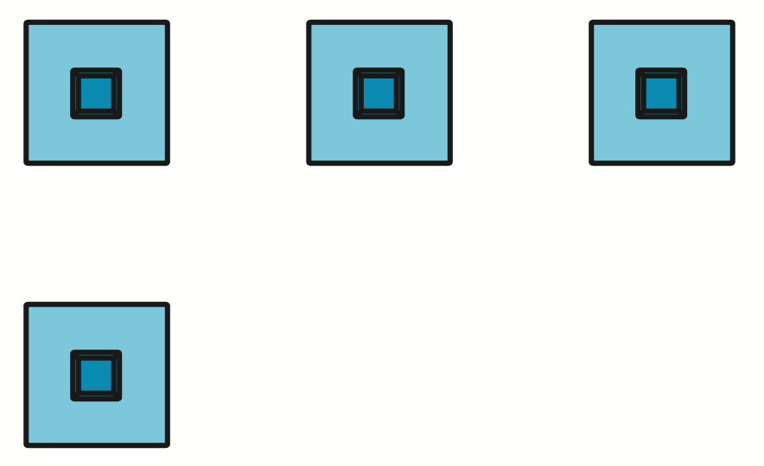
Connecting Cube Flash
How many do you see?
How do you see them?
Use your fingers to show your partner how many cubes you see.
Tell your partner how many cubes you see and how you see them.
Unit 1 ● Lesson 17 ● Warm-up

Slide 79
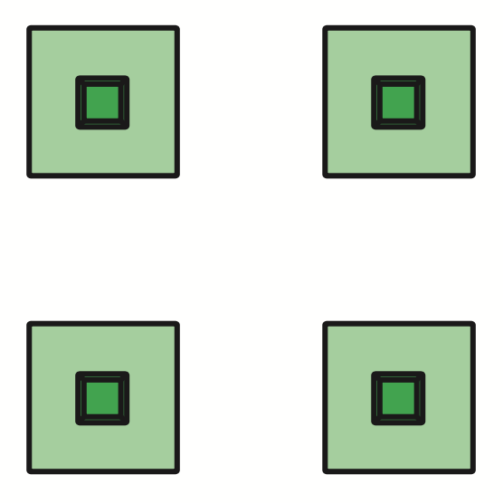
Connecting Cube Flash
How many do you see?
How do you see them?
Use your fingers to show your partner how many cubes you see.
Tell your partner how many cubes you see and how you see them.
Unit 1 ● Lesson 17 ● Warm-up

Slide 80
Connecting Cube Flash
What is the same about these groups of connecting cubes? What is different?
There are 4 connecting cubes in this group. There are also 4 connecting cubes in this group.
Unit 1 ● Lesson 17 ● Warm-up

Slide 81
Count Cubes
Figure out how many cubes are in your collection. Show how you counted your collection. Show your thinking using objects, drawings, numbers, or words.
How many cubes are in your collection? Tell your partner how many cubes are in your collection without counting them again.
Unit 1 ● Lesson 17 ● Activity 1

Slide 82
Count Cubes
How many cubes are in _____’s collection?
How do you know?
When we counted, the last number we said was _____. That tells us that there are _____ objects in our collection.
Unit 1 ● Lesson 17 ● Activity 1

Slide 83
Connecting Cube Creations
Use all of your connecting cubes to create whatever you’d like.
Tell your group what you made and how many cubes you used without counting them again.
Unit 1 ● Lesson 17 ● Activity 2

Slide 84
Connecting Cube Creations
Tell your partner what is the same about what _____ and _____ made.
Unit 1 ● Lesson 17 ● Activity 2

Slide 85
Connecting Cube Sculptures
What are some questions we can ask about what your classmates made?
Unit 1 ● Lesson 17

