Slide 1
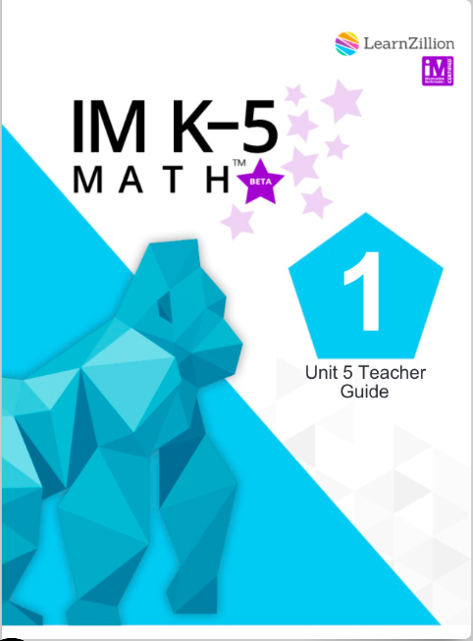
Illustrative Mathematics
Unit Preview
Grade 1 - Unit 5
Adding Within 100
This document has been created by the CT Region 7 Unified Education Consortium and is not an official IM material.
Language is taken from IM Grade One Units by Illustrative Mathematics. Copyright 2020 by Illustrative Mathematics.
All Rights Reserved, adapted and shared with permission.

Slide 2
Unit Details
Lessons: 14 | Sections: 3 | Total Days: 20
Unit Goal: Students use place value understanding and properties of operations to add within 100.
Standards: 1.NBT.A.1, 1.NBT.C.4, 1.NBT.C.5, 1.NBT.C.6, 1.OA.A.1, 1.OA.A.2, 1.OA.C.6, 1.OA.D.8
Mathematical Practices: MP1, MP3, MP4, MP6, MP7
Mathematical Language Routines: MLR2: Collect and Display, MLR6: Three Reads, MLR7: Compare and Connect, MLR8: Discussion Supports
Instructional Routines: How Many Do You See?, Choral Count, 5 Practices, Number Talk, Act It Out, Which One Doesn’t Belong?, Estimation Exploration
Vocabulary: N/A

Slide 3
Starting with the End in Mind
Reflect: Why is it important to know and track this information about students? How will you use the data from this assessment to inform your instruction? What misconceptions might students have as they take the assessment?
Consider: How will you assess students in person? How will you assess them remotely?
Take the Unit 5 Assessment …..

Slide 4
Dive Deep Into the Unit
Read the Unit Overview
What should students be able to do when they begin this unit?
What background knowledge should students have to help them succeed with this unit?
What should students be able to do when they finish this unit?
What will students learn in each section?
Materials
Review the black line masters that are used in this unit.
What materials need to be prepped ahead of time?
Read the Center Overview
What materials do you need to successfully implement these centers?

Slide 5
Section A Overview
Add Without Composing a Ten
Read & Reflect on Section A
Goals: What are the goals of this section?
Routines: Read through the warm-ups for each lesson in the section.
Which routines are familiar and which ones are new?
Centers: Read through the centers included in this section.
How might you use these centers with students?
What materials will you need to prepare?
Supports: Select a lesson that has supports for students with disabilities and English learners and read the detailed description of the support within the lesson activity.
How do the supports increase access for students with disabilities or are English learners? How might these supports benefit all students?
Assessment: Read through the cool-downs for each lesson in the section and review the section checkpoint.
Which cool-downs are familiar and which ones are new?
How will student understanding be assessed in this section?

Slide 6
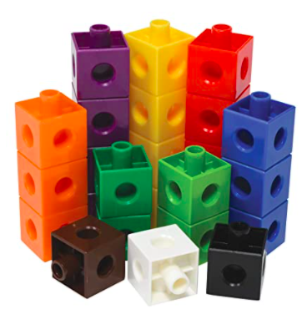
Section A Debrief Activity
Lesson 2, Activity 1
Find the Sum
Read the PLC activity. What are the benefits of this activity? What kind of responses will students give? What misconceptions might they have? Think about how you would present this activity in person. Be prepared to demonstrate for your colleagues how you would present this activity virtually.

Slide 7
Section B Overview
Compose a Ten: One- and Two-Digit Numbers
Read & Reflect on Section B
Goals: What are the goals of this section?
Routines: Read through the warm-ups for each lesson in the section.
Which routines are familiar and which ones are new?
Centers: Read through the centers included in this section.
How might you use these centers with students?
What materials will you need to prepare?
Supports: Select a lesson that has supports for students with disabilities and English learners and read the detailed description of the support within the lesson activity.
How do the supports increase access for students with disabilities or are English learners? How might these supports benefit all students?
Assessment: Read through the cool-downs for each lesson in the section and review the section checkpoint.
Which cool-downs are familiar and which ones are new?
How will student understanding be assessed in this section?

Slide 8
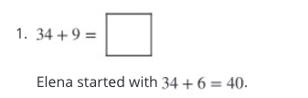
Section B Debrief Activity
Lesson 6, Activity 2
Elena Adds
Read the PLC activity. What are the benefits of this activity? What kind of responses will students give? What misconceptions might they have? Think about how you would present this activity in person. Be prepared to demonstrate for your colleagues how you would present this activity virtually.

Slide 9
Section C Overview
Compose a Ten: Add Within 100
Read & Reflect on Section C
Goals: What are the goals of this section?
Routines: Read through the warm-ups for each lesson in the section.
Which routines are familiar and which ones are new?
Centers: Read through the centers included in this section.
How might you use these centers with students?
What materials will you need to prepare?
Supports: Select a lesson that has supports for students with disabilities and English learners and read the detailed description of the support within the lesson activity.
How do the supports increase access for students with disabilities or are English learners? How might these supports benefit all students?
Assessment: Read through the cool-downs for each lesson in the section and review the section checkpoint.
Which cool-downs are familiar and which ones are new?
How will student understanding be assessed in this section?

Slide 10
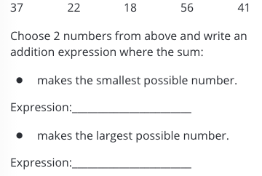
Section C Debrief Activity
Lesson 12, Activity 2
Reason About Addition
Read the PLC activity. What are the benefits of this activity? What kind of responses will students give? What misconceptions might they have? Think about how you would present this activity in person. Be prepared to demonstrate for your colleagues how you would present this activity virtually.

Slide 11
Final Reflections
Be prepared to discuss the following questions in your debrief session.
What are the goals of this unit?
How can warm-up/cool-down routines be presented to students during remote learning? What are the most important things to consider as you plan to complete these routines?
What center is the one you are most excited to see your students use? Why? Is there a center that you are feeling nervous about using?
How might you use the supports suggested in this unit?
How do you plan to use the “practice problems”?
How will you assess students if they are in the classroom? How will you assess students if they are learning from home? How will you track assessment data?
How can we build a learning community and continue mathematical discourse in a remote learning environment?
What further supports do you need to feel like you can be successful in the implementation of this unit?

