Slide 1
Multimedia Elements
For a Midsummer Night’s Dream

Slide 2
Video Links
· Additional Resource 1 (Silent) https://vimeo.com/126199604 · Additional Resource 2 https://vimeo.com/126197160 · Additional Resource 3 https://vimeo.com/126197162 · Additional Resource 4 https://vimeo.com/126197816 · Additional Resource 5 https://vimeo.com/126197155 · Additional Resource 6 https://vimeo.com/126197157

Slide 3
About the Following Photos
The Core Classics® condensed script of A Midsummer Night’s Dream was field-tested in rehearsals by a youth troupe at the Live Arts community theater in Charlottesville, Virginia. The photographs here show scenes from their recent performance.

Slide 4
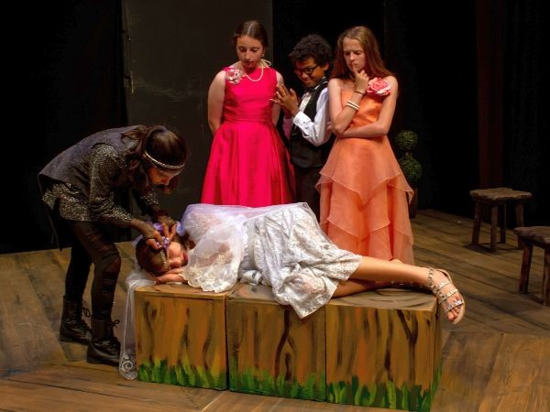

Slide 5
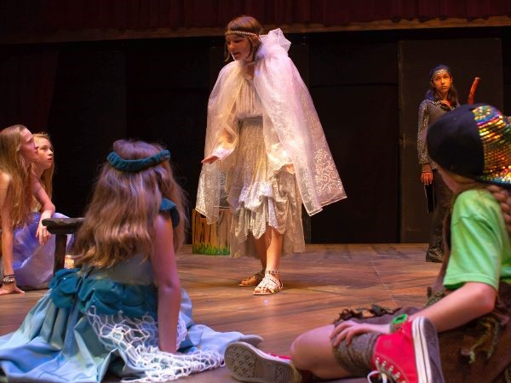

Slide 6
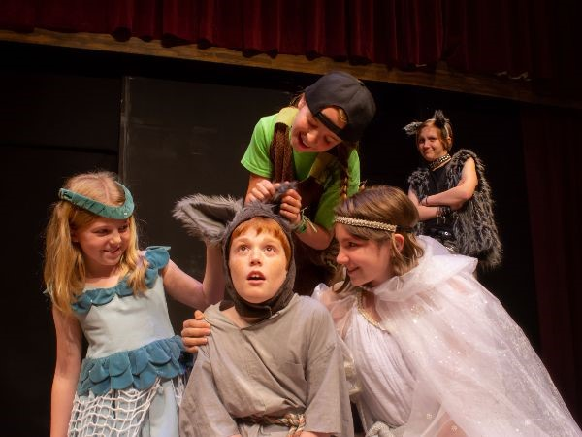

Slide 7
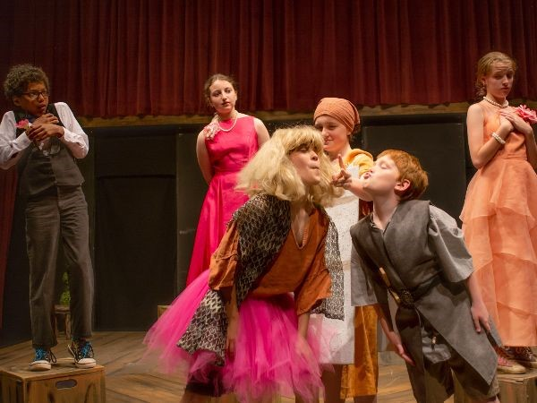

Slide 8
Enchanted Forest Clip Art
Other images to supplement retelling

Slide 9
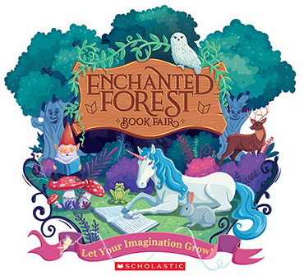

Slide 10
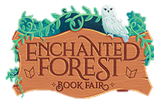

Slide 11
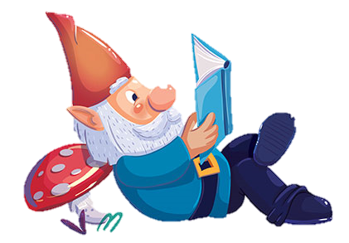
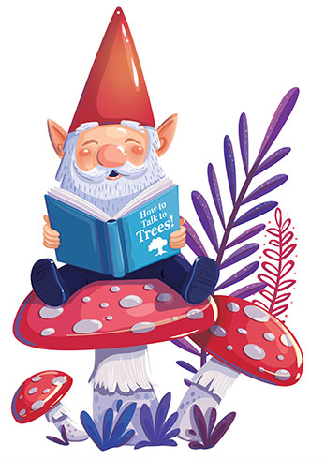


Slide 12
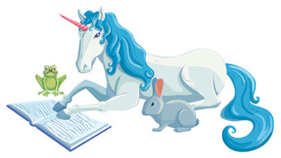

Slide 13
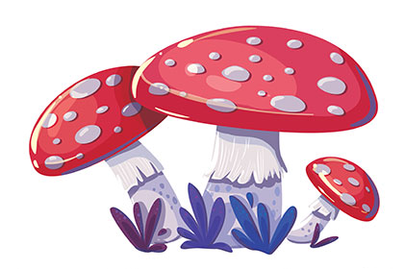

Slide 14
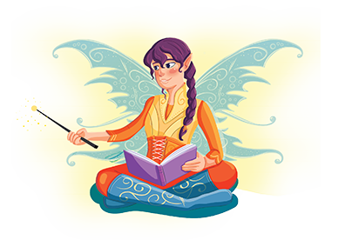

Slide 15
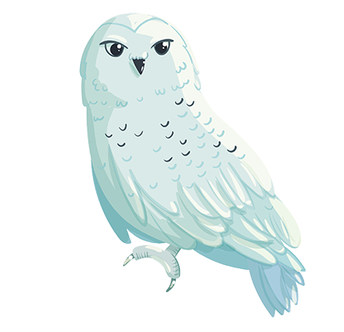
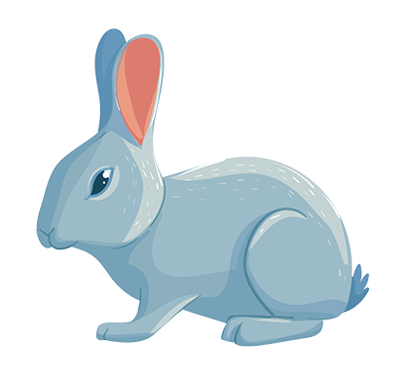
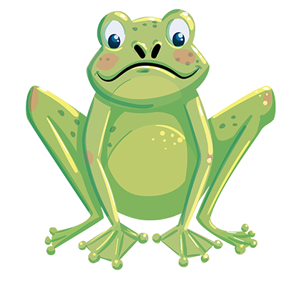

Slide 16
