Slide 1
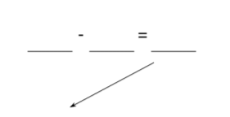

Directions:
● Students start at 99.
Spin to get a number to subtract from your starting number.
● Take turns spinning and finding the difference
● The first person to get less than 10 wins!
Player 1
Player 2
5
6
5
5
5
5
5
5
5
5
5
5
5
5
5
6
6
6
6
6
6
6
6
6
6
6
6
5
6
5
6
5
5
5
5
5
5
5
5
5
5
5
5
5
5
6
6
6
6
6
6
6
6
6
6
6
6
6
6
6
7
8
7
7
7
7
7
7
7
7
7
7
7
7
7
8
8
8
8
8
8
8
8
8
8
8
8
7
8
7
8
7
7
7
7
7
7
7
7
7
7
7
8
8
8
8
8
8
8
8
8
8
8
8
8
8
Spinner
9
10
9
9
9
9
9
9
9
9
9
9
9
9
9
10
10
10
10
10
10
10
10
10
10
10
10
9
10
9
10
9
9
9
9
9
9
9
9
9
9
9
9
10
10
10
10
10
10
10
10
10
10
10
10
10
10
10
10
10
10
10
10
10

