Slide 1
Look for Small Groups
Materials needed:
Activity 2: picture (with illustrations that include small groups of images) per group of 2 students
Activity 3: pattern blocks, connecting cubes, geoblocks, picture books, BLMs

Slide 2
Let’s explore counters and 5-frames.

Slide 3
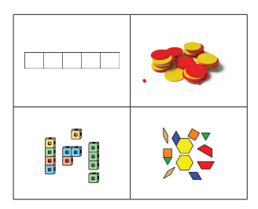
Warm Up: Notice and Wonder
What do you notice?
Tell your partner what you noticed.
What do you wonder?
Tell your partner what you wonder.

Slide 4
Warm Up Synthesis
How are these tools the same? How are they different?

Slide 5

Activity 1: Exploring Counters and 5-Frames
As you explore counters, you will also explore a new tool called a 5-frame.
Why do you think we call this a 5-frame?
Let’s explore counters and 5-frames.

Slide 6
Activity 1: Synthesis
We've learned about tools that can help us do math- connecting cubes, pattern blocks, counters, and 5-frames.
Which tools can you use to count? Why?
Which tools can you use to make shapes? Why?
Let’s practice counting to 10.

Slide 7
Lesson Synthesis
Today, we explored pattern blocks and you explained to your partner what you were doing with the blocks. Let’s add to our chart from yesterday about what doing math together looks like.

