Slide 1
Exploring Math Tools
Materials needed: pattern blocks, connecting cubes, geoblocks
• BLMs for each center

Slide 2
Let’s explore our math tools.

Slide 3
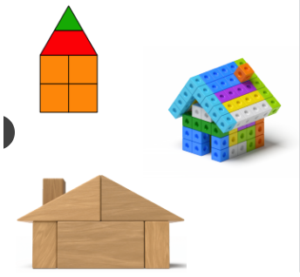
Warm Up: Notice and Wonder
What do you notice?
Tell your partner what you noticed.
What do you wonder?
Tell your partner what you wonder.

Slide 4
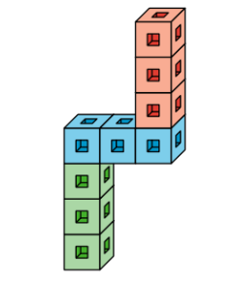
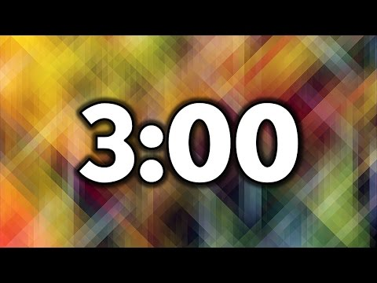
Activity 1 Center - Connecting Cubes
We are going to look at a new center that you can choose from during choice time.
How could you use cubes with this picture?
Use your cubes to build this figure.
Choose another page and use your cubes to build the figure.

Slide 5

Activity 1 Synthesis
Let’s share.
Show your partner what you made and describe it to them.

Slide 6
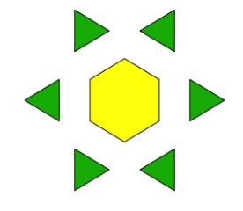
Activity 2 Center - Pattern Block Puzzles
We are going to look at a new center that you can choose from during choice time.
How could you use pattern blocks with this picture?
Use your pattern blocks to fill in the puzzle.
Show your partner how you filled in the puzzle. Tell them which pattern blocks you used.
Notes:
Give students several opportunities to try different pattern block puzzles. See lesson plan for questions to ask students (place on index or sticky notes).

Slide 7
Activity 2 Synthesis
Let’s share.
Which puzzle was your favorite?
Tell your partner why it was your favorite.

Slide 8
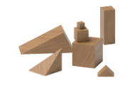
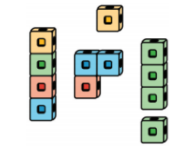
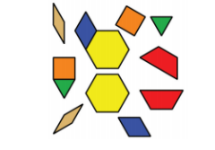

Activity 3 Center - Choice
Today you will get to choose the math tool you want to work with.
Think about what you would like to work with first.
Notes:
Give students several opportunities to try different center options. See lesson plan for questions to ask students (place on index or sticky notes).

Slide 9
Activity 3 Synthesis
Let’s share.
Tell your partner how _______ described their work.
What was your favorite activity?
Tell your partner why it was your favorite.
Notes:
Students are share and describing their work.

Slide 10
Lesson Synthesis
Today, we got to choose a math tool to work with. We also listened carefully to other students so we could repeat their math ideas.

Slide 11
Let’s explore our math tools.

