Slide 1
Explore Pattern Geoblocks
Materials needed: Geoblocks

Slide 2
Let’s explore blocks.

Slide 3
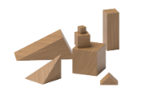
Warm Up: Notice and Wonder
What do you notice?
Tell your partner what you noticed.
What do you wonder?
Tell your partner what you wonder.

Slide 4
Warm Up Synthesis
What is one thing you think you could do or make with the geoblocks?

Slide 5

Activity 1 Explore Connecting Cubes
Let’s explore blocks.
Think about what you want to do or make with the blocks.

Slide 6
Activity 1 Synthesis
Let’s share.
What is one thing you did or made with the blocks?

Slide 7
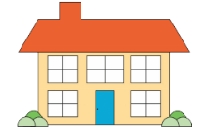
Activity 2
What do you notice?
What do you wonder?
Work with your partner to create a house.

Slide 8
Activity 1 Synthesis
Let’s share.
What new ideas did you hear your partner talk about today when they used the blocks?
What did you see your partner do with their blocks?

Slide 9
Lesson Synthesis
Let’s practice counting to 10.

